Slide 1
MSCA Doctoral Networks
Project Management (incl. financial aspects)
Kimberley Rentner – grant advisor and project manager at Research Grant Support (Amsterdam UMC)

Slide 2

About me
Grant advisor (pre-award) and project manager (post-award)
Background
Biomedical Sciences (UU), PhD research on prostate cancer (Erasmus MC)
Then… research management
Grant support officer and project manager (Theme Sophia, Erasmus MC)
proEVLifeCycle (EU, MSCA ITN)
Started during COVID pandemic (Vumc, 2020):
Finished project: MIRIADE (MSCA ITN 2019-Charlotte Teunissen)
Now
Dedicated PM: MenoPause (NWA-ORC 2022)
PM advise
PM support during Grant Agreement Preparation (GAP) phase

Slide 3
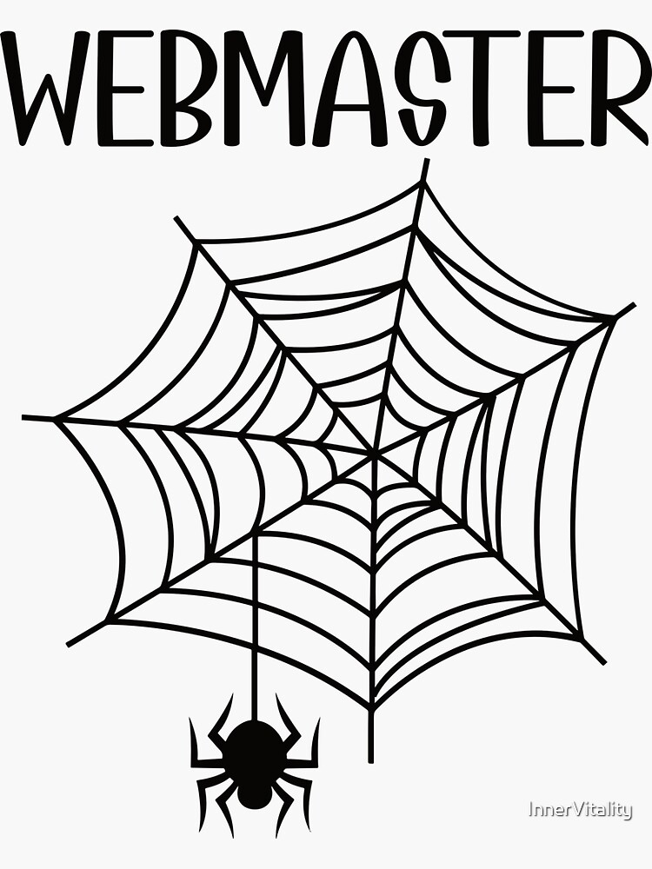
My job
No official job description for (EU/research) project manager
My main tasks
Be the expert
Know, understand or learn all the ‘rules’ (Grant Agreement, Consortium Agreement, etc.)
Communication
Liaise between consortium (Coordinator, PI’s, fellows, administrative personnel, etc.) and the EU
Reporting
Report to the EU on activities (continuous and periodic)
Keep track of the project and keep the project on track (monitor and collect)
Prepare amendments
Organisation
Meetings, workshops, trainings, etc.
All administrative work (agenda’s, minutes, archiving, etc.)
Problem-solving
Everything and anything: from visa applications to meeting logistics

Slide 4
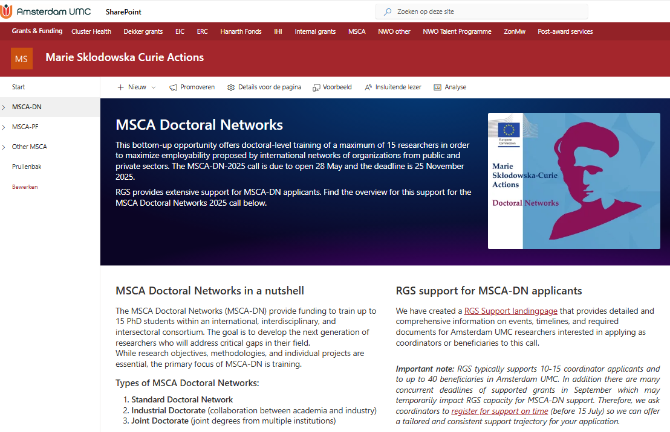
MSCA Doctoral Networks
Funding to train a maximum of 15 PhD students in an international, interdisciplinary and intersectoral consortium to be the next generation researchers filling a gap in your field
The research objectives, methodology and interconnected individual research projects should be solid, however, the most important aspect is training
Three ‘flavors’ – Standard Doctoral Network, Industrial Doctorate, Joint Doctorate
Standard Doctoral Network: 48 month duration, max. 540 person months (15 PhD students for 36 months each), secondments up to 1/3 of fellowship duration
MSCA-DN-2025 deadline 25 November 17:00 CET
Dedicated research support SP hubsite at AUMC (see screenshot on the right)
RGS SharePoint MSCA-DN

Slide 5
MSCA Doctoral Networks
Each PhD student has their own ‘Individual Research Project’ (IRP) at a Beneficiary - all IPRs should be interconnected
PhD students can be seconded to another consortium member (Beneficiary or Associated Partner), preferably in another sector
PhD students receive formal training in core research skills, advanced research skills and transferable skills in local courses, specific training, network-wide events
PhD students are exposed to other sectors through secondments, training, consortium members and collaborations
Project should result in excellent employability of your researchers and increased R&I capacity in EU, in addition to ‘standard’ scientific/societal/economic impact
RGS SharePoint MSCA-DN

Slide 6
Amsterdam UMC in a MSCA-DN
Competitive call, but Amsterdam UMC is relatively successful (11 active MSCA-DN coordinator projects, and 16 as beneficiary)
Successful Coordinators and Beneficiaries recruiting PhD students to either Amsterdam UMC location can qualify for the 4th year incentive arrangement (50k per student)
Make sure to have a plan for PhD students at Beneficiaries in a country with 4-year PhD trajectory
Additional matching, depending on budget for Amsterdam UMC each year (60k per student)

Slide 7
Maximum EU contribution
Minimum of 3 beneficiaries
Fellowship duration of Doctoral Candidates (DCs)
36 months (DN, DN-ID)
48 months (JD)
Max 540 persons months
15 DCs for 36 months (DN, DN-ID)
11 DCs 48 months (JD)
Mobility rule*:
Important to keep in mind if local language is required to carry out work (e.g. clinical work)
40% rule: no more than 40% of total budget to one EU country (excl. central redistribution)

Slide 8
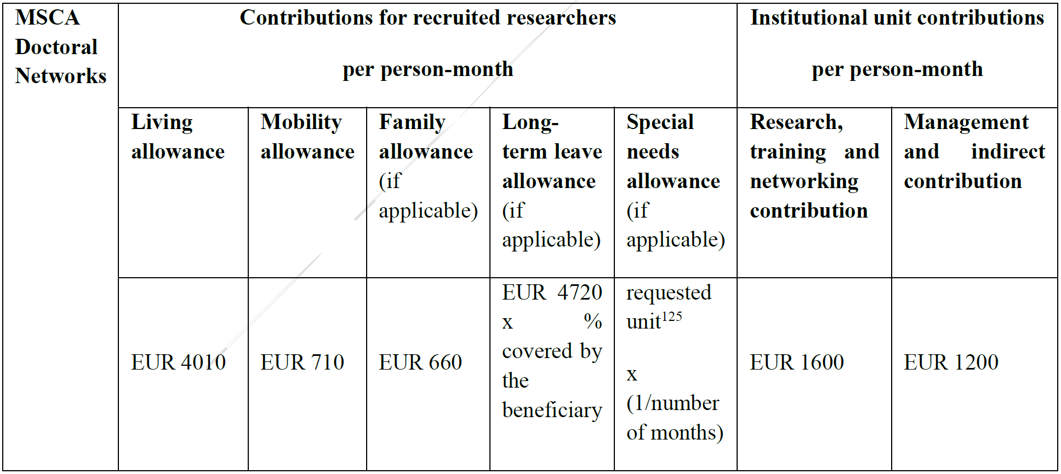
Funding mechanism / cost categories
Source: MSCA DN - Guide for applicants v4 (11 Apr. 2025) – Applicable unit costs (page 118)

Slide 9
Contributions for researchers (1)
Funding based on unit costs x number of person months (PMs)
The three allowances below should be paid out in full to the DC in the form of salary
Living allowance
Country correction coefficient applies (NL= x111,6%)
Amount is a gross amount (so covers taxes, social security, pension, voluntary deduction etc.)
Mobility allowance
Household, relocation and personal travel expenses (e.g. visiting family abroad) NOT professional mobility costs (e.g. secondment housing and congress travel must be paid from the Institutional RTN)
Family allowance
For married DCs (or relationshipstatus equivalent to) or DCs with dependent children for family-related obstacles/costs
Can be awarded during the project if family status changes

Slide 10
Contributions for researchers (2)
New unit cost categories in Horizon Europe
Long-term leave allowance
Covers costs of a DCs long-term (>30 consecutive days) leave
E.g. maternity or paternity leave, long sick leave or other
Special needs allowance
For DCs with disabilities, whose long-term physical, mental, intellectual, or sensory impairments are certified by a national authority.
For costs related to the fellow’s disability which are necessary for participation in the action.

Slide 11
Contributions for researchers (3)
Most common issue in DN implementation
Living, family and mobility allowances are gross amounts (e.g. without tax deductions and social contributions and includes holiday pay and an end of year bonus).
DCs receive less than the unit costs in EU documentation and compare their salary with the other DCs after the start of the project
DCs should be informed at the start of the project by their beneficiary (a financial advisor or HR expert) on their nett salary (nett amounts)!!
At Amsterdam UMC: DCs/PhD candidates receive standard pay based on national PhD salary scales, the remaining amount (difference between allowances and salary payments) is paid as a single extra payment at the end of the project.
Some National Contact Points provide country-specific guidance on financial aspects of MSCA actions that can be used to explain the salary to the fellow

Slide 12
Institutional costs
Funding based on unit costs x number of PMs
Meant to cover costs by host institutions (beneficiaries) and project implementation
Research, training and networking costs:
Purchase of materials
Travel (and accommodation) to workshops and meetings
Organisation of training courses, secondment costs (compensation Ass. Part., housing, travel)
Tuition fees (UK!), visa expenses, language courses, residency cards, etc…
Partial redistribution to central costs (aka the coordinator) for central training activities
Management and indirect costs
Overall legal, financial, administrative and ethical management
Indirect costs to be used by the beneficiary
Substantial redistribution to central costs
Salary of project manager, travel/accommodation costs of Advisory Board, website related costs, etc.

Slide 13
Budget redistribution
As part of the Consortium Agreement negotiations, coordinators retain a percentage of the Institutional unit costs for central costs.
~50% of ‘Management and indirect costs’ To cover expenses like the salary of a project manager, communication & dissemination activities (incl. a website), costs related to external experts needed to implement the action (e.g. Ethics advisor) etc.
Between 20-40% of the ‘Research, Training and Networking’ costs To cover central training of fellows (training weeks) and network meetings (incl. travel expenses of Associated Partners and Advisory Board members)
Final retainments are dependent on the number of DCs (total budget available) and central costs

Slide 14
PM tips (1) Application phase
Administration related
Only include key deliverables and milestones on scientific work (=less admin work for researchers and PM)
Spread out deliverables and milestones over the course of the project (not too many at the beginning or the end of the project)
Budget related
Combine training weeks with network meetings (limit costs)
Long secondments = higher costs
Related to the temporary housing of the fellow: only use the max duration of a secondment if scientifically justified

Slide 15
PM tips (2) Implementation phase
Secondments
Switching the timing and location of secondments is generally accepted, reducing the time is not. If the duration needs to be reduced, ask permission from EU beforehand!
Training and dissemination
Look into possibilities of shared training (with other EU projects)
Actively involve your DCs in dissemination activities (e.g. social media, public presentations)

Slide 16
PM tips (3) Recruitment
Mind the fellow eligibility rules
Mobility rule* (e.g. international recruitment)
DCs must be doctoral candidates (i.e. no doctoral degree at the date of the recruitment)
Mind recruitment process requirements (open and transparent)
Involve HR department(s)
Must post vacancies on EURAXESS
Ensure equal opportunities to all potential applicants, be conscious of gender and diversity
Compliance is checked (e.g. number of applicants, gender, nationality) --> keep records!
Clearly explain salary in vacancy and mobility requirements (mobility rule and secondments)
After recruitment
Plan meeting with DC a.s.a.p. to explain their salary (to be repeated as many times as needed)
Institutional costs expenditures: to be decided upon by the institute/PI, not the fellow

