Slide 1
Ethical considerations and responsible data sharing in the context of FAIR (Ethics, GDPR, consent)
HemaFAIR/HELIOS training school on FAIR principles
12-14 May 2025
Larnaca, Cyprus
Viviana Giannuzzi
Fondazione per la Ricerca Farmacologica Gianni Benzi onlus

Slide 2
Disclaimer
Funded by the European Union.
Views and opinions expressed are however those of the author(s) only and do not necessarily reflect those of the European Union or the EMA and its committees and working parties with which the author(s) is/are affiliated.
Neither the European Union nor the granting authority nor EMA can be held responsible for them.
Reproduction is permitted provided the source is acknowledged
No financial disclosure to declare

Slide 3
AGENDA
ETHICS
GDPR
INFORMED CONSENT
INFORMED ASSENT

Slide 4
AGENDA
ETHICS
GDPR
INFORMED CONSENT
INFORMED ASSENT

Slide 5
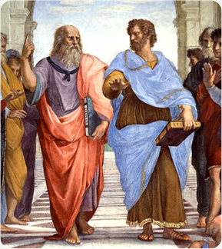
ETHICS
a branch of philosophy which studies human conduct and the basic criteria by which behaviours and choices are evaluated
(Aristotle, the 3rd century BC)
Notes:
Ethical issues in medical research | PPT

Slide 6
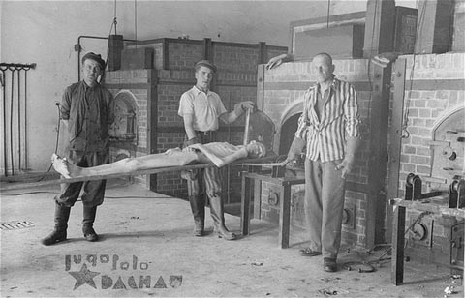
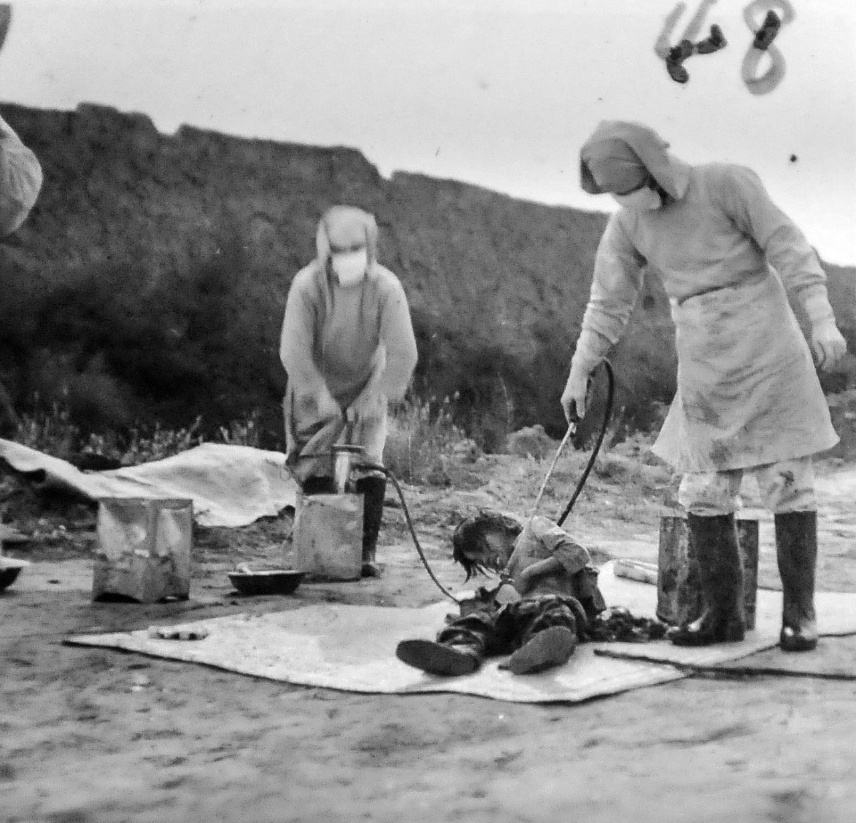
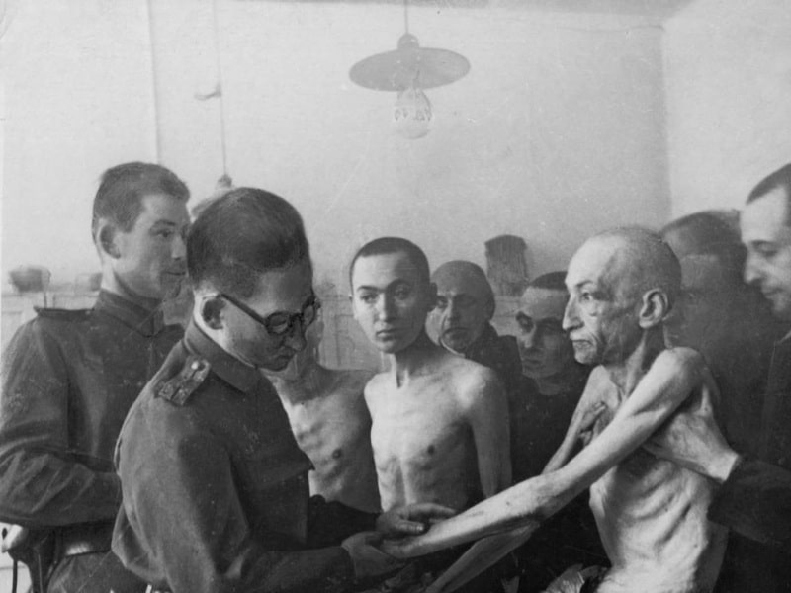
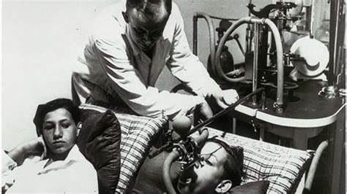
EXPERIMENTS ON HUMANS DURING 2nd WORLD WAR: HUMAN RIGHTS VIOLATION
Conducted in concentration camps on prisoners, without consent
Torture and administration of toxic substances for research purposes
Lack of respect and dignity for victims, treated as human guinea pigs
Fundamental ethical principles of medicine ignored
Need for ensuring absolute respect for human rights in all research and medical practice

Slide 7
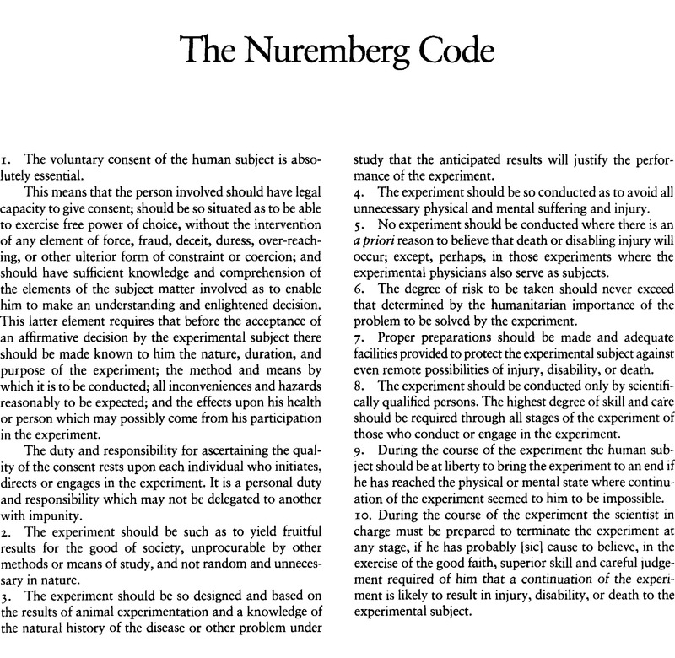
THE NUREMBERG CODE
Issued in 1947 following the crimes committed by Nazis to establish ethical standards for medical research
Informed Consent
Patients must be informed and give consent before participating in medical research
Respect for Human Dignity
dignity and rights of patients must be respected every time
Notes:
The Nuremberg Judgment | Origins
PPT - Literature Review and Ethical Issues PowerPoint Presentation, free download - ID:263470

Slide 8
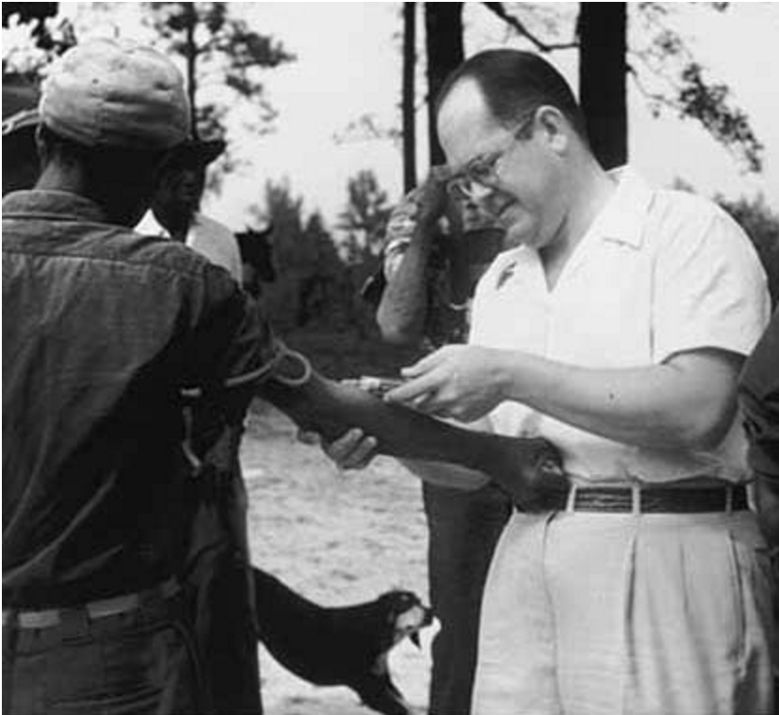
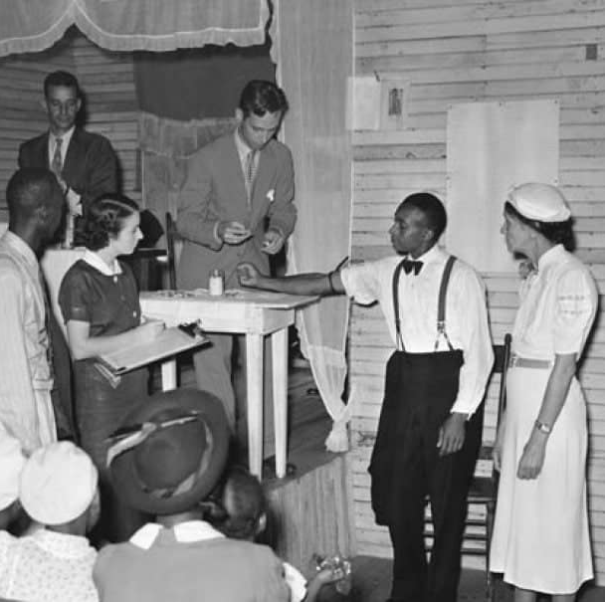
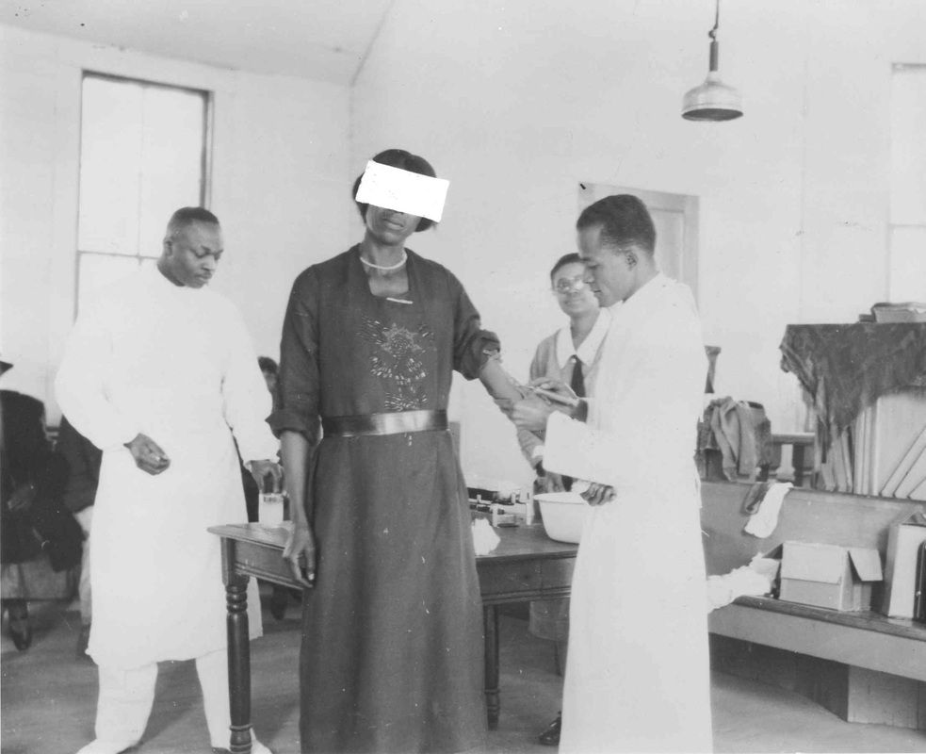
THE TUSKEGEE SYPHILIS STUDY
Conducted by the U.S. Public Health Service from 1932 to 1972 to study untreated syphilis in African American men
600 African American sharecroppers, 399 of whom had syphilis were enrolled
Men were told they were receiving free healthcare, but were never treated for syphilis, even after funding was cut
Consequences:
  Many participants died, 40 wives contracted syphilis
  19 children born with congenital syphilis
The study led to ethical reforms in clinical s and the establishment of Human Research Protection standards
Notes:
20 Photos from the Tuskegee Syphilis Study - History Collection

Slide 9
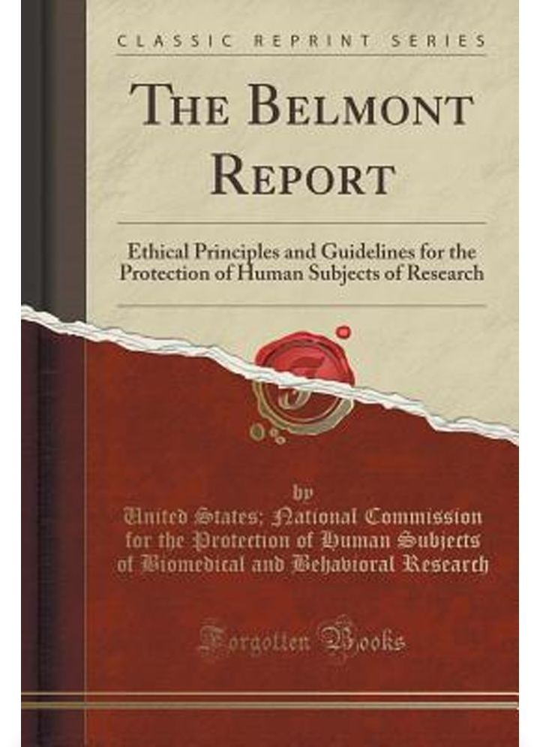
THE BELMONT REPORT (1979)
Articulated in 3 basic ethical principles relevant to human research
Individual autonomy
Protection of individuals with reduced authonomy
Respect to persons
Benefence
Maximise benefits and minimise harms
Justice
Equitable distribution of research costs and benefits
Notes:
https://www.slideserve.com/cinderella/ethics-in-psychological-research
PPT - Top Ten Investigator Responsibilities When Conducting Human Subjects Research PowerPoint Presentation - ID:5870820
Belmont Report - The Three Benchmark Rules | PPT

Slide 10
HELSINKI DECLARATION
Risks, Burdens, and Benefits
Individual, Group, and Community Vulnerability
Scientific Requirements and Research Protocols
Research Ethics Committees
Privacy and Confidentiality
Free and Informed Consent
Use of Placebo
Post- Provisions
Research Registration, Publication, and Dissemination of Results
Unproven Interventions in Clinical Practice
Ethical principles for medical research involving humans, including research using identifiable human material or data
Notes:
a statement of ethical principles for medical research involving human participants, including research using identi􀀯able human material or data
adopted by physicians, but principles to be upheld by all individuals, teams, and organizations involved in medical research
protection of all research participants, including both patients and healthy volunteers

Slide 11
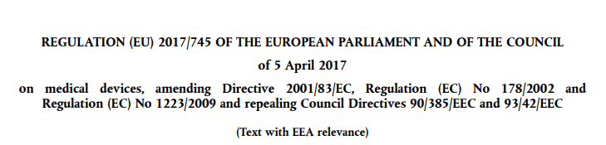
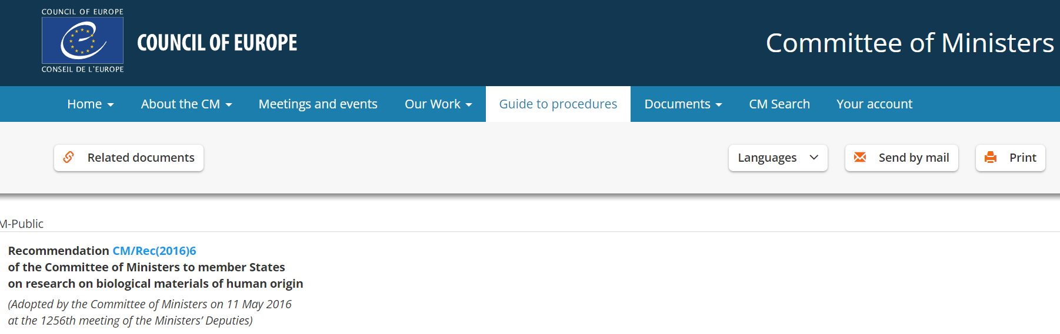
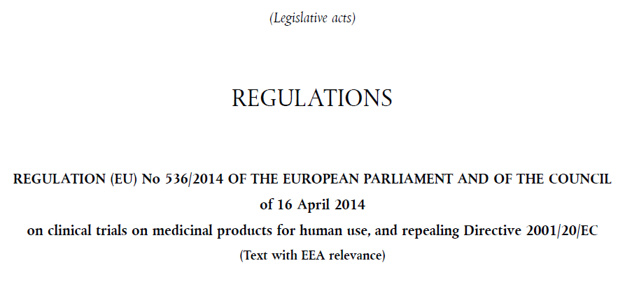
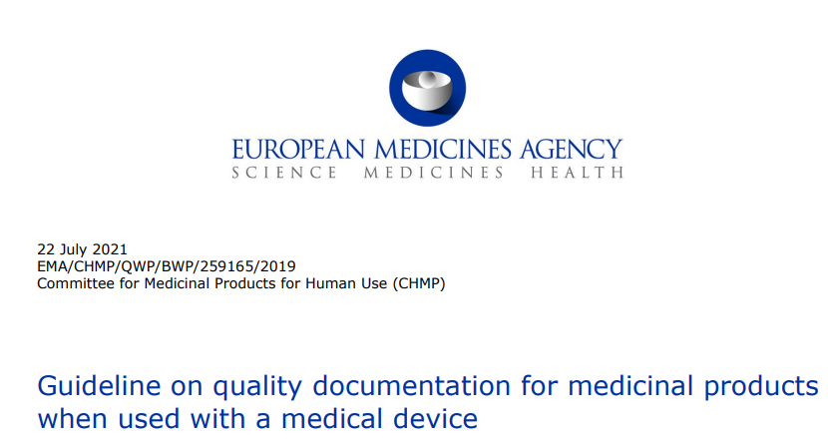
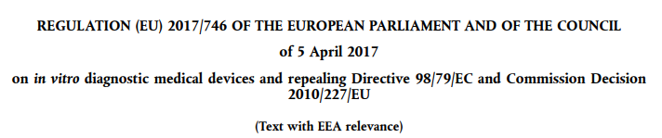
RULES TO COMPLY WITH IN THE EU

Slide 12

MAIN ETHICS ISSUES IN SCIENTIFIC RESEARCH
Human embryos & foetuses
Human beings
Human cells or tissues
- Genetic data
Animals
Non-EU countries
Environment, health & safety
Personal data
- Special populations
Artificial Intelligence
European Commission, July 2021

Slide 13
MAIN ETHICS ISSUES IN SCIENTIFIC RESEARCH
Human embryos & foetuses
Human beings
Human cells or tissues
- Genetic data
Animals
Non-EU countries
Environment, health & safety
Personal data
- Special populations
Artificial Intelligence
European Commission, July 2021

Slide 14

HUMAN RESEARCH
CLINICAL STUDIES
Clinical
Low-intervention clinical
Non-interventional study
Risk/benefit
Informed consent and recruitment
Management of research and health data
Use and storage of cells/tissues
Study-related procedures

Slide 15


HUMAN RESEARCH
ETHICS COMMITTEE APPROVAL ensures that a research study respects the rights, dignity, and safety of participants
To protect participants
To promote fairness
To ensure scientific integrity and legal compliance
SPECIAL REQUIREMENTS FOR SPECIAL POPULATIONS (vulnerable, children, others unable to provide consent)
Notes:
Protect participants: ensure informed consent, privacy, and minimisation of risks
Ensure scientific integrity: verify that the study has a sound and ethical methodology
Promote fairness: prevent exploitation, discrimination, or coercion
Legal compliance: check adherence to national and international rules (e.g., GDPR, Declaration of Helsinki

Slide 16

Special category: health data
PERSONAL DATA
Clinical Practice
Screening initiatives
Data related to biological samples
Patient-reported outcomes (PROs)
Clinical studies
Electronic Health Records
Patient registries
Data related to biological samples
PROs
RWD
Patient-reported outcomes (PROs)
RWD
Real world data (RWD)
Prescriptions
Interventional data
Adverse events reporting
Demographic and clinical data
Health information technology for patient medical history tiny person concept – VectorMine
Notes:
https://vectormine.com/item/health-information-technology-for-patient-medical-history-tiny-person-concept/

Slide 17
BENEFITS OF DATA USE FOR RESEARCH
a significant resource to improve population health, effectiveness and efficiency of healthcare systems
Increases knowledge of the disease/condition
Reproduces research, encourages the validation of hypothesis, reinforces scientific enquiries
Allows new discoveries and findings
Promotes personalised treatments
Avoids unnecessary repetition of studies, accelerates development, reduces costs
Improves the quality of life of patients
Allows analysis on a large amount of data
Promotes development and validation of artificial intelligence models to predict new interventions efficacy
OECD DELSA/HEA/HCQ 2011; Landi, A, et al Data Intell 2020
https://it.freepik.com/
Notes:
Health data are a real value for scientific research
and nowadays there is an urgent need to reconcile the benefits of data sharing with privacy rights and constraints and ethical and legal requirements.
Health data constitutes a significant resource and makes economic and ethical sense to use this data as much as possible to improve population health and the effectiveness and the efficiency of health care systems

Slide 18
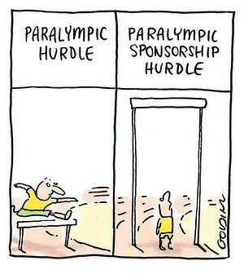
BENEFITS OF DATA USE FOR RESEARCH
Data sharing needed ⇨ strong collaboration required
Allow clinical studies enrolling fewer patients, shorter and less frequent hospital visits
Rare disease patients more predisposed to consent for data access and sharing
Courbier S. et al., 2019; EC Study on the use of RWD. Final report and recommendations 2021

Slide 19
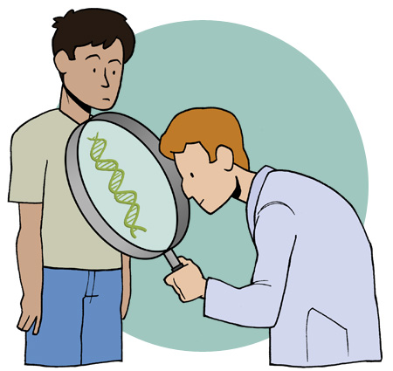

ETHICS ISSUES RELATED WITH GENETIC DATA
Ad hoc clinical study protocol procedures
Specific informed consent requirements: 2 separate information and signatures
Incidental findings: knowledge of one’s carrier status for recessive genetic diseases ⇨ privacy may be compromised
CIOMS WHO guidelines 2016; Giannuzzi v et al., 2017 Eur J Pediatr

Slide 20
FURTHER CHALLENGES FOR RARE DISEASES
Combination of health and genetic data ⇨ risk of re-identification increases
data segmentation, encryption, and controlled access protocols measures enforced
continuous monitoring
periodic audits to assess and address
Notes:
The risk of stigmatisation, discrimination and manipulation of individuals may arise in case of personal data breach or disclosure of special categories of personal data to unauthorised people. In addition, when dealing with genetic data and rare disease patients, i.e. a ‘small sample’, the risk of re-identification may arise. More in detail:
Risk of stigmatisation, discrimination and manipulation: they might arise from data disclosures when data is used beyond the purposes of its processing; this acknowledges the social risks of personal data breaches.
Risk of re-identification: The combination of health and genetic data increases the risk of re-identification. Measures such as data segmentation, encryption, and controlled access protocols are enforced, along with continuous monitoring and periodic audits to assess and address emerging risks.

Slide 21

ARTIFICIAL INTELLIGENCE potential risks to be identified and mitigated
Bias: algorithms may reflect existing prejudices in training data
Discrimination
Transparency and explainability: how to understand why AI made a particular decision?
Who is responsible when AI gets it wrong?
Handling and protecting privacy
Educate stakeholders on trustworthy AI
Proper testing, validation and monitoring
Strong data governance
Explainability
Notes:
Ensuring AI aligns with ethical principles:
Human autonomy → AI should not undermine decision-making.
Harm prevention → Strong data governance.
Fairness & transparency → Avoid bias, ensure explainability
considering the use of AI models, further consideration and safeguards should be made to guarantee the right to privacy and to protection of personal data throughout the entire duration of the research.
First of all, the AI system intended for use in the health sector needs to be reliable and accurate and provide high-quality data.
The new European Union (EU) AI Regulation imposes specific measures for “high-risk” AI systems e.g. they should have a risk-management system and a certificate, ensuring bias detection and correction in relation to the high-risk AI systems. Additionally, as underlined by the new European Regulation on AI (Regulation (EU) 2024/1689) (3), high-risk AI systems must undergo rigorous testing and validation to ensure their safety, transparency, and accountability, thereby aligning with EU standards on data protection and fairness foreseen by the European GDPR (4–13).
The 7 Assessment List for Trustworthy Artificial Intelligence for self-assessment (ALTAI) (14) requirements are to be verified for each AI system, in order to detect any potential risks. ALTAI presented by the independent High-Level Expert Group on AI that was established by the European Commission:
Human agency and oversight
Technical robustness and safety
Privacy and data governance
Transparency
Accountability
Societal and environmental well-being
Diversity, non-discrimination, and fairness.

Slide 22
THE 7 ALTAI REQUIREMENTS
Assessment List for Trustworthy Artificial Intelligence for self-assessment (ALTAI) requirements to be verified for each AI system in order to detect any potential risks:
Human agency and oversight
Technical robustness and safety
Privacy and data governance
Transparency
Accountability
Societal and environmental well-being
Diversity, non-discrimination, and fairness
Independent High-Level Expert Group on AI established by EC
Notes:
The new European Union (EU) AI Regulation imposes specific measures for “high-risk” AI systems e.g. they should have a risk-management system and a certificate, ensuring bias detection and correction in relation to the high-risk AI systems. Additionally, as underlined by the new European Regulation on AI (Regulation (EU) 2024/1689) (3), high-risk AI systems must undergo rigorous testing and validation to ensure their safety, transparency, and accountability, thereby aligning with EU standards on data protection and fairness foreseen by the European GDPR (4–13).
The 7 Assessment List for Trustworthy Artificial Intelligence for self-assessment (ALTAI) (14) requirements are to be verified for each AI system, in order to detect any potential risks. ALTAI presented by the independent High-Level Expert Group on AI that was established by the European Commission:
Human agency and oversight
Technical robustness and safety
Privacy and data governance
Transparency
Accountability
Societal and environmental well-being
Diversity, non-discrimination, and fairness.
Human agency. Users should be able to make informed autonomous decisions regarding AI systems. They should be given the knowledge and tools to comprehend and interact with AI systems to a satisfactory degree and, where possible, be enabled to reasonably self-assess or challenge the system. AI systems should support individuals in making better, more informed choices in accordance with their goals. AI systems can sometimes be deployed to shape and influence human behaviour through mechanisms that may be difficult to detect, since they may harness sub-conscious processes, including various forms of unfair manipulation, deception, herding and conditioning, all of which may threaten individual autonomy. The overall principle of user autonomy must be central to the system’s functionality. Key to this is the right not to be subject to a decision based solely on automated processing when this produces legal effects on users or similarly significantly affects them

Slide 23
AGENDA
ETHICS
GDPR
INFORMED CONSENT
INFORMED ASSENT

Slide 24
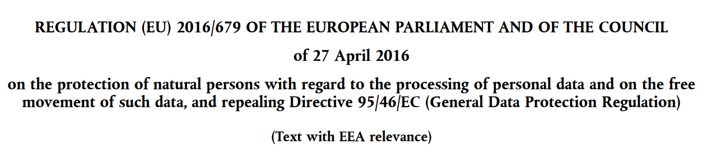
DATA PROTECTION: THE GDPR
EU legal framework in force since 2018 ruling how to process data of individuals
Key aims
To strengthen individuals’ rights over their personal data
To increase transparency and accountability for data controllers and processors
To establish a single set of data protection rules across the EU

Slide 25
DATA PROTECTION: THE GDPR
“Member States may maintain or introduce further conditions, including limitations, with regard to the processing of genetic data, biometric data or data concerning health”
Key aims
To strengthen individuals’ rights over their personal data
To increase transparency and accountability for data controllers and processors
To establish a single set of data protection rules across the EU

Slide 26

DATA PROTECTION PRINCIPLES
Lawfulness, fairness, transparency
Purpose limitation
Data minimisation
Accuracy
Storage limitation
Integrity and confidentiality
Accountability
Notes:
collected for specified, explicit and legitimate purposes and not further processed in a manner that is incompatible with those purposes; further processing for archiving purposes in the public interest, scientific or historical research purposes or statistical purposes shall, in accordance with Article 89(1), not be considered to be incompatible with the initial purposes (‘purpose limitation’);
adequate, relevant and limited to what is necessary in relation to the purposes for which they are processed (‘data minimisation’);
accurate and, where necessary, kept up to date; every reasonable step must be taken to ensure that personal data that are inaccurate, having regard to the purposes for which they are processed, are erased or rectified without delay (‘accuracy’);
kept in a form which permits identification of data subjects for no longer than is necessary for the purposes for which the personal data are processed; personal data may be stored for longer periods insofar as the personal data will be processed solely for archiving purposes in the public interest, scientific or historical research purposes or statistical purposes in accordance with Article 89(1) subject to implementation of the appropriate technical and organisational measures required by this Regulation in order to safeguard the rights and freedoms of the data subject (‘storage limitation’);
processed in a manner that ensures appropriate security of the personal data, including protection against unauthorised or unlawful processing and against accidental loss, destruction or damage, using appropriate technical or organisational measures (‘integrity and confidentiality’).
2. The controller shall be responsible for, and be able to demonstrate compliance with, paragraph 1 (‘accountability’).

Slide 27


KEY DEFINITIONS
PERSONAL DATA
BIOMETRIC and GENETIC
DATA
PROCESSING
PSEUDONYMISATION

Slide 28

KEY DEFINITIONS
Any information relating to an identified or identifiable natural person (‘data subject’)
⇨ identifiable: can be directly or indirectly identified, e.g. by a name, number, location data, online identifier or to one or more factors specific to the physical, physiological, genetic, mental, economic, cultural or social identity
PERSONAL DATA

Slide 29

KEY DEFINITIONS
Any operation or set of operations performed on personal data, e.g. collection, recording, organisation, structuring, storage, adaptation or alteration, retrieval, consultation, use, disclosure by transmission, dissemination or otherwise making available, alignment or combination, restriction, erasure or destruction
PROCESSING

Slide 30

KEY DEFINITIONS
The processing of personal data in such a manner that the personal data can no longer be attributed to a specific data subject without the use of additional information
PSEUDONYMISATION

Slide 31


PROTECTING DATA
PROS: guarantees privacy
CONS: undermines the meaning of research; impossibility to re-contact subjects for new researches or communicating results
PROS: builds trust and enhances the involvement of subjects; allows the re-contacting of subjects for new researches and communicating results
CONS: guarantees a non complete confidentiality
Anonymisation
Pseudonymisation
Link with the data subject removed
Link with the data subject maintained through a key under the Investigator/data manager’s custody
GDPR does not apply to anonymous information!
H2020. i-Consent project 2021; GDPR
Notes:
Protection of personal data is required to guarantee the individual’s right to confidentiality, through the anonymization, codification or pseudonymization of stored information that can be carried out on biological samples, tissues and/or collected health data stored for clinical practice purposes.
Data protection reduces the risk that information can be used for discriminatory purposes, minimizing the possibility that stakeholders other than donors, family members, investigators and the scientific community might access personally identifiable information collected and stored for scientific purposes.

Slide 32

KEY DEFINITIONS
BIOMETRIC DATA: personal data which allow or confirm the unique identification of that natural person (e.g. facial images or dactyloscopic data)
GENETIC DATA: personal data relating to the inherited or acquired genetic characteristics of a natural person which give unique information about the physiology or the health of that natural person
BIOMETRIC and GENETIC
DATA

Slide 33
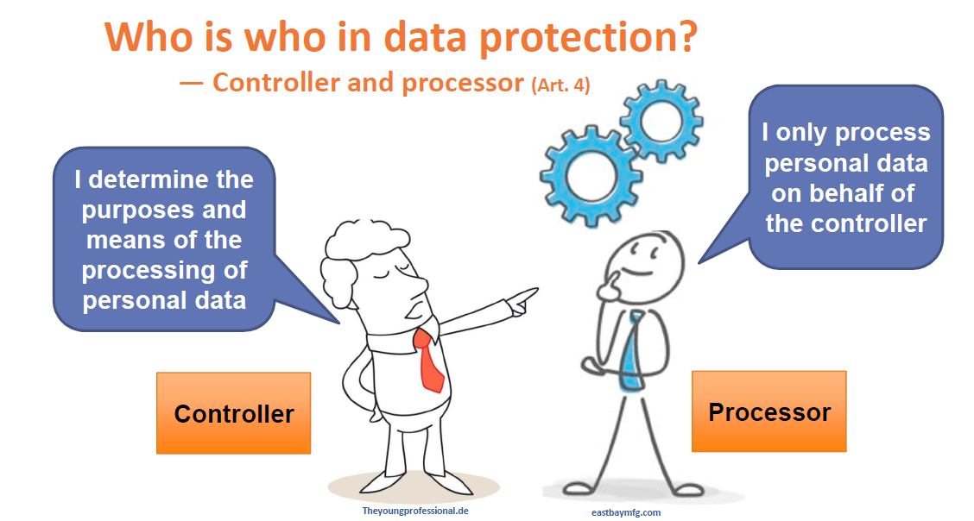
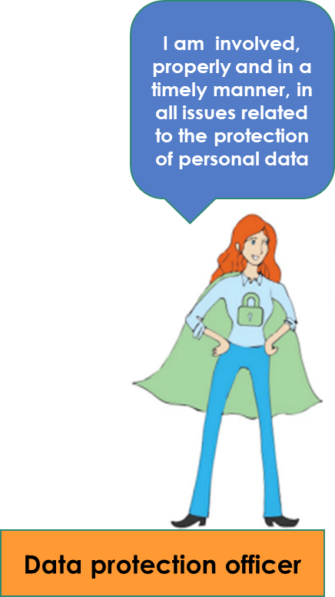
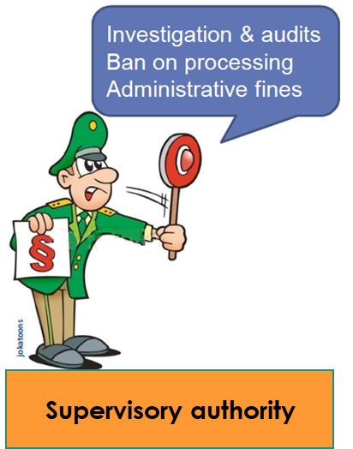
ROLE AND RESPONSABILITIES
Source: modified by Elixir LU. Webinar Feb 2018

Slide 34
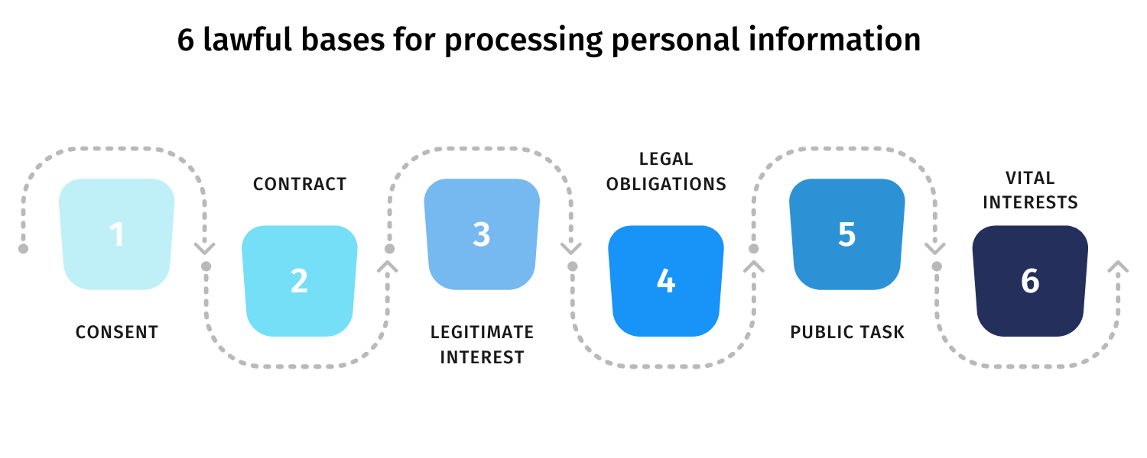
LEGAL BASIS FOR DATA PROCESSING
remains the main legal basis for processing personal data!
Notes:
Informed consent is only one of the legal bases for data processing according to the EU GDPR….

Slide 35
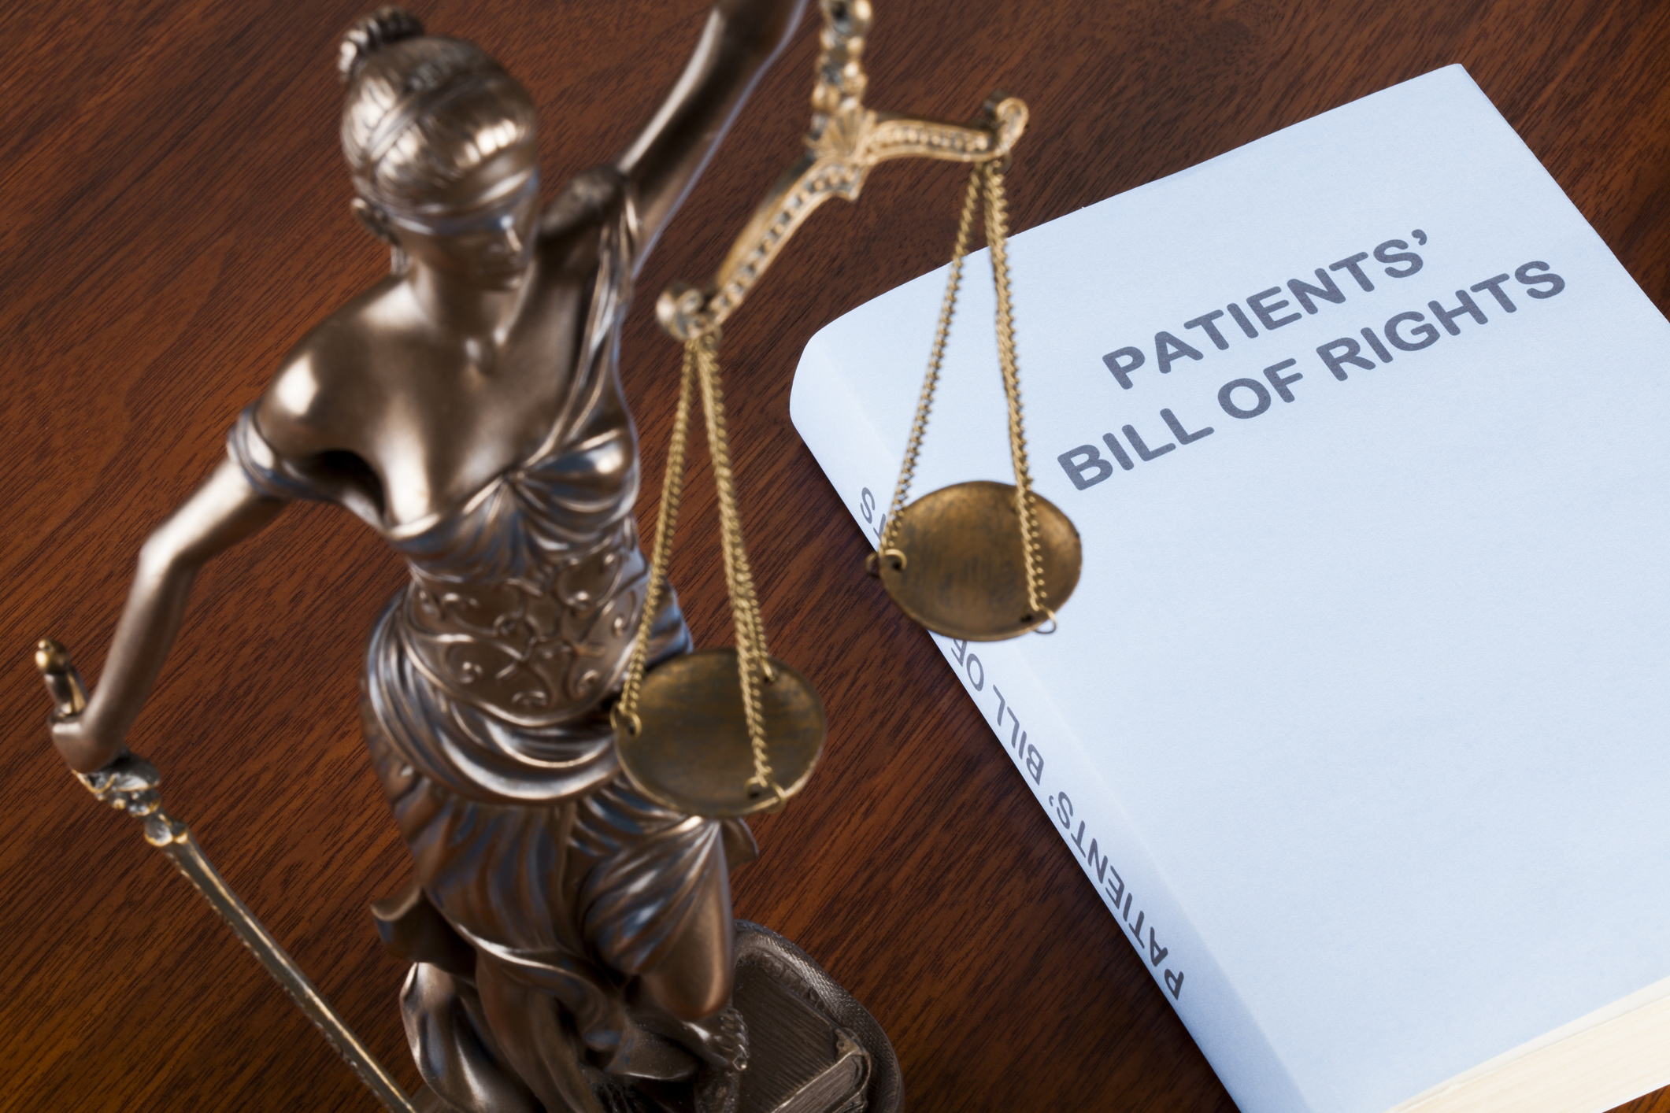
DATA PROTECTION – PATIENTS’ RIGHTS
Right to be informed
Right of access
Right to rectification
Right to object to processing
Right to restrict processing
Right to data portability
Right to be forgotten
Rights in relation to automated decision making and profiling

Slide 36


DATA SHARING/ACCESS
making research data available to others (scientists, institutions, public) to reuse, check, or build upon
Why is it important?
Accelerates discovery
Improves transparency
Avoids duplication
Enables collaboration
SHARE WHIT CARE
Data Sharing/Access Agreement: a formal document that sets the rules for how data can be accessed, used, and protected between parties
Notes:
DATA SHARING/ACCESS e parlare di Data Sharing/Access Agreement

Slide 37


DATA TRANSFER
transfer of personal data which are undergoing processing or are intended for processing after transfer to a third country or to an international organisation
Data controller /processor
in the EU collecting personal data from a subject anywhere in the world
based outside the EU collecting personal data from EU citizens
ADEQUACY DECISION ⇨ adequate level of protection in a non-EU country (assessed by the EC with periodic reviews) ⇨ the transfer does not require any specific authorisation!
NO ADEQUACY DECISION ⇨ transfer allowed only with appropriate safeguards by controller/processor
DEROGATIONS ⇨ The data subject has explicitly consented to the proposed transfer, after having been informed of possible risks due to the absence of an adequacy decision and appropriate safeguards
EDPB Guidelines 3/2018

Slide 38
AGENDA
ETHICS
GDPR
INFORMED CONSENT
INFORMED ASSENT

Slide 39
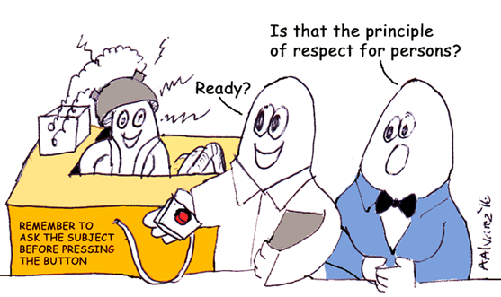
INFORMED CONSENT
A fundamental ethical principle in human research
The Belmont Report, 1978
Notes:
Participation by individuals capable of giving informed consent as subjects in medical research must be voluntary.
Although it may be appropriate to consult family members or community leaders, no individual capable of giving informed consent may be enrolled in a research study unless he or she freely agrees. (Helsinki decl)

Slide 40
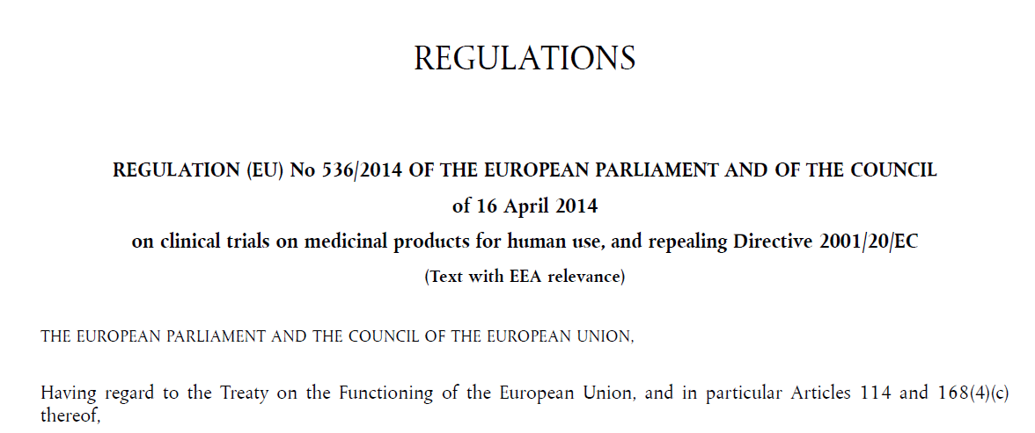
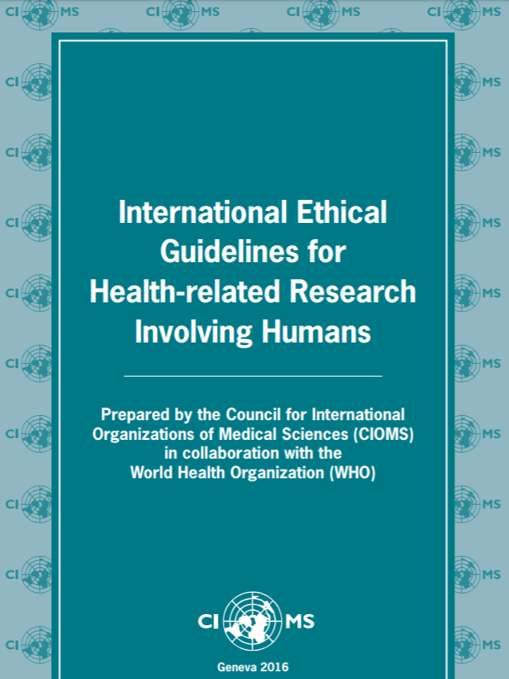
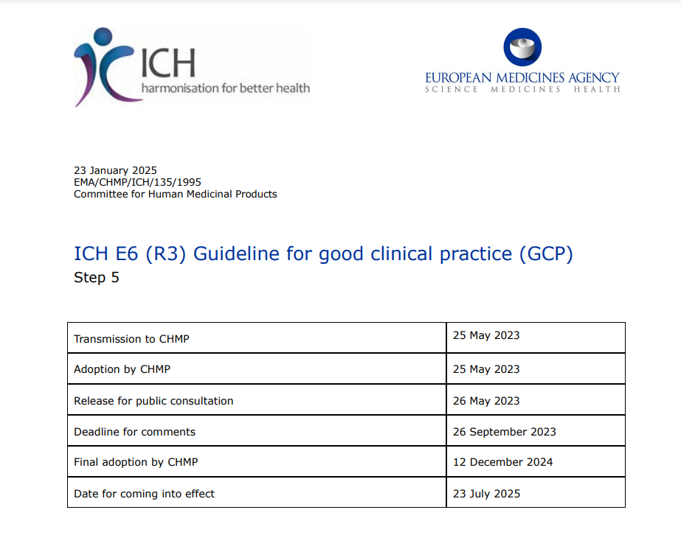
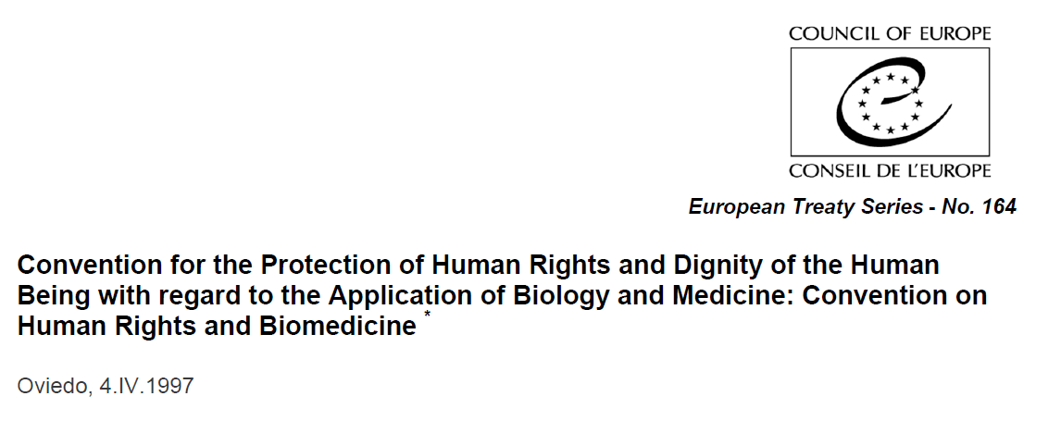
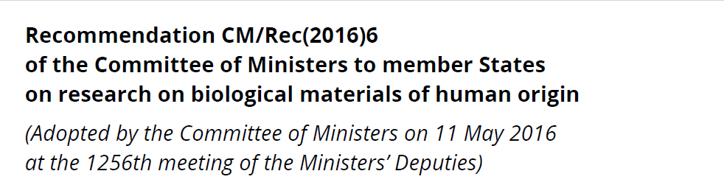
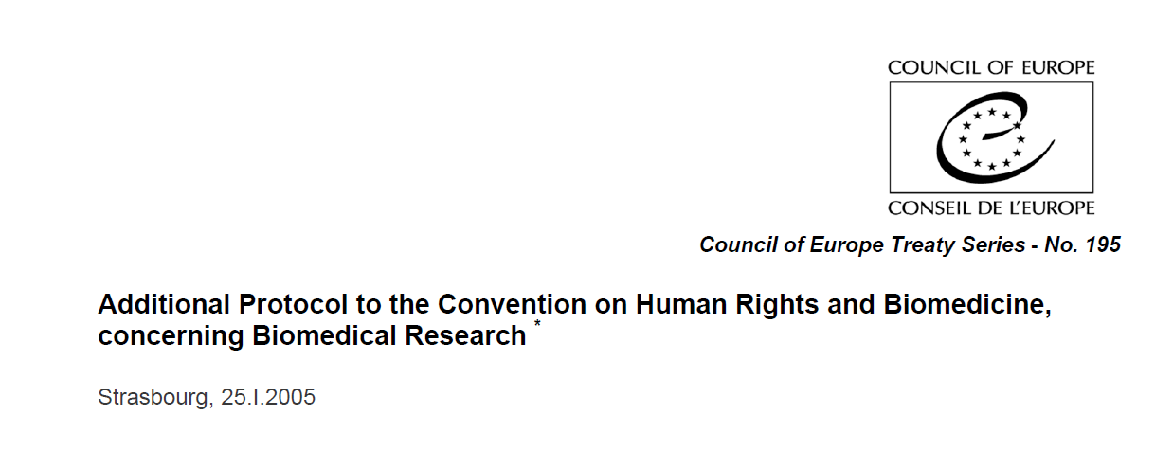

ETHICAL AND REGULATORY FRAMEWORK APPLYING TO INFORMED CONSENT

Slide 41

INFORMED CONSENT
A subject's free and voluntary expression of his or her willingness to participate in a clinical , after having been informed of all aspects of the study relevant to the subject's decision to participate
INFORMATION
+
and has freely agreed in writing (signature)
WRITTEN CONSENT
Regulation (EU) 536/2014; ICH--GCP
Notes:
Reg (EU) n. 536/2014 definition
‘Informed consent’ means a subject's free and voluntary expression of his or her willingness to participate in a particular clinical , after having been informed of all aspects of the clinical that are relevant to the subject's decision to participate or, in case of minors and of incapacitated subjects, an authorisation or agreement from their legally designated representative to include them in the clinical
GDPR Reg (EU) n. 2016/679 definition
‘Consent’ of the data subject means any freely given, specific, informed and unambiguous indication of the data subject's wishes by which he or she, by a statement or by a clear affirmative action, signifies agreement to the processing of personal data relating to him or her
"Any freely given, specific, informed and unambiguous indication of the data subject's wishes by which they, by a statement or by a clear affirmative action, signify agreement to the processing of personal data." (GDPR – Regulation (EU) 2016/679, Art. 4(11))
"A decision, which must be written, dated and signed, to take part in a clinical , given freely after being duly informed, by a person capable of giving consent." (Regulation (EU) 536/2014, Art. 2(21))

Slide 42

HOW
informed
voluntary
given for a specific purpose
enough time
explicit and given via a positive act
clear and plain language
possible and easy consent withdrawal
documented
Regulation (EU) 536/2014; ICH--GCP

Slide 43

INFORMED CONSENT PROCESS
A dynamic and continuous process
begins when the recruitment of subjects starts…
INFORMATION
COMPREHENSION
VOLUNTARY DECISION
COMPREHENSION MONITORED AND MAINTAINED
AVAILABILITY OF NEW INFORMATION
Written informed consent form to be updated and re-submitted to Ethics Committees
…but does not end with the signature of the subject…
Regulation (EU) 536/2014; ICH--GCP
Notes:
Patient Consent | PPT

Slide 44
CONSENT IN SPECIAL SITUATIONS
Emergency situations
possible deferred consent
Paediatric patients
consent + assent
Incapacitated subjects
signatures of subject + his/her legally designated representative
Subjects unable to write
‘Cluster’ and low-intervention s with marketed drugs used according the MA
recorded through appropriate alternative means & presence of at least 1 impartial witness
simplified methods allowed
Regulation (EU) 536/2014

Slide 45
INFORMED CONSENT
Guideline 9: individuals capable of giving informed consent
Guideline 10: Modifications and waivers of informed consent
Guideline 11: Collection, storage and use of biological materials and related data
Guideline 12: Collection, storage and use of data in health related research
Guideline 16: Research involving adults incapable of giving informed consent
Guideline 17: Research involving children and adolescents
Appendix 2: Obtaining informed consent: essential information for prospective research participants

Slide 46


INFORMED CONSENT
Besides the consent to the research, participants MUST provide the researcher with the consent to the processing of their personal data…
The lack of consent to data processing may compromise the participation in the study!
EDPB, Opinion 3/2019
Notes:
“The informed consent foreseen under the Clinical Regulation must not be confused with the notion of consent as a legal ground for the processing of personal data under the GDPR. Provisions of Chapter V CTR on informed consent, in particular Article 28, respond primarily to core ethical requirements of research projects involving humans deriving from the Helsinki Declaration.
The obligation to obtain the informed consent of participants in a clinical is primarily a measure to ensure the protection of the right to human dignity and the right to integrity of individuals under Article 1 and 3 of the Charter of Fundamental Rights of the EU; it is not conceived as an instrument for data protection compliance.”

Slide 47
How to prepare the informed consent material & which contents

Slide 48

INFORMED CONSENT MATERIAL
Information sheet + consent form
Separate information and signatures for:
Participating in the study
Personal data processing
Genetic tests
(if any)
Regulation (EU) 2016/679; CIOMS WHO guidelines 2016
Questa foto di Autore sconosciuto è concesso in licenza da CC BY-NC

Slide 49
CONTENTS FOR THE INFORMATION SHEET
Benefits, risks and inconveniences
Study justification, objectives, design
Availability of results
Subject´s rights
Contacts
Stopping rules
Handling of data and samples after the
Guarantees of protection of participating subjects
Procedures, duration, visits, all interventions
Any compensation for expenses
Treatment alternatives (if not participating)
Any source of funding
Arrangements for taking care of subjects after study end
transfer of data and samples
foreseen secondary uses of data and samples
genetic testings
Regulation (EU) 536/2014; ICH--GCP

Slide 50

CONTENTS FOR THE INFORMATION SHEET
Type of personal data processed
Initial & future purposes
Storage duration and safeguards
Any transfer to third countries and safeguards
Any automated decision-making
Responsible people for processing
Rights of the subject
Consent for further purposes may be obtained in the original consent…
Subjects may be re-contacted for being involved in other researches..
or
Regulation (EU) 2016/679
Acknowledgment: https://it.freepik.com/
Notes:
The right to request access to data
The right to data portability, as applicable
The right to lodge a complaint with a supervisory authority
The right to rectification or erasure of personal data or restriction of processing concerning the data subject
“When research purposes cannot be fully specified, a controller must seek other ways to ensure the essence of the consent requirements are served best, for example, to allow data subjects to consent for a research purpose in more general terms and for specific stages of a research project that are already known to take place at the outset.
As the research advances, consent for subsequent steps in the project can be obtained before that next stage begins. Yet, such a consent should still be in line with the applicable ethical standards for scientific research…”

Slide 51
SUBJECT’S RIGHTS ON DATA
To access one’s own data
To data portability
To object or restrict the processing of data
To delete data
To request rectification
To withdraw
To lodge a complaint with a supervisory authority
Regulation (EU) 2016/679
Acknowledgment: https://it.freepik.com/

Slide 52
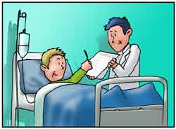
CONTENTS FOR THE CONSENT FORM
To ask participants if have..
read and understood the information
been able to ask questions – fully answered
understood that participation is voluntary
had enough time to consider participation in study
Consent to:
participate in the study
use samples
process data ⇨ consent for each purpose
Where applicable:
further use data/samples or be recontacted for future researches
transfer outside EU
PRINCIPLE OF GRANULARITY
GDPR; EDPB Guidelines 05/2020
Notes:
to verify that
information has been given
the subject has consented
“Consent should cover all processing activities carried out for the same purpose or purposes. When the processing has multiple purposes, consent should be given for all of them”

Slide 53

DATA (AND SAMPLES) RE-USE FOR RESEARCH
Secondary use of data:
use of data for a different purpose than the original one ⇨ new purpose
Further Processing:
additional use or data modification, analysing, aggregating or transforming data⇨ not necessarily new/unrelated purpose continuing or expanding upon the original purpose
Notes:
The terms "secondary use of data" and "further processing" are related but not exactly the same. Here's a breakdown of the difference:
Secondary Use of Data: This refers to using data for purposes other than the primary reason it was originally collected. For example, if a company collects personal data for one specific purpose, like processing an order, but later decides to use that data for a different purpose, such as marketing, that's a secondary use of data. In many cases, secondary uses require explicit consent from the data subjects (the people the data pertains to), especially under data protection laws like the GDPR.
Further Processing: This refers to additional use or modification of data after its initial collection, often for purposes related to or compatible with the original purpose. It involves actions like analyzing, aggregating, or transforming data. "Further processing" doesn't necessarily imply a shift to a completely new or unrelated purpose, though it might in some cases. It's more about extending or elaborating on the initial purpose of data collection.
In essence:
Secondary use typically implies a shift to a new purpose.
Further processing usually refers to continuing or expanding upon the original purpose of data collection.
However, in practical contexts, both terms can sometimes overlap, especially if the data is being processed for new purposes. The key difference lies in whether the new purpose is considered compatible with or entirely separate from the original purpose.
https://www.ema.europa.eu/en/about-us/how-we-work/big-data#hma/ema-big-data-steering-group-section EMA; Bahr A et Al. 2015
Health information technology for patient medical history tiny person concept – VectorMine

Slide 54

INFORMED CONSENT MATERIAL
SIGNED AND DATED by the subject/legally designated representative and by the person who obtains the consent
COPY of the informed consent and any other written information PROVIDED
DOCUMENTED in the medical records
Regulation (EU) 536/2014; ICH--GCP

Slide 55
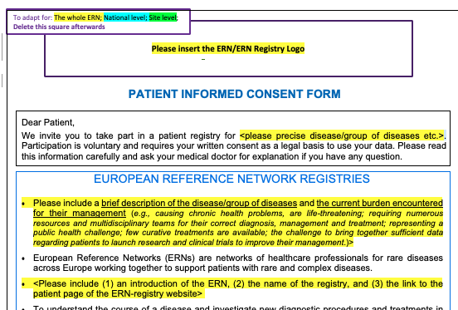
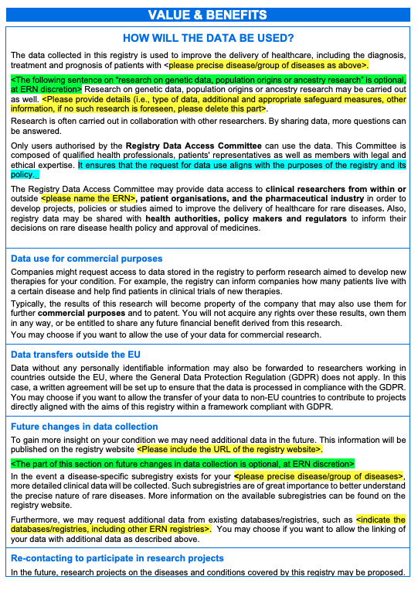

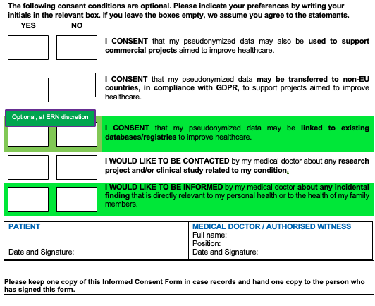

COMMON INFORMED CONSENT FOR RARE DISEASE REGISTRIES
Available in 26 languages
Adaptation at:
ERN level
National level
Site level
in compliance with applicable laws & standards
https://www.ejprarediseases.org/ern-registries-generic-icf/

Slide 56

TYPES OF CONSENT
Verbal
Written
Electronic
As applicable according to the national law
Notes:
https://image3.slideserve.com/6269641/types-of-consent-l.jpg

Slide 57

DYNAMIC CONSENT
A model of informed consent
enables individuals to have ongoing control and management over their participation in research or data sharing activities
allows participants to continuously engage with researchers, providing ongoing consent for specific research activities or data uses
Questa foto di Autore sconosciuto è concesso in licenza da CC BY-NC-ND
could help individuals to control their data
Notes:
Informed consent and medical confidentiality have traditionally been used as mechanisms for data control in health sector. But today, in this really data intensive environment, they seem to offer only a limited amount of control over the production, collection, use and circulation of health data. Consent procedures often fall short of adequately informing individuals about the terms of use of their data, and in the context of data, patients may experience a really big lack of control over where their data is going. And in addition, traditional mechanisms such as informed consent are becoming of limited value when it comes to evaluation of big data research due to the quantity of data. Therefore, there is a need to explore different or alternative types of consent. For instance, it can be dynamic consent and meta consent.
So dynamic consent is a personalized, participant centric communication interface to enable research participants to be at the center of the decision making on what actually happens with their data. This approach is called dynamic because it allows interactions over time. It allows participants to consent to new projects, withdraw their consent or make other choices in real time as their circumstances change.
The dynamic consent model does not restrict participants to the opportunity to give wrote consent only, but allows them to provide different types of consent depending on the kind of a study. These consent preferences then travel securely with their samples or data so that third parties know the scope of the consent that applies.
Dynamic consent goes beyond informed consent and could help individuals to control their data and also their online presence.
Another type of model called meta consent, it presents the idea that people should be asked how and when they would like to be presented with a request for consent. So, people should be asked to design how they in the future would like to provide consent to the use of their personal health data or biological material by expressing a preference for how and when to provide consent. Individuals can be set to provide consent on a meta level, and this is basically a defining idea in the model of meta consent.
Considering the alternative models of consent, it is also very important to note that the introduction of new elements for data control does not exclude the use of traditional methods. So different models should be explored depending on the situation setting and individual preferences. There is no single solution for consent.
In certain situations, the best solution will be broad consent, in other situations may be dynamic, consent may be required, and in some cases, consent will be overridden by public interest needs. So, in certain situations they might also be needed for deferred consent, which is used to recruit patients in emergency research when informed consent cannot be obtained prior to enrollment and the environment should remain really flexible yet safe to respect diverse preferences and needs. It is also worth noting that in times, consent may not be a legal requirement to conduct research. In such situations, other safeguards should be put in place. For instance, it can be additional security measures, strong anonymization or pseudo-anonymization techniques or greater oversight mechanisms.

Slide 58
AGENDA
ETHICS
GDPR
INFORMED CONSENT
INFORMED ASSENT

Slide 59

PROTECTING CHILDREN’S RIGHTS
Additional protection to be granted
Children are less aware of their rights, risks and consequences of research and sharing data
Information to be adapted, easily accessible, using clear and plain language!
Notes:
Additional protection should be granted to personal and sensitive data coming from children since children are less aware of the risks and consequences of sharing data and of their rights…
Any information addressed specifically to a child should be adapted to be easily accessible, using clear and plain language!

Slide 60

PROTECTING CHILDREN’S RIGHTS
From "protect children from science" to "protect children with science"
need for getting reliable evidence
need for protecting participants

Slide 61
RULES TO COMPLY WITH

Slide 62


ROLES IN PAEDIATRIC RESEARCH
MINOR
PAEDIATRIC POPULATION
A subject who is, according to the national law, under the age of legal competence to give informed consent
Children between birth and < 18 years
EMANCIPATED MINOR
LEGALLY DESIGNATED REPRESENTATIVE
Able to legally consent for him/herself according to national law (elements of vulnerability considered)
Parents or legal person to provide informed consent on behalf of minor or incapacitated subject
Regulation (EU) 536/2014; EC Ethical Recommendations, 2017
Acknowledgment: https://it.freepik.com/

Slide 63


INFORMED CONSENT IN PAEDIATRIC STUDIES
Explain orally -
provide answers
Questions and opinions
  Verify that the information is understood
Show and give same information in written format (or electronic forms, depending on national laws)
Signed and dated by legally designated representative(s) and study personnel performing the interview and giving the information
Regulation (EU) 536/2014; EC Ethical Recommendations, 2017

Slide 64
INFORMED ASSENT
Age-appropriate information to be provided and adapted to child language skills and understanding
Questions and opinions according to age and maturity
Use of visual strategies (drawings, pictures, cartoons), other media and formats encouraged
Assent signed by child according to willingness & capability (and national law)
Regulation (EU) 536/2014; EC Ethical Recommendations, 2017

Slide 65


HOW CHILDREN PARTICIPATE IN THE PROCESS
ASSENT
AGREEMENT
Minor's statement of will to participate in a with legal value according to the EU national law (in addition to the consent given by the legally designated representative)
  Explicit wish of a minor (capable of forming an opinion and assessing the information) to refuse participation in, or to withdraw from, the , respected by the investigator
Analogy to “assent” where is not a legal requirement
Investigator to request agreement (recommended)
DISSENT
Minor shall assent to participate in a
Regulation (EU) 536/2014; EC Ethical Recommendations, 2017

Slide 66

HOW CHILDREN PARTICIPATE IN THE PROCESS
If during a clinical the minor reaches the age of legal competence to give informed consent as defined in the law of the Member State concerned, his or her express informed consent shall be obtained before that subject can continue to participate in the clinical
Acknowledgment: https://it.freepik.com/
Regulation (EU) 536/2014

Slide 67


Age groups - specificities

Slide 68
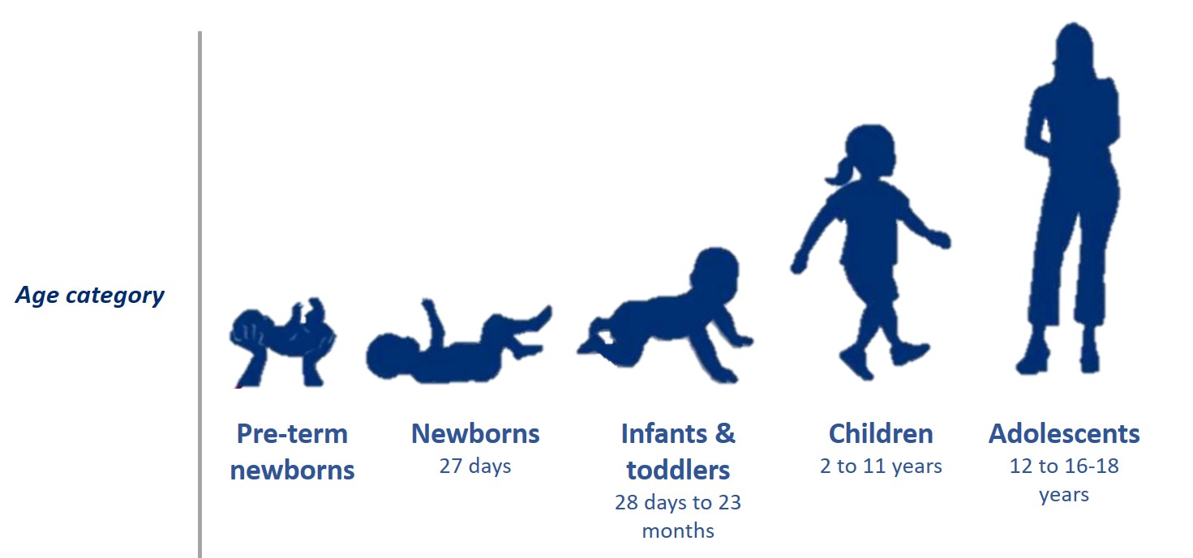
PAEDIATRIC AGES
Age only partly correlates with maturity – age is only used as practical instrument to define age groups
CPMP/ICH/2711/99

Slide 69

ASSENT BY AGE GROUPS
Newborns and infants (from birth to 2 years of age)
Pre-schoolers
(2-5 years of age)
Schoolers
(6-9 years of age)
Adolescents (10-18 years of age)
Only consent from parent(s)/legal representative(s)
Assent + consent from parent(s)/legal representative(s)
Different legal competence across countries, protection of confidentiality and socially sensitive issues
EC Ethical Recommendations, 2017
Notes:
Some consider that adolescents above a certain age are no longer minors, and have the legal competence to give informed consent on research participation while for others national law requires assent from all or part of this group…

Slide 70

ASSENT AND CONSENT: DIFFERENCES ACROSS EUROPE
Age of legal competence to consent
Number of signatories required in consent
Austria | Not specified (practice: 14 years) | Both parents
Finland | 15 years | 1 parent
UK | 16 years | 1 parent
Ireland | 16 years (clinical s) 18 years (all other research) | 1 parent
Spain | 18 years | 1 parent
Belgium | 18 years | 1 parent at recruitment, both parents at some point
Germany | 18 years | Both parents
Italy | 18 years | Both parents
The Netherlands | 18 years | Both parents
Modified from Lepola P. et al, Arch Dis Child 2016

Slide 71
How to prepare the informed assent material
& which contents

Slide 72

INFORMED ASSENT
AGE-APPROPRIATE INFORMATION to be adapted to the language skills and understanding of the child -> Tailored for age groups
APPROPRIATE FORMAT -> use of visual strategies encouraged (drawings, pictures, cartoons), but also other media and formats may be used
Cultural differences to be considered

Slide 73
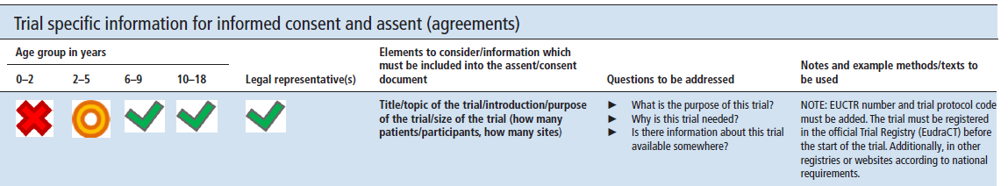
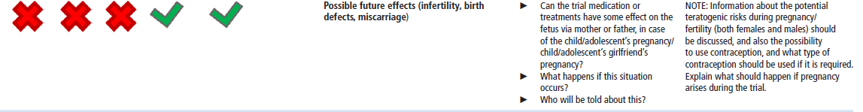
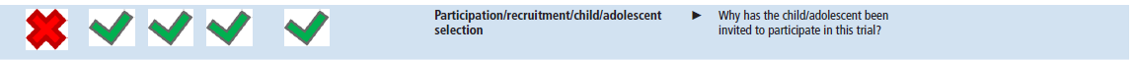
INFORMED CONSENT AND ASSENT IN PAEDIATRIC STUDIES
Assent/informed consent guidance
No specific provisions for children in the GDPR…
EMA; Lepola, Kindred, Giannuzzi et al, Arch Dis Child 2021; GDPR
Notes:
Child to be informed of the possibility to freely withdraw from the CT, at any time for any reason, without any disadvantage or prejudice especially regarding medical care

Slide 74
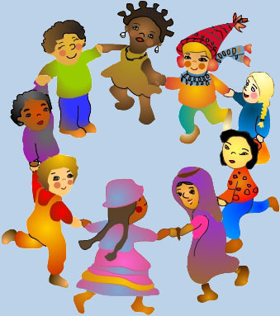
INFORMATION MATERIAL FOR MULTI-NATIONAL STUDIES
Harmonised throughout sites
Translated in writing, or a competent translator should be present
EC Ethical Recommendations, 2017

Slide 75

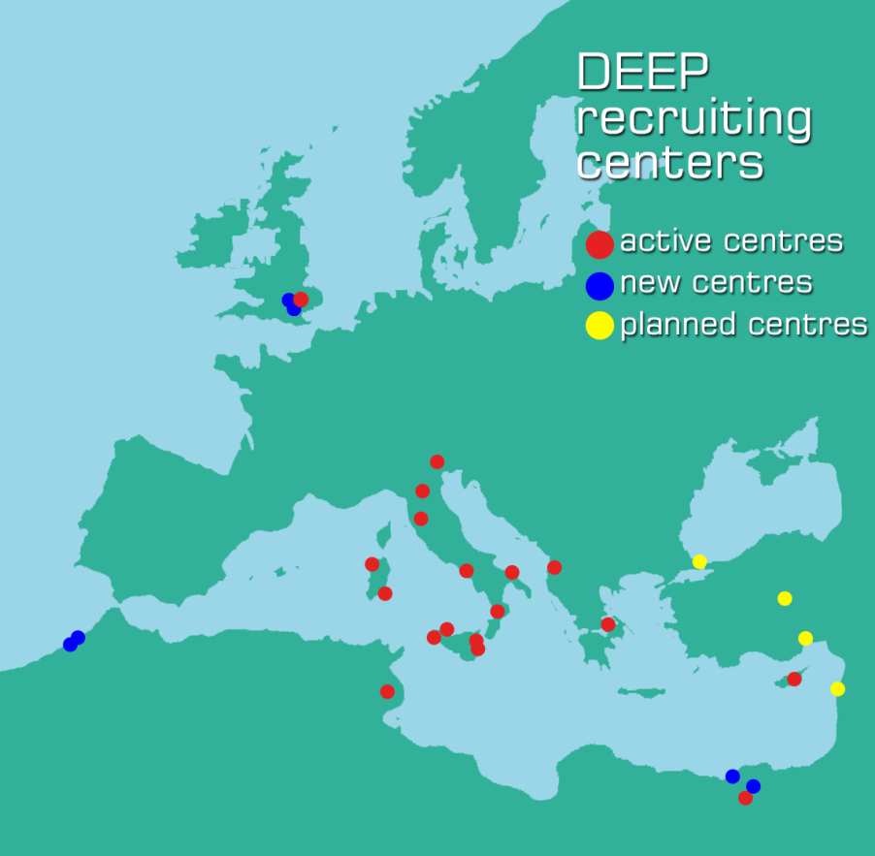
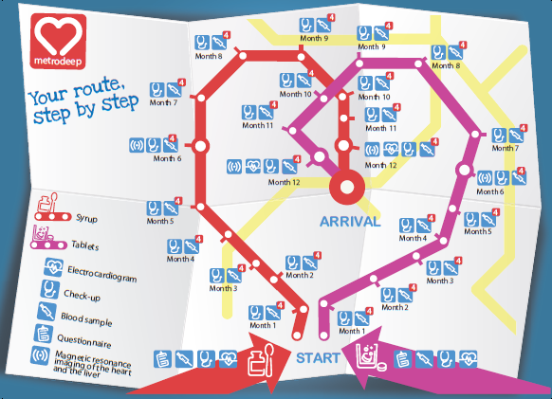


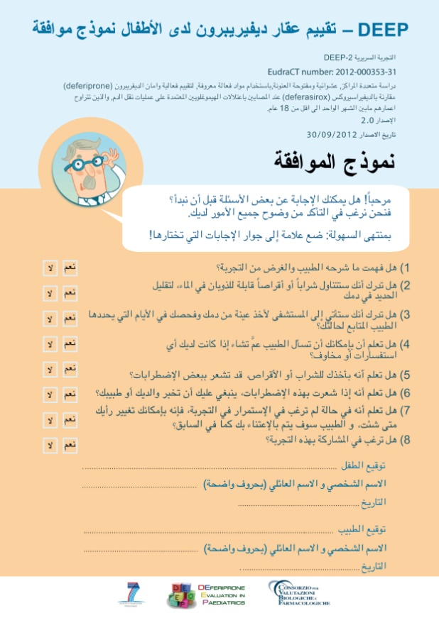

GOOD EXPERIENCES
3 different BOOKLETS explaining aims and procedures and what they are going to experience
2 different ASSENT FORMS
Translated in the national language:
Albanian, Arabic, English, French, Greek, Italian, Turkish
Grant agreement no: 261483

Slide 76
TAKE HOME MESSAGES
Ethical principles are integral part of human research, including use of identifiable samples or data
Over the years, specific rules have been released at international and EU level
Informed consent and assent: a dynamic and continuous process
In paediatric studies ⇨ children participation, respect of emerging maturity
New methods for collecting informed consent and assent or their updates (e.g., digital consent/assent)

Slide 77


Thanks for your attention!
Viviana Giannuzzi
vg@benzifoundation.org
A special thanks to
Annalisa Landi and Sabina Sblano

Slide 78

EXERCISE – CROSSWORD PUZZLE
Are you ready for the crossword challenge on ethics, GDPR, and consent?
Who will be the champion?
https://puzzel.org/en/crossword/build?p=-OPf8Nd21eW8IOO3piRi&menu=content

