Slide 1
Methods to make research data Findable in RDs:
Persistent identifiers, metadata standards and ontologies
César Bernabé
cbernabe.com
Notes:
Learn methods to make research data Findable in RDs
Understand what persistent identifiers, metadata standards and ontologies are

Slide 2
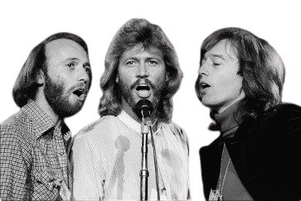
Methods to make research data Findable in RDs:
Persistent identifiers, metadata standards and ontologies
César Bernabé
featuring: Bee Gees

Slide 3
Agenda
Persistent Identifiers
Metadata standards
Ontologies (for findability)

Slide 4
Overview
Miro Board
Notes:
Demonstration:
https://miro.com/app/board/uXjVI6XaRYU=/

Slide 5
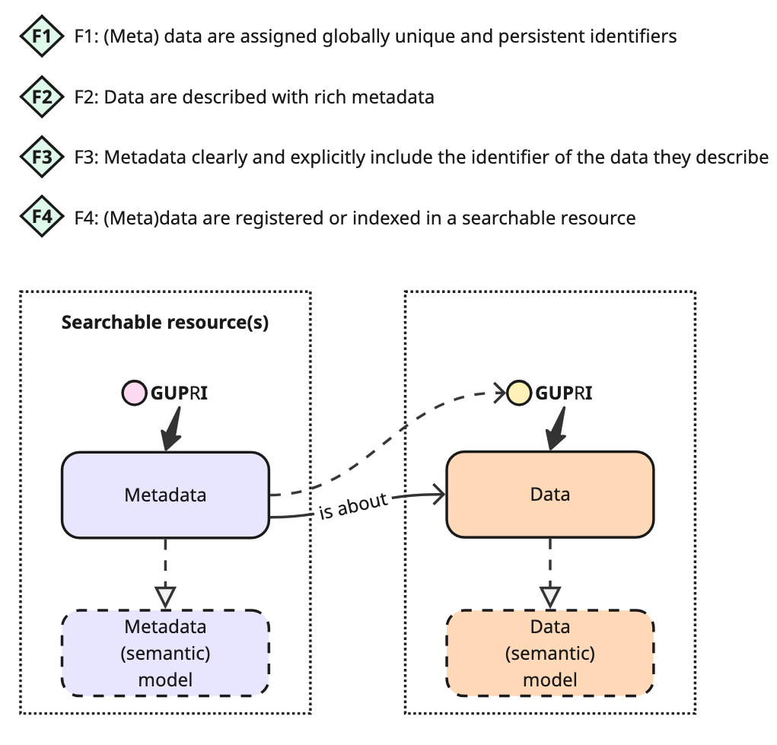
Overview
Notes:
Demonstration:
https://miro.com/app/board/uXjVI6XaRYU=/

Slide 6
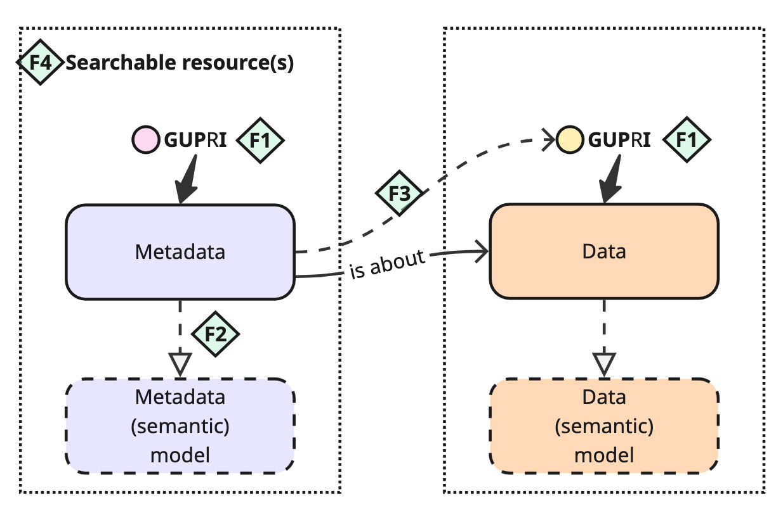
Overview
Notes:
https://miro.com/app/board/uXjVI6XaRYU=/

Slide 7


Persistent identifier????

Slide 8
Persistent Identifiers
G
lobal
Globally unique means that the identifier is guaranteed to unambiguously refer to exactly one resource in the world.
U
nique
P
ersistent
I
dentifier

Slide 9
Persistent Identifiers
G
lobal
Globally unique means that the identifier is guaranteed to unambiguously refer to exactly one resource in the world.
U
nique
P
ersistent
I
dentifier

Slide 10
Persistent Identifiers
G
lobal
Globally unique means that the identifier is guaranteed to unambiguously refer to exactly one resource in the world.
Persistence refers to the requirement that this globally unique identifier is never reused in another context, and continues to identify the same resource, even if that resource no longer exists, or moves.
U
nique
P
ersistent
I
dentifier

Slide 11
Persistent Identifiers
G
lobal
Globally unique means that the identifier is guaranteed to unambiguously refer to exactly one resource in the world.
Persistence refers to the requirement that this globally unique identifier is never reused in another context, and continues to identify the same resource, even if that resource no longer exists, or moves.
U
nique
P
ersistent
I
dentifier

Slide 12

Persistent Identifiers
G
Bee Gees
Beegees.com
lobal
U
nique
I’m unique!
P
ersistent
I
dentifier
Notes:
Demonstration:
https://www.beegees.com/
https://jsonformatter.org/json-pretty-print

Slide 13
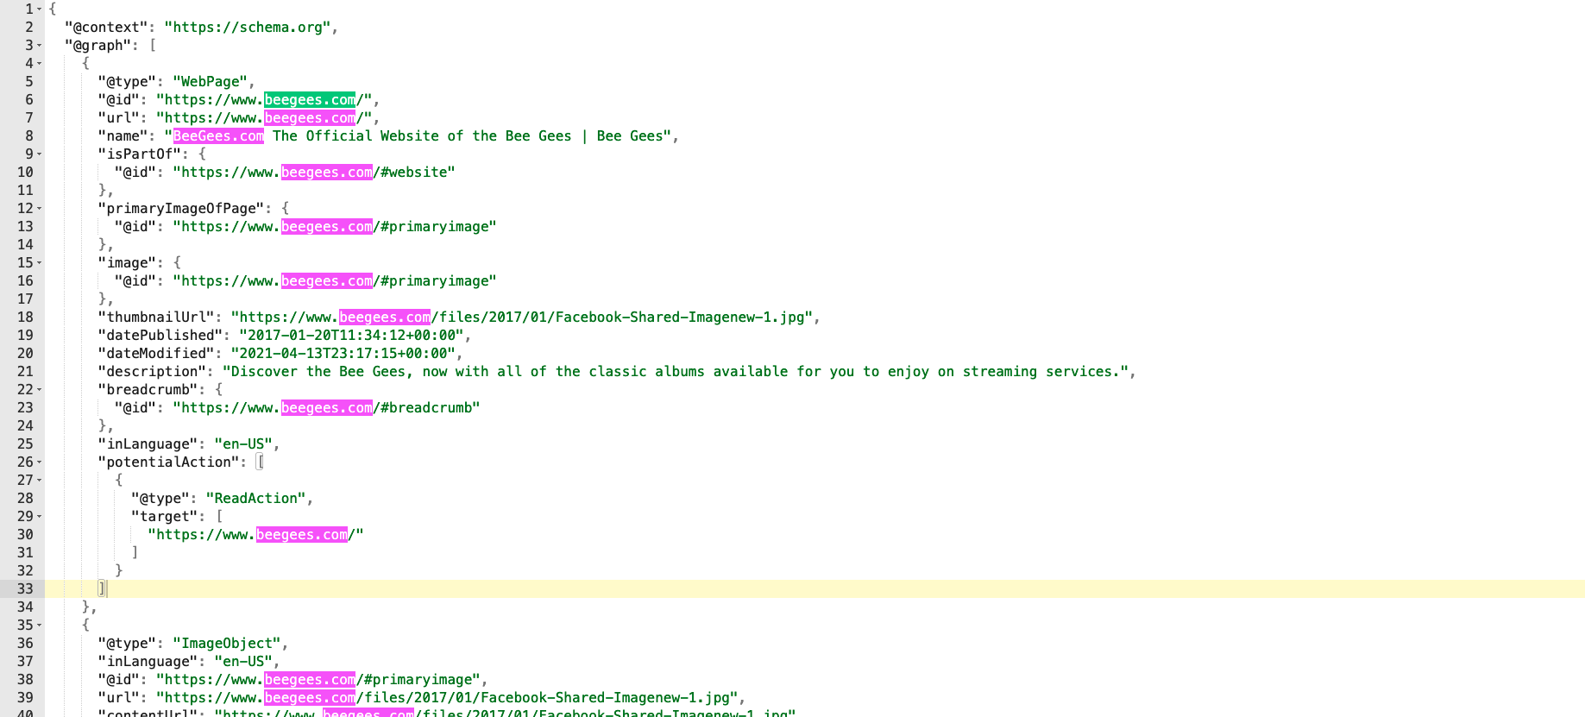
Persistent Identifiers
Beegees.com
Notes:
Demonstration:
https://www.beegees.com/
https://jsonformatter.org/json-pretty-print

Slide 14
Anatomy of a PID
https://www.beegees.com/v1/TR01A052
Base URI
Version
Local ID

Slide 15





Anatomy of a PID
https://www.beegees.com/v1/TR01A052
Base URI
Version
Local ID
ID
TR01A052

Slide 16
In short words…
GUPI is an URL (already global and unique) that points to your resource (e.g., metadata, data) and is persistent.
It is (usually) composed by:
  Based URL
  Version (not always)
  Local identifier
https://www.beegees.com/v1/TR01A052
Base URI
Version
Local ID

Slide 17
Persistent Identifiers: examples
Your own URL (as long as persistency is guaranteed)
Third party services:
  DOI.org
  W3ID.org
  PURL.org
  SURF.nl
Notes:
- Demonstration with PURL

Slide 18
Guideline
Only create your own identifiers for new knowledge
  Wherever you are referring to existing knowledge, do so using existing identifiers

Slide 19
Guideline
“Cool URIs don’t change” because when they do change (or disappear) all existing references break.

Slide 20
Guideline
“Cool URIs don’t change” [6] because when, they do change (or disappear) all existing references break.
Versioning: Whether you produce original data, or reference others’ data, consider the impact of changes.
https://www.beegees.com/v1/TR01A052
Base URI
Version
Local ID

Slide 21
Guideline
Identifiers that you have exposed publicly may be deprecated but must never be deleted or reassigned to another record.

Slide 22
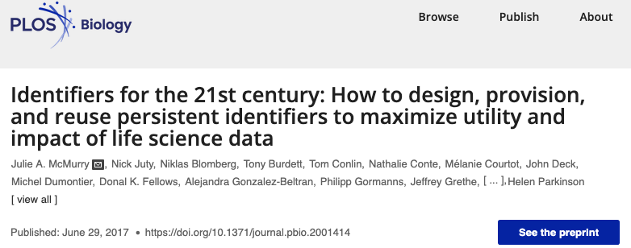
Guidelines
Notes:
https://journals.plos.org/plosbiology/article?id=10.1371/journal.pbio.2001414

Slide 23
Persistent identifiers service
Persistency guarantees: Are there formal guarantees or policies on the persistence of identifiers over time?
  Sustainability plan: Is there a documented plan for long-term service provision (e.g. financial model, succession planning)?
  Funding model: Is the service financially stable (e.g. supported by a consortium, subscription fees, or public funding)?

Slide 24
Take home message
“Persistent identifiers prevent link rot.
Link rot is the process by which URLs stop referring to the original source through time because they are moved or deleted.
Without a GUPI, the data object simply will not be findable let alone reusable in the long-run.”
Source: CESSDA Training Team (2017 - 2022). CESSDA Data Management Expert Guide. Bergen, Norway: CESSDA ERIC. Retrieved from https://dmeg.cessda.eu/

Slide 25
Questions?

Slide 26
Metadata Standards
Part II

Slide 27
Overview

Slide 28
Overview

Slide 29
Metadata standard
A metadata standard is a formal specification that defines how descriptive information (metadata) about a resource should be structured and represented to ensure consistency, interoperability, and reusability across systems and domains.

Slide 30
Metadata standard
A metadata standard is a formal specification that defines how descriptive information (metadata) about a resource should be structured and represented to ensure consistency, interoperability, and reusability across systems and domains.

Slide 31
Metadata standard
A metadata standard is a formal specification that defines how descriptive information (metadata) about a resource should be structured and represented to ensure consistency, interoperability, and reusability across systems and domains.

Slide 32
Metadata standard
A metadata standard is a set of rules or guidelines that define a common vocabulary, structure, and semantics for describing data or other digital objects.
It typically includes:
Elements/fields (e.g. title, creator, date, identifier)
Definitions of those elements (what each means)
Allowed formats or controlled vocabularies (e.g. ISO 8601 for dates, ORCID for person identifiers)
Relationships between elements (sometimes hierarchical or semantic)

Slide 33
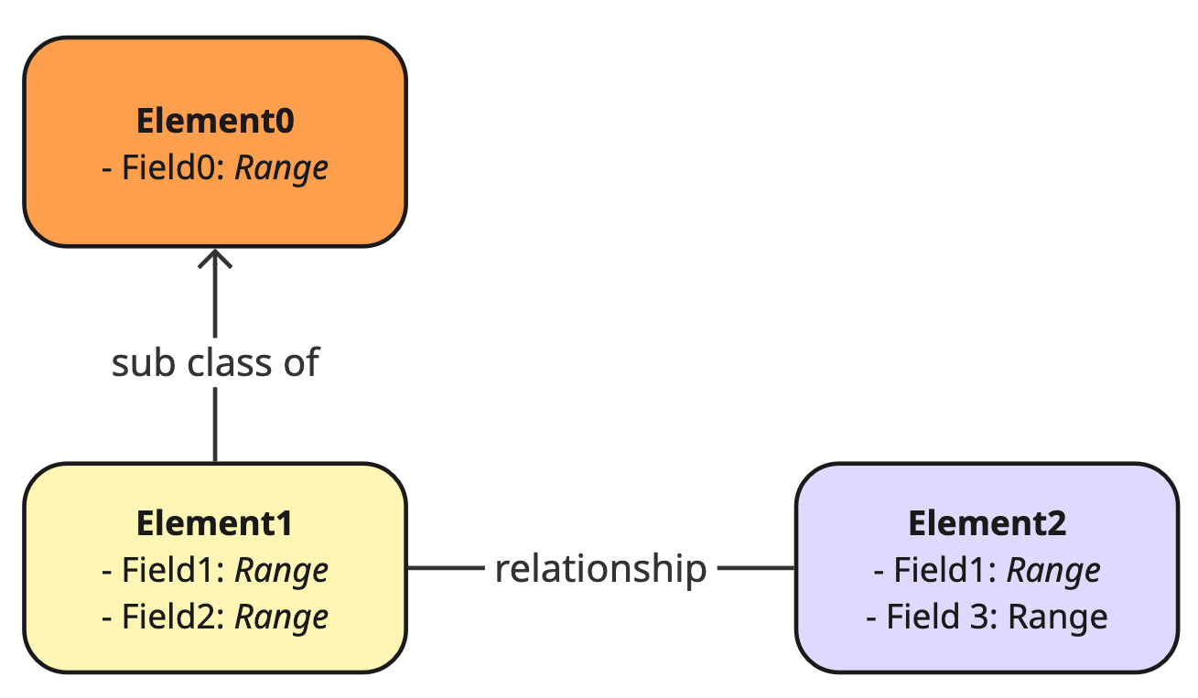
Metadata standard
Notes:
- Documentation with clear definition!

Slide 34
Metadata standard
DCAT – for data catalogs (used by Open Data Portals, W3C standard)
Dublin Core – general-purpose, widely used (e.g. dc:title, dc:creator)
MIAME – for microarray data (Minimum Information About a Microarray Experiment)
Schema.org – used for structured data on the web
Etc.

Slide 35
Metadata standard
DCAT – for data catalogs (used by Open Data Portals, W3C standard)
Dublin Core – general-purpose, widely used (e.g. dc:title, dc:creator)
MIAME – for microarray data (Minimum Information About a Microarray Experiment)
Schema.org – used for structured data on the web
Etc.

Slide 36
DCAT
DCAT (Data Catalog Vocabulary) is designed to describe datasets in catalogues. Its goal is to enable interoperability between data catalogues published on the Web.
Core concepts:
  dcat:Catalog – a data catalog
  dcat:Dataset – a dataset in the catalog
  dcat:Distribution – a downloadable file or API
  dct:title, dct:description, dct:publisher, etc. – metadata elements (from Dublin Core)

Slide 37
DCAT
DCAT (Data Catalog Vocabulary) is designed to describe datasets in catalogues. Its goal is to enable interoperability between data catalogues published on the Web.
Core concepts:
  dcat:Catalog – a data catalog
  dcat:Dataset – a dataset in the catalog
  dcat:Distribution – a downloadable file or API
  dct:title, dct:description, dct:publisher, etc. – metadata elements (from Dublin Core)

Slide 38
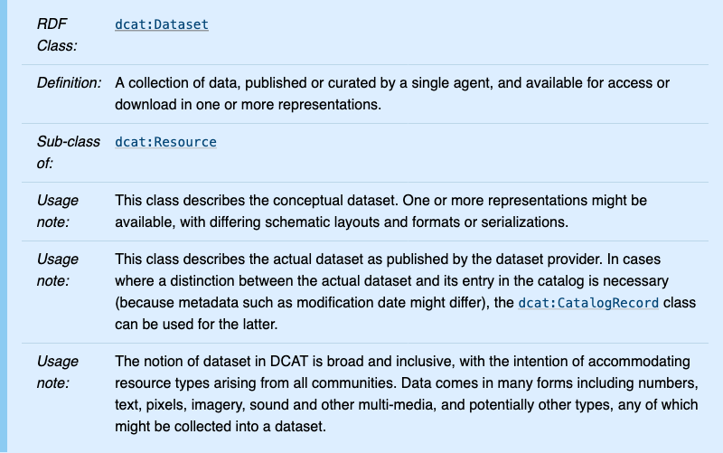
DCAT
(Class description)

Slide 39
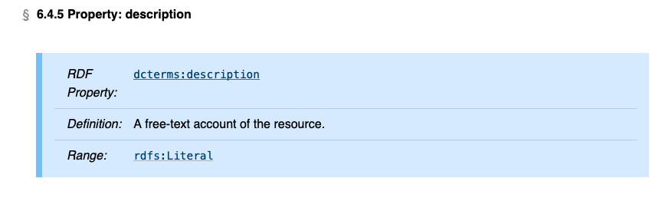
DCAT (property description)

Slide 40
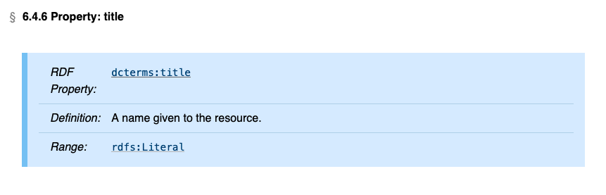
DCAT

Slide 41
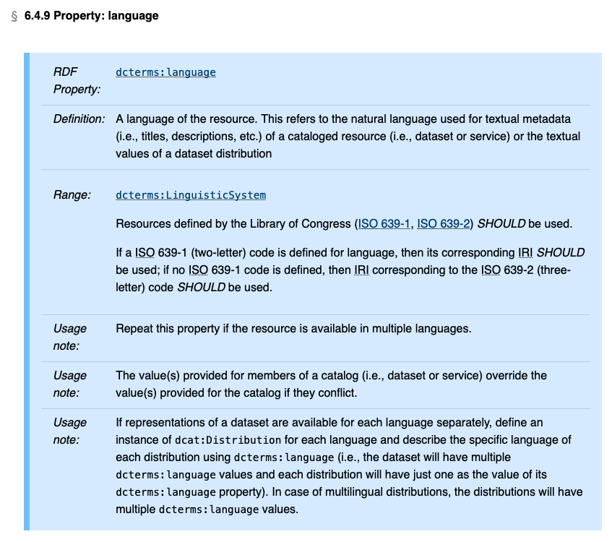
DCAT

Slide 42
DCAT flavours
DCAT-AP (Application Profile for Europe)
Maintained by: The Semantic Interoperability Centre Europe (SEMIC.EU)
Used across: European Commission’s data portal, EU Member States
For sharing information about Catalogues containing Datasets and Data Services descriptions in Europe
HealthDCAT-AP:
Health-related extension of the DCAT-AP

Slide 43
DCAT Specification
DCAT Specification
Notes:
Demonstration:
https://www.w3.org/TR/vocab-dcat-3/

Slide 44
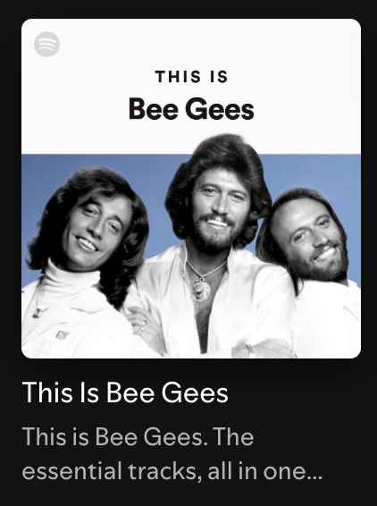
Example
dcat:Catalog (an album, or a playlist)
dct:title: “This is Bee Gees”
dct:creator: “Spotify”
dcat:theme: “Rock”, “Soft Rock”, “Pop Rock”
dcat:dataset: List of songs (datasets)

Slide 45
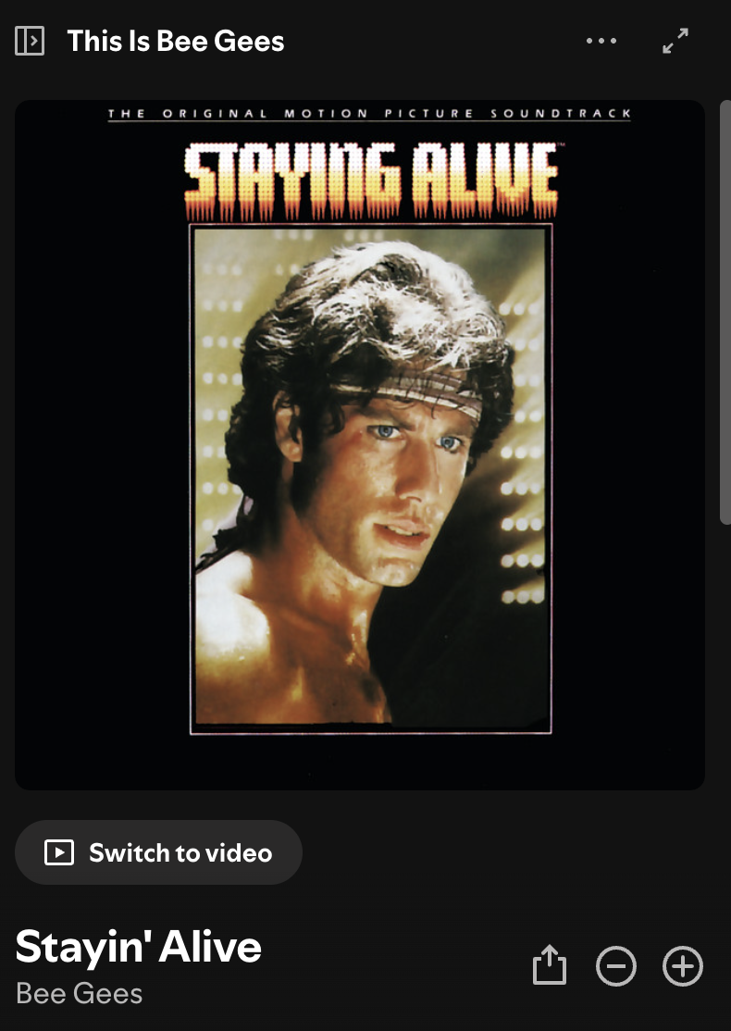
Example
dcat:Dataset
dct:title: “Stayin’ Alive”
dct:creator: “Bee Gees”
dct:issued: 1977
dcat:distribution: Streaming/Download options

Slide 46
Example
dcat:Distribution
dct:title: “Streaming - Spotify”
dct:description: “Stream Stayin’ Alive on Spotify”
dct:accessURL: “magnet link to song on Spotify”
dcat:Distribution
dct:title: “Vinyl”
dct:description: “Buy the vinyl with song”
dct:accessURL: “Link to vinyl on Amazon”

Slide 47
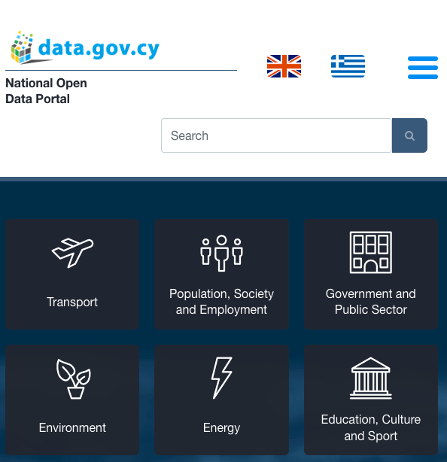
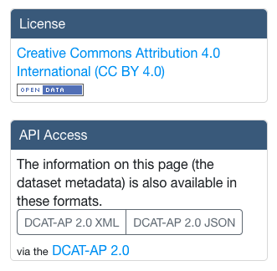
Where’s DCAT used?
Notes:
https://data.gov.cy/en/dataset/780

Slide 48
Take home message
“Research data loss in most repositories starts with the wrong or a lack of metadata standards.
Thus, the use of metadata standards embedded in digital data from the outset is recommended as a starting point for research data preservation [26,31].”
Source: Mosha, N. F., & Ngulube, P. (2023). Metadata Standard for Continuous Preservation, Discovery, and Reuse of Research Data in Repositories by Higher Education Institutions: A Systematic Review. Information, 14(8), 427. https://doi.org/10.3390/info14080427

Slide 49
Quiz time!
Notes:
Take two minutes to check DCAT’s documentation..
List two classes that you would use to describe the case of a rare disease dataset that belongs to an ERN (e.g. EuRRECa and EuRR-Bone)

Slide 50
Questions?

Slide 51
Ontologies (for Findability)
Part III

Slide 52
Overview
Notes:
https://miro.com/app/board/uXjVI6XaRYU=/

Slide 53
Overview
Notes:
https://miro.com/app/board/uXjVI6XaRYU=/

Slide 54
Overview
Notes:
https://miro.com/app/board/uXjVI6XaRYU=/

Slide 55
Quiz time!
Notes:
- Mentimer quiz

Slide 56
What’s an ontology?
An ontology is a formal, explicit specification of a shared conceptualization of a domain.
Translating: It’s a structured model that defines the key concepts, their properties, and the relationships between them, so that both humans and machines can understand and use data consistently.

Slide 57
What’s an ontology?
An ontology is a formal, explicit specification of a shared conceptualization of a domain.
Translating: It’s a structured model that defines the key concepts, their properties, and the relationships between them, so that both humans and machines can understand and use data consistently.

Slide 58
What’s an ontology?
An ontology is a formal, explicit specification of a shared conceptualization of a domain.
Translating: It’s a structured model that defines the key concepts, their properties, and the relationships between them, so that both humans and machines can understand and use data consistently.

Slide 59
What’s an ontology?
An ontology is a formal, explicit specification of a shared conceptualization of a domain.
Translating: It’s a structured model that defines the key concepts, their properties, and the relationships between them, so that both humans and machines can understand and use data consistently.

Slide 60
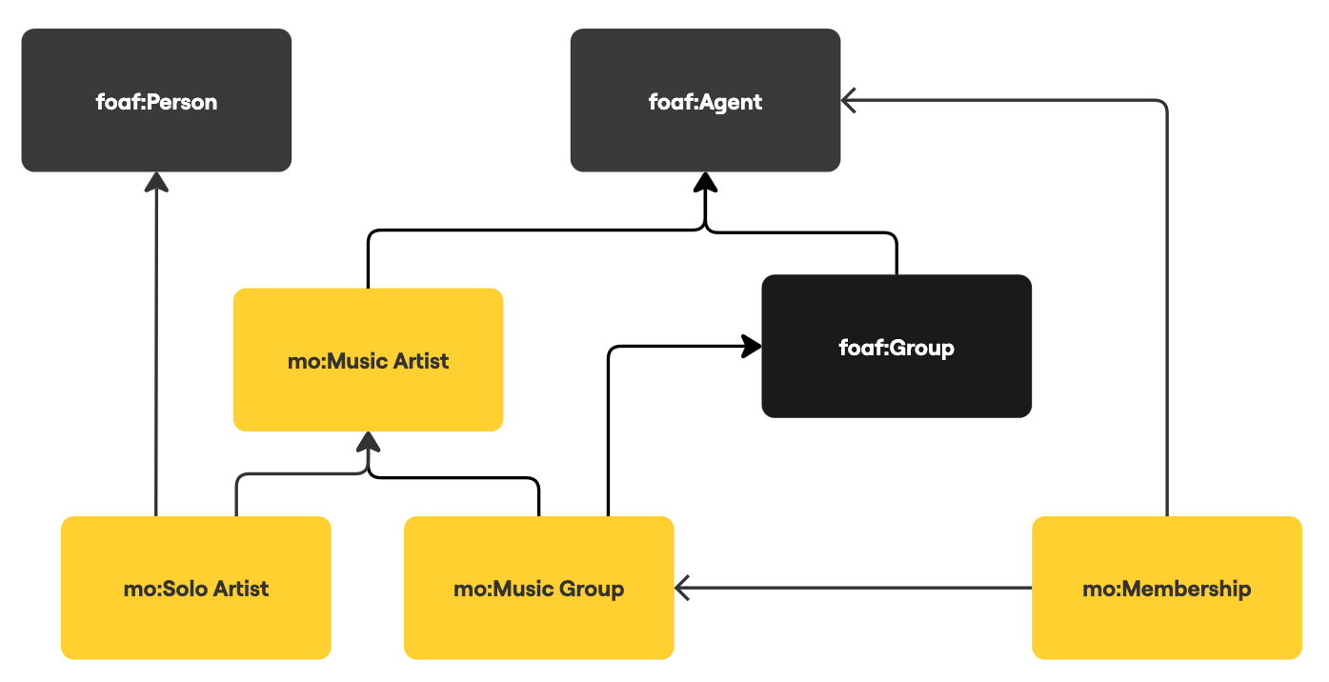
Example: Music Ontology (MO)

Slide 61
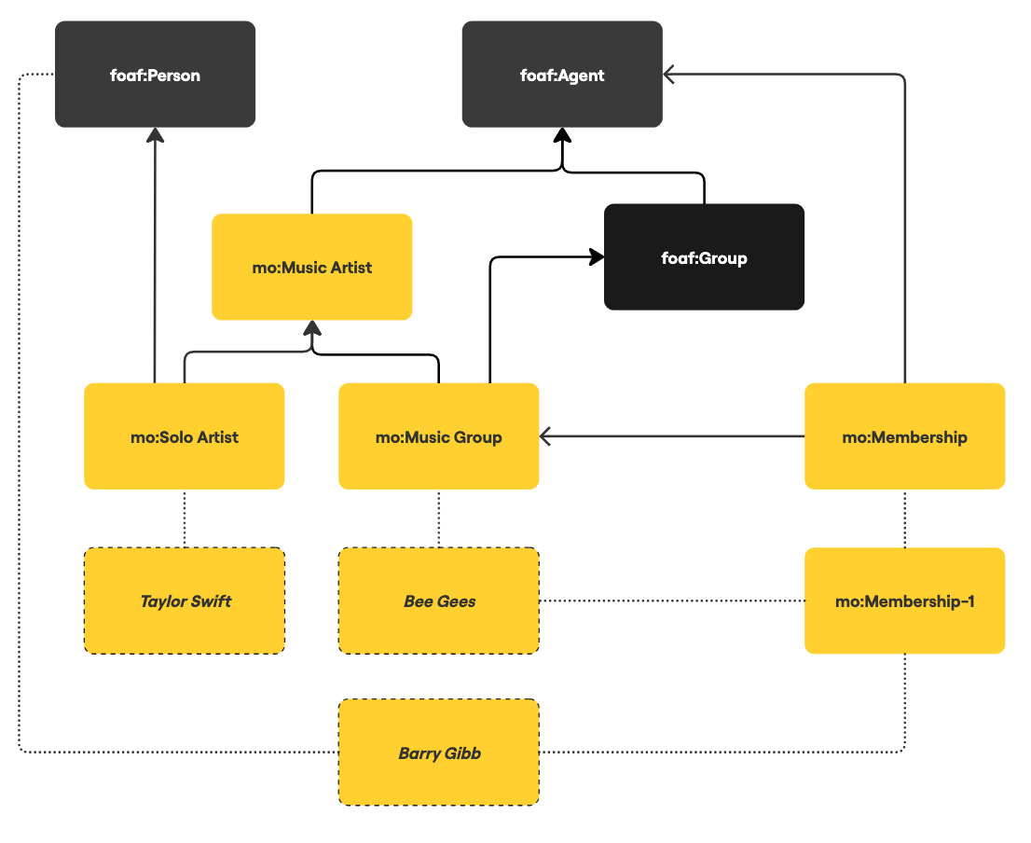

Slide 62
Ontologies (for findability)
Findability: Ontologies provide standardised terms and identifiers that enhance metadata indexing and semantic search.
Accessibility: Ontologies support making access conditions clear and explicit.
Interoperability: Ontologies define shared vocabularies and formal relationships, enabling cross-domain data integration.
Reusability: Ontologies provide clear semantics about data concepts, which facilitates reuse.
Notes:
- Mentimer quizz

Slide 63
Ontologies (for findability)
Findability: Ontologies provide standardised terms and identifiers that enhance metadata indexing and semantic search.
Accessibility: Ontologies support making access conditions clear and explicit.
Interoperability: Ontologies define shared vocabularies and formal relationships, enabling cross-domain data integration.
Reusability: Ontologies provide clear semantics about data concepts, which facilitates reuse.

Slide 64
Example
dcat:Catalog (an album, or a playlist)
dct:title: “This is Bee Gees”
dct:creator: “Spotify”
dcat:theme: “Rock”, “Soft Rock”, “Pop Rock”
dcat:dataset: List of songs (datasets)

Slide 65
Example
dcat:Catalog (an album, or a playlist)
dct:title: “This is Bee Gees”
dct:creator: “Spotify” http://www.ebi.ac.uk/swo/organization/SWO_9000022
dcat:theme: “Rock”, “Soft Rock”, “Pop Rock”
dcat:dataset: List of songs (datasets)
Notes:
- Spotify: Software Ontology

Slide 66
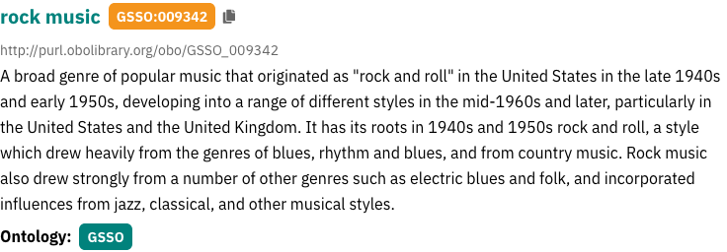
Example
dcat:Catalog (an album, or a playlist)
dct:title: “This is Bee Gees”
dct:creator: “Spotify” http://www.ebi.ac.uk/swo/organization/SWO_9000022
dcat:theme: “Rock”, “Soft Rock”, “Pop Rock”
Notes:
- Spotify: Software Ontology

Slide 67
Example
dcat:Dataset
dct:title: “Stayin’ Alive”
dct:creator: “Bee Gees”
dct:issued: 1977
dcat:distribution: Streaming/Download options

Slide 68
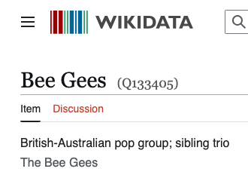
Example
dcat:Dataset
dct:title: “Stayin’ Alive”
dct:creator: “Bee Gees”
dct:issued: 1977
dcat:distribution: Streaming/Download options

Slide 69
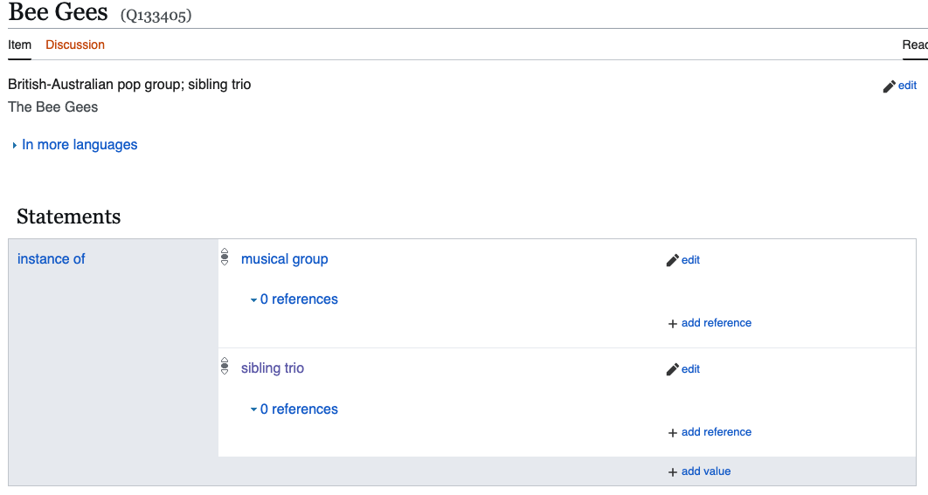

Slide 70
Where to find ontologies?
Ontology Lookup Service (OLS): ebi.ac.uk/ols4/
Bioportal: bioportal.bioontology.org
Ontobee: ontobee.org
Notes:
- Demonstrate OLS if lot of time left..

Slide 71
How to reuse them?
Check if the ontology aligns with your domain
Check the ontology’s community support
Check the ontology status (e.g. is it actively maintained or deprecated?)
Check the ontology license
Prefer widely adopted and standard ontologies
Notes:
- Guidelines on reusing ontologies..

Slide 72
Take home message
“The use of ontologies can facilitate data integration in many ways,
including metadata representation, automatic data verification, global conceptualization, and support for high-level semantic queries.”
Source: Zhang, H., Guo, Y., Li, Q. et al. An ontology-guided semantic data integration framework to support integrative data analysis of cancer survival. BMC Med Inform Decis Mak 18 (Suppl 2), 41 (2018). https://doi.org/10.1186/s12911-018-0636-4

Slide 73
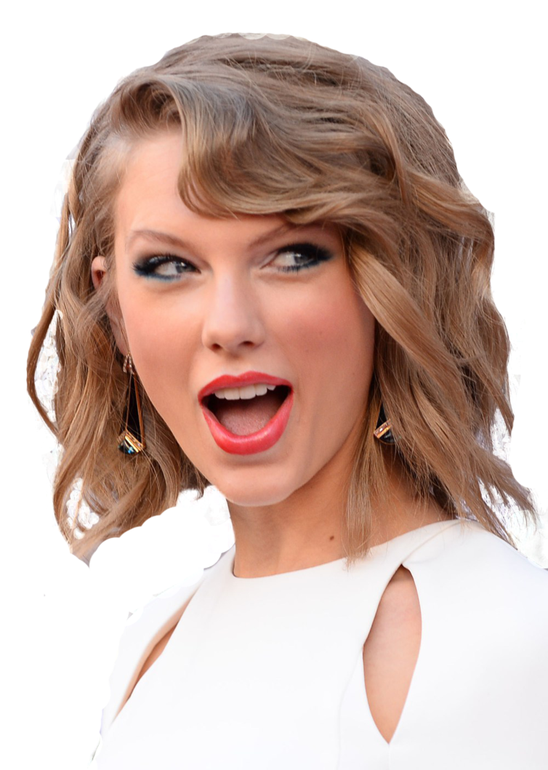
Disclaimer
The author of this presentation was actually listening to Taylor Swift wile designing it.

Slide 74
Questions?

