Slide 1
FAIR Principles Training School
Reusability
14 May 2025

Slide 2
Topic & Learning Goals
The Role of FAIR Data in Enhancing Research Reproducibility and Data Re-use
2. Recognize the relationship and the differences between FAIR data and Open Science practices
6. Develop skills to make data Reusable through proper documentation, use conditions, and provenance information
14. Integrate FAIR data practices into the full research data lifecycle
15. Understand the role of FAIR data in enhancing the reproducibility of research projects and re-use of data

Slide 3


Slide 4
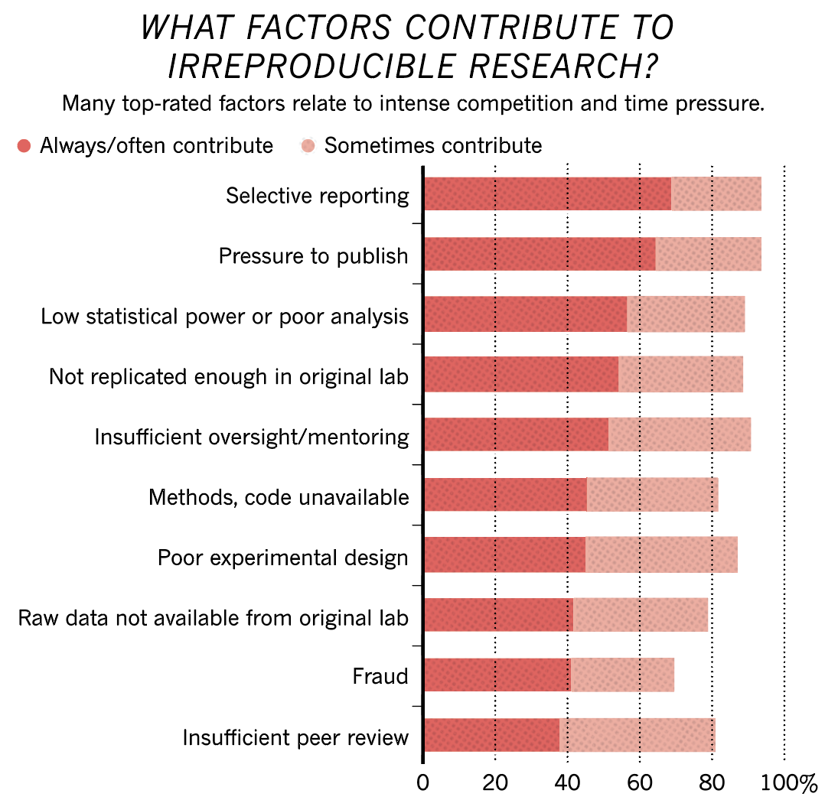
You are not the only one!
More than 70% of researchers have tried and failed to reproduce another scientist's experiments, and more than half have failed to reproduce their own experiments
Baker, M. 1,500 scientists lift the lid on reproducibility. Nature 533, 452–454 (2016). https://doi.org/10.1038/533452a

Slide 5
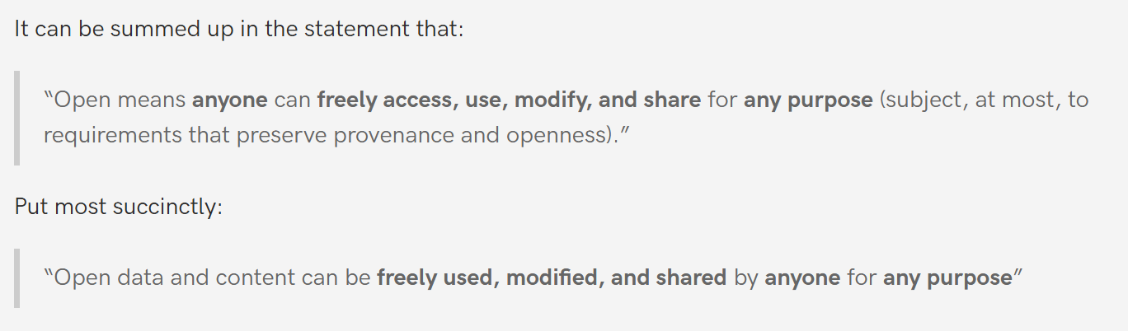
FAIR data and/or Open data
FAIR data adheres to FAIR Principles (to some extent)
Open (source: https://opendefinition.org/)

Slide 6
FAIR data and/or Open data
FAIR but non-open data
“Accessible” Principle: Once the user finds the required data, she/he/they need to know how they can be accessed, possibly including authentication and authorisation.
  Authentication may be restricted by, e.g., fees or location

Slide 7
FAIR data and/or Open data
Open but not so FAIR data
  E.g., Datensatzbeschreibung FDZ Gesundheit

Slide 8
FAIR data and/or Open data
Data should be “as FAIR as possible”
Data should be as open as possible, and as closed as needed

Slide 9
Reusability Principles
Source: https://www.go-fair.org/fair-principles/
Reusable
The ultimate goal of FAIR is to optimise the reuse of data. To achieve this, metadata and data should be well-described so that they can be replicated and/or combined in different settings.
R1. (Meta)data are richly described with a plurality of accurate and relevant attributes
  R1.1. (Meta)data are released with a clear and accessible data usage license
  R1.2. (Meta)data are associated with detailed provenance
  R1.3. (Meta)data meet domain-relevant community standards

Slide 10
R1. (Meta)data are richly described with a plurality of accurate and relevant attributes
The data publisher should provide not just metadata that allows discovery, but also metadata that richly describes the context under which the data was generated. This may include
  the experimental protocols,
  the manufacturer and brand of the machine or sensor that created the data,
  the species used,
  the drug regime, etc.
Moreover, R1 states that the data publisher should not attempt to predict the data consumer’s identity and needs. We chose the term ‘plurality’ to indicate that the metadata author should be as generous as possible in providing metadata, even including information that may seem irrelevant.
Source: https://www.go-fair.org/fair-principles/r1-metadata-richly-described-plurality-accurate-relevant-attributes/

Slide 11
R1.1. (Meta)data are released with a clear and accessible data usage license
R1.1 is about legal interoperability. What usage rights do you attach to your data?
Clarity of licensing status will become more important with automated searches involving more licensing considerations. The conditions under which the data can be used should be clear to machines and humans.

Slide 12
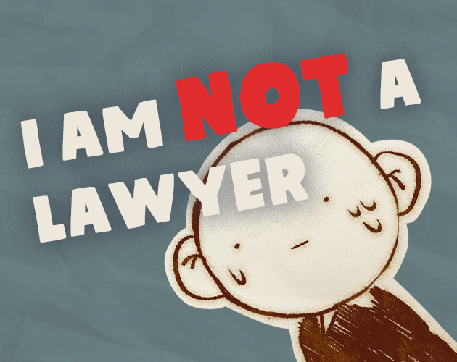
Copyright and licensing
Copyright is a type of intellectual property that protects original works of authorship as soon as an author fixes the work in a tangible form of expression.
Source:
https://www.copyright.gov/what-is-copyright/
Licensing is the granting of (copyright) permissions to persons as licensees
Source: https://purejamgames.itch.io/i-am-not-a-lawyer

Slide 13
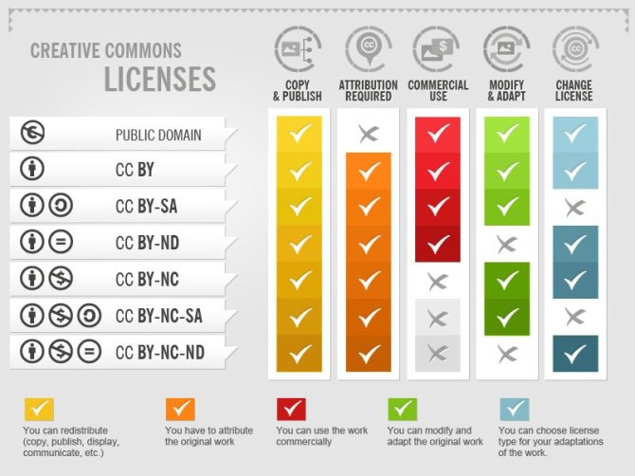

Licenses
Creative Commons (CC)
  BY = attribution
  SA = Share-alike
  NC = Non-commercial
  ND = no derivatives
CC0 = Public domain
See: https://chooser-beta.creativecommons.org/
Creative Commons licenses by Foter (CC-BY-SA)

Slide 14

Licenses
Creative Commons (CC)
Copyleft
comparable to the ShareAlike aspect of a CC license

Slide 15

Licenses
Creative Commons (CC)
Copyleft
The GNU General Public License
a free, copyleft license for software and other kinds of works

Slide 16
Reusing & Producing – Licensing
Reusing materials
  Adhere to the license, i.e., reuse conditions
Producing materials
  Clearly state copyright holder / authorship
  Determine the desired license
  Ensure your license adheres to that of any reused material

Slide 17
R1.2. (Meta)data are associated with detailed provenance
Source: https://www.go-fair.org/fair-principles/r1-2-metadata-associated-detailed-provenance/
For others to reuse your data, they should know
where the data came from (i.e., clear story of origin/history),
who to cite and/or how you wish to be acknowledged.
Include a description of the workflow that led to your data:
  Who generated or collected it?
  How has it been processed?
  Has it been published before?
  Does it contain data from someone else that you may have transformed or completed?
  Ideally, this workflow is described in a machine-readable format.

Slide 18
R1.3. (Meta)data meet domain-relevant community standards
Source: https://www.go-fair.org/fair-principles/r1-3-metadata-meet-domain-relevant-community-standards/
It is easier to reuse data sets if they are similar:
same type of data, data organised in a standardised way, well-established and sustainable file formats, documentation (metadata) following a common template and using common vocabulary.
If community standards or best practices for data archiving and sharing exist, they should be followed. For instance, many communities have minimal information standards (e.g., MIAME, MIAPE). FAIR data should at least meet those standards. Other community standards may be less formal, but nevertheless, publishing (meta)data in a manner that increases its use(ability) for the community is the primary objective of FAIRness.
Note that quality issues are not addressed by the FAIR principles. The data’s reliability lies in the eye of the beholder and depends on the intended application.

Slide 19
Exercise - inventorize
R1.1: Verify copyright and licensing of the dataset
R1.2: What info do you have / need regarding
  where the data came from
  who to cite and/or how the author/holder wishes to be acknowledged;
  the workflow that led to the data
R1.3: What community standards are used

Slide 20
FAIR for reproducible research
Baker, M. 1,500 scientists lift the lid on reproducibility. Nature 533, 452–454 (2016). https://doi.org/10.1038/533452a

Slide 21
FAIR for reproducible research
Baker, M. 1,500 scientists lift the lid on reproducibility. Nature 533, 452–454 (2016). https://doi.org/10.1038/533452a

Slide 22
Take-home message
Reproducibility depends on Findability
  Without persistent IDs and metadata, others can’t find your data or know it exists
Reproducibility depends on Accessibility
  Without clear access policies, others can’t know how your data can be accessed
Reproducibility depends on Interoperability
  Without the usage of standards, others can’t interpret or combine dataset
Reproducibility depends on Reusability
  Without documentation, licenses and provenance information,
  others can’t can rerun, validate, nor extend your work

