Slide 1
FAIR Principles Training School
Analysis of FAIR Data
14 May 2025

Slide 2
Topic & Learning Goals
Explain methods for the analysis of FAIRified datasets
16. Explain methods for the analysis of FAIRified datasets

Slide 3
Reuse – two approaches
Centralized - Data sharing – merging federated datasets in a central (temporary) repository





Slide 4
Reuse – two approaches
Federated - Data visiting – algorithm is sent to federated datasets, only aggregate results are returned





Slide 5
How to do (linked) data reuse
Research topic: (famous) people with hematologic diseases
  Wikipedia: Sickle cell disease – Wikipedia
  Wikidata: sickle-cell disease (wd:Q185034) - Wikidata
  Wikidata: hemoglobinopathy (wd:Q1642147) – Wikidata

Slide 6
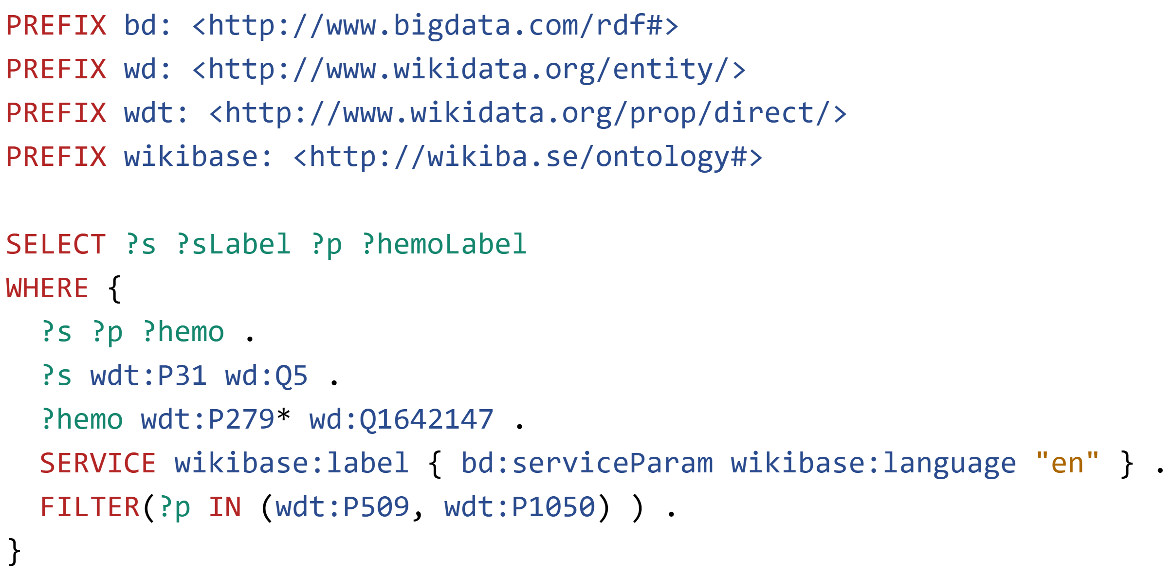
How to do (linked) data reuse
Wikidata Query Service
“ontologies”
Select subjects, their label, predicates,
and the object label; Where the subject
is_a (P31) person (Q5), and the object a type of (P279) hemoglobinopathy (Q1642147)
forget this for now

Slide 7
How to do (linked) data reuse
Research topic: prevalence of sickle cell disease

Slide 8

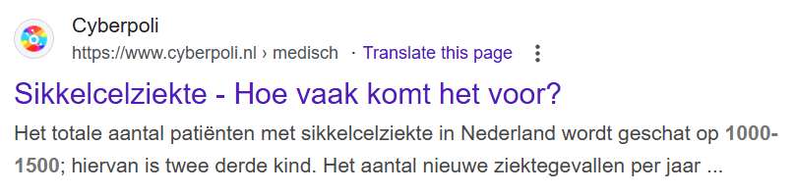

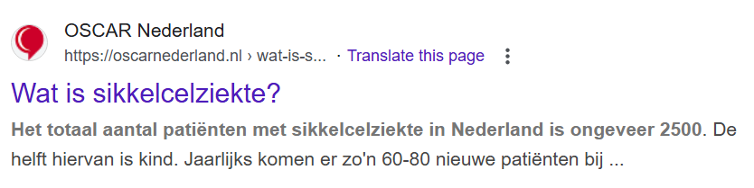
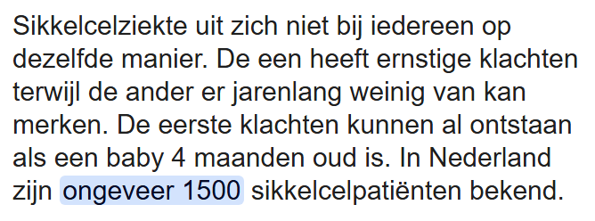
Example: the Netherlands

Slide 9
How to do (linked) data reuse
IthaMaps website
Wikidata country populations: Wikidata Query Service

Slide 10
How to make this concrete
IthaMaps website
ithamaps_ds.xlsx data

Slide 11
How to make this concrete
Research topic: prevalence of sickle cell disease
Research question: prevalence of sickle cell disease per million population

Slide 12
Tools
SPARQLer – General purpose processor
https://sparql.org/sparql.html
YasGUI – Yet Another SPARQL Graphical User Interface
https://yasgui.org/

Slide 13
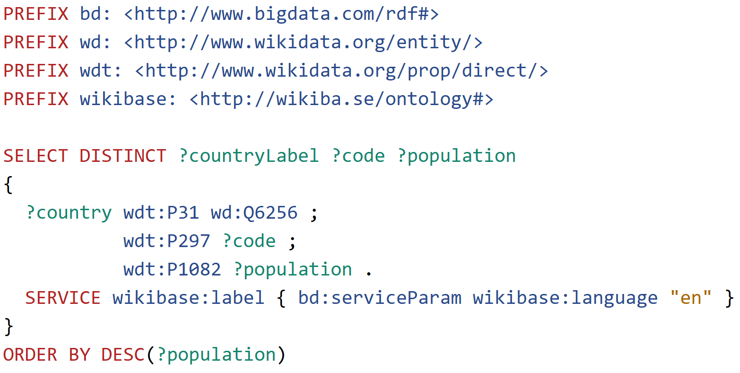
Countries and population
Wikidata Query Service

Slide 14
Tools
SPARQLer – General purpose processor
https://sparql.org/sparql.html
YasGUI – Yet Another SPARQL Graphical User Interface
https://yasgui.org/
Countries & populations: Wikidata Query Service

Slide 15
“FAIR” Sickle_cell incidence
@prefix : <http://example.org/> .
:record1 :CountryCode "AL" ; :Country "Albania" ; :Continent "Europe" ; :incidence "30"^^xsd:float .
:record2 :CountryCode "DZ" ; :Country "Algeria" ; :Continent "Africa" ; :incidence "191"^^xsd:float .
:record3 :CountryCode "AO" ; :Country "Angola" ; :Continent "Africa" ; :incidence "13300"^^xsd:float .
:record4 :CountryCode "AR" ; :Country "Argentina" ; :Continent "South America" ; :incidence "4"^^xsd:float .
:record5 :CountryCode "AW" ; :Country "Aruba" ; :Continent "North America" ; :incidence "1"^^xsd:float .
:record6 :CountryCode "AU" ; :Country "Australia" ; :Continent "Oceania" ; :incidence "5"^^xsd:float .
:record7 :CountryCode "AT" ; :Country "Austria" ; :Continent "Europe" ; :incidence "1"^^xsd:float .
:record8 :CountryCode "BS" ; :Country "Bahamas" ; :Continent "North America" ; :incidence "8"^^xsd:float .
:record9 :CountryCode "BH" ; :Country "Bahrain" ; :Continent "Asia" ; :incidence "59"^^xsd:float .
https://tableconvert.com/csv-to-rdf

Slide 16
Tools
SPARQLer – General purpose processor
https://sparql.org/sparql.html
YasGUI – Yet Another SPARQL Graphical User Interface
https://yasgui.org/
Countries & populations: Wikidata Query Service
Convert CSV to RDF using Convert CSV to RDF Online
“FAIR” Sickle_cell incidence as a self-hosted service

Slide 17
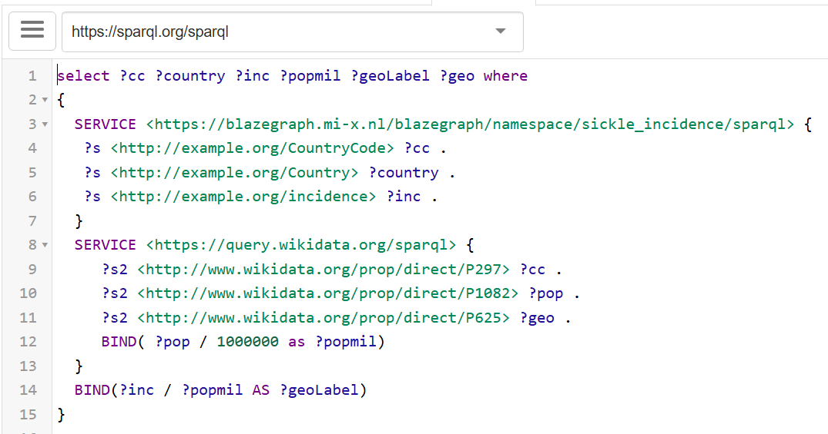
All combined: One query
 General purpose (federated) SPARQL endpoint
 SPARQL endpoint for proprietary server
 Get incidence data for each country
 SPARQL endpoint for wikidata server
 Get population data for each country
 Calculate population in millions
 Calculate incidence per million population

Slide 18
Tools - simplified
SPARQLer – General purpose processor
https://sparql.org/sparql.html
YasGUI – Yet Another SPARQL Graphical User Interface
https://yasgui.org/
Countries & populations: Wikidata Query Service
Convert CSV to RDF using Convert CSV to RDF Online
“FAIR” Sickle_cell incidence RDF file (in turtle format, watch file extension) as a web-based file

Slide 19
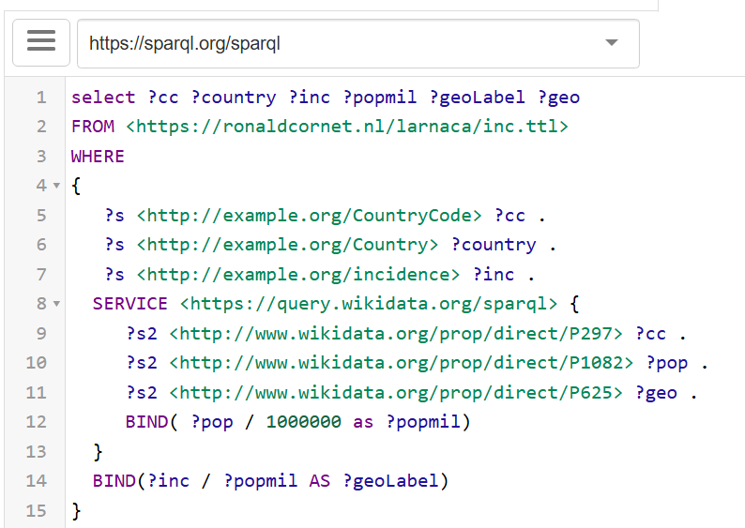
All combined: One query - simpler
 General purpose (federated) SPARQL endpoint
 RDF file in turtle format (NB: proper extension)
 Get incidence data for each country
 SPARQL endpoint for wikidata server
 Get population data for each country
 Calculate population in millions
 Calculate incidence per million population

Slide 20
Approach - Conclusion
Reuse of existing linked data (wikidata population data)
FAIR sickle cell data
Linked through country code as unique identifier
  Better would be to have a URI for that
One entry point to query data from both sources
Free map visualization

Slide 21
Finally...
A big thank you to ...

Slide 22
