Slide 1
FAIR Principles Training School
Interoperability
13 May 2025

Slide 2
Topic & Learning Goals
Recognize methods and standards for enhancing data Interoperability across systems (machine-actionability and importance of metadata and ontologies in making data interoperable)
Recognize methods and standards for enhancing data Interoperability across systems
Understand how to select and use FAIR-compliant data repositories
Understand what machine-actionability and its importance in FAIR data practices entails
Understand what metadata standards and ontologies are and how they make (meta)data more Interoperable.

Slide 3

Current practice
Data Sharing and Management Snafu in 3 Short Acts - YouTube

Slide 4
Interoperability
Inter - opera - ability
[between each other] [work] [ability]
= Ability to work together
 
 

Slide 5
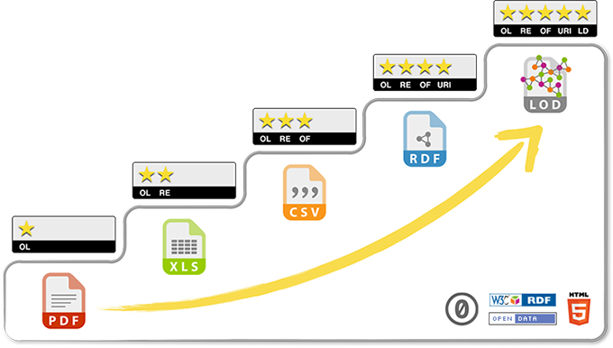
What: Interoperability layers
“5-star linked open data”
Open license → structured → open format → URI-based → linked
Syntactic interoperability / Semantic interoperability
Accessibility

Slide 6
Interoperability Principles
Interoperable
The data usually need to be integrated with other data. In addition, the data need to interoperate with applications or workflows for analysis, storage, and processing.
I1. Data and metadata use a formal, accessible, shared, and broadly applicable language for knowledge representation
I2. Data and metadata use vocabularies that follow FAIR principles
I3. Data and metadata include qualified references to other (meta)data
Source: https://www.go-fair.org/fair-principles/

Slide 7
I1. Data and metadata use a formal, accessible, shared, and broadly applicable language for knowledge representation
Knowledge representation ~ ontologies

Slide 8
Ontologies
Also called: Controlled Vocabularies, thesauri, terminologies, …
For example:
  ORDO – Orphanet Rare Disease Ontology
  SNOMED CT
  Mondo Disease ontology
  HPO – Human Phenotype Ontology
  GO – Gene Ontology

Slide 9
Ontologies – main purposes
Encoding
  A unique identifier (per ontology) to represent entity types (concepts; data elements / properties)
Describing
  Human-readable labels (names, synonyms) in (m)any languages
  Machine-readable properties and mappings to other
Ordering
  Storage and retrieval at “arbitrary” level of detail

Slide 10
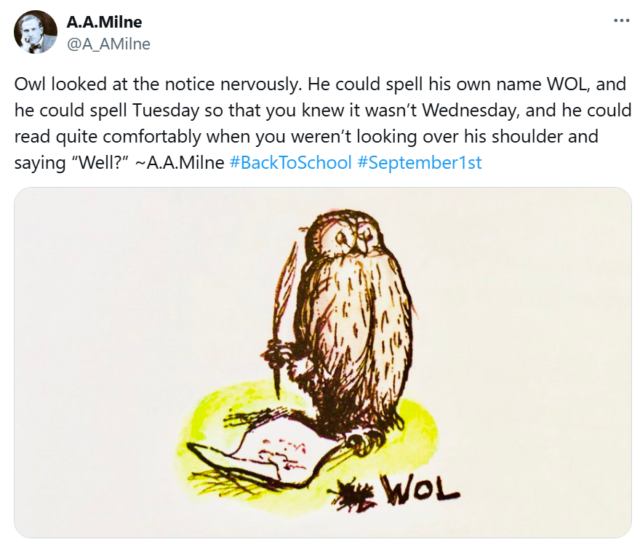
I1. Data and metadata use a formal, accessible, shared, and broadly applicable language for knowledge representation
Knowledge representation ~ ontologies
Languages:
  RDF/OWL (Resource Description Framework / Web Ontology Language)
  JSON-LD (JavaScript Object Notation – Linked Data)
Source:
https://x.com/A_AMilne/status/1300667646149566465

Slide 11
I2. Data and metadata use vocabularies that follow FAIR principles
ORDO, SNOMED CT, Mondo, HPO, GO must be FAIR themselves
Any proprietary vocabulary should also be made FAIR

Slide 12
I3. Data and metadata include qualified references to other (meta)data
A qualified reference is a cross-reference that explains its intent
For example, X is regulator of Y is a much more qualified reference than X is associated with Y, or X see also Y
The goal therefore is to create as many meaningful links as possible between (meta)data resources to enrich the contextual knowledge about the data, balanced against the time/energy involved in making a good data model
https://www.go-fair.org/fair-principles/i3-metadata-include-qualified-references-metadata/

Slide 13
Interoperability Principles
Interoperable
The data usually need to be integrated with other data. In addition, the data need to interoperate with applications or workflows for analysis, storage, and processing.
I1. Data and metadata use a formal, accessible, shared, and broadly applicable language for knowledge representation
I2. Data and metadata use vocabularies that follow FAIR principles
I3. Data and metadata include qualified references to other (meta)data

Slide 14
One more thing: conceptual modelling
Person
is_role_of
is_role_of
Patient
Healthcare Professional
treats

Slide 15
Conceptual modelling
Person
1
1
n
is_role_of
is_role_of
n
Patient
Healthcare Professional
n
n
treats

Slide 16
Conceptual modelling
Person
1
has_condition
n
Condition
1
1
has_focus
is_role_of
n
n
Healthcare Professional
performs
Treatment
1
n

Slide 17
Conceptual modelling
Fhir:condition
OMOP:condition_occurrence
openEHR:problem/diagnosis
Fhir:patient
OMOP:person
CDISC:study_subject
openEHR:person
Person
1
has_condition
n
Condition
1
n
has_focus
is_role_of
n
1
Fhir:practitioner
openEHR:individual_healthcare_provider
Healthcare Professional
performs
Treatment
1
n
Fhir:procedure
OMOP:procedure_occurrence
openEHR:procedure

Slide 18
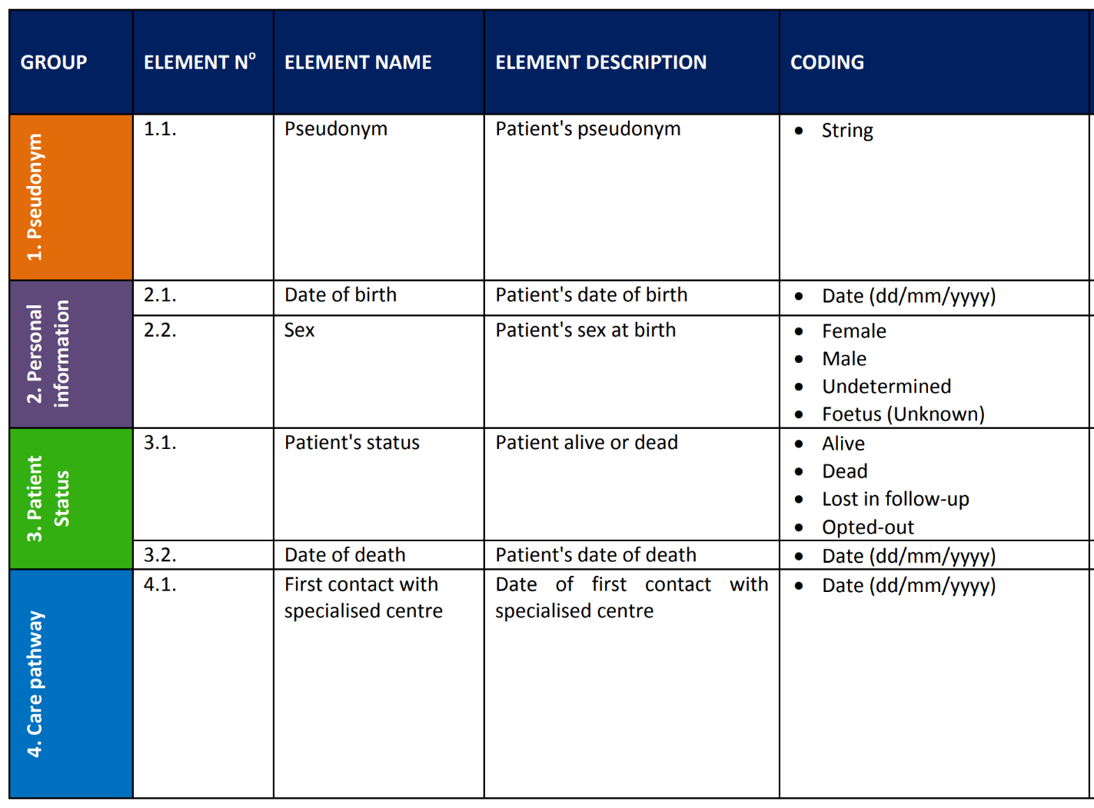
Let’s make this concrete
Person
has_condition
Condition
is_role_of
has_focus
Healthcare Professional
Treatment
performs

Slide 19
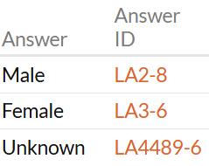
“Simple” cases
NCIT:C80244 Pseudonym: ST
LOINC:21112-8 Date_of_birth: TS
LOINC:76689-9 Sex at birth: CD
LOINC:81954-0 Date_of_death: TS
Person
has_condition
Condition
is_role_of
has_focus
Healthcare Professional
Treatment
performs

Slide 20
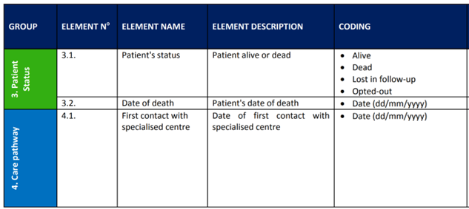
“Patient status”?
“Mixed” value set:
  Alive
  Dead
  Lost in follow-up
  Opted out
Person
has_condition
Condition
is_role_of
has_focus
Healthcare Professional
Treatment
performs

Slide 21
“Date of 1st contact with specialised centre”?
Meaning needs clarification
Ideally, this information is derived from properly modelled information
Person
has_condition
Condition
is_role_of
has_focus
Healthcare Professional
Treatment
performs

Slide 22
Conceptual modelling - checklist
Model according to the source data ← Reuse!
  What is being captured?
    E.g., date of birth of a person
  What do I want to know?
    E.g., age of a person

Slide 23
Conceptual modelling - checklist
Model according to the source data
Data consists of triples
  entity-attribute-value, e.g., person – date of birth – 1957-07-06
  Also called subject-predicate-object triples

Slide 24
Conceptual modelling - checklist
Model according to the source data
Data consists of triples
Attributes / Predicates shouldn’t be “overloaded”
  Date of first contact with specialised centre
  Lowest systolic blood pressure in the first 24 hours of ICU admission
  Break down based on the constituting entities and attributes

Slide 25
Conceptual modelling - checklist
Model according to the source data
Data consists of triples
Attributes / Predicates shouldn’t be “overloaded”
Use concepts from existing ontologies when and where possible
  For entities, attributes and values
  _______
  Barend Mons date of birth

Slide 26
Conceptual modelling - checklist
Model according to the source data
Data consists of triples
Attributes / Predicates shouldn’t be “overloaded”
Use concepts from existing ontologies when and where possible
  For entities, attributes and values
  _______
  Barend Mons date of birth July 6th, 1957
  Check that attributes are of the proper type
  Patient01 : sickle cell disease (finding) = confirmed (qualifier value)

Slide 27
Conceptual modelling - checklist
Model according to the source data
Data consists of triples
Attributes / Predicates shouldn’t be “overloaded”
Use concepts from existing ontologies when and where possible
Any standard (model / ontology / …) is better than no standard

Slide 28
Conceptual modelling - checklist
Model according to the source data
Data consists of triples
Attributes / Predicates shouldn’t be “overloaded”
Use concepts from existing ontologies when and where possible
Any standard (model / ontology / …) is better than no standard

Slide 29
Exercise: Conceptual modeling of a subset of data elements
15:15 - 15:25 (10 min.) | Introduction (plenary) Goal: Apply methods and standards for enhancing data Interoperability
15:25 - 15:55 (30 min.) | Select a standard, e.g., from HL7 FHIR, OMOP-CDM, or openEHR (in groups) Participants pick a set of data elements (about 10 to 20) (10 min) Participants group these data elements by “semantic similarity” (10 min) Participants discuss what data elements would fit where into the selected model (10 min)
15:55 - 16:15 (20 min.) | Interoperability of models (in groups) Groups are paired Each pair discusses the grouping and the placement of groups in the selected models Based on commonalities and differences, groups define lessons learnt and questions
16:15 - 17:00 (45 min.) | Summary of group findings & discussion (plenary) Which are the lessons learnt Which questions remain?

Slide 30
Exercise – introduction
Select a standard, e.g., from HL7 FHIR, OMOP-CDM, or openEHR (per table)
  Browse the standard to understand what concepts are mentioned in it
Participants pick a set of data elements (about 10 to 20) (10 min)
  Select a set of data elements from your data set. Balance simple / common data elements and hard / specific data elements
Participants group these data elements by “semantic similarity” (10 min)
  Determine what data elements are similar: e.g., demography, conditions, procedures, …
Participants discuss what data elements would fit where into the selected model (10 min)
  Explore the selected model and see where the data elements could “fit”

Slide 31
Exercise - outcomes
Data set: [name of your data set]
Standard: [HL7 FHIR / OMOP-CDM / openEHR / (other?) ]
List of data elements with corresponding fit in standard
  E.g.,
    date of birth = FHIR:Patient.birthdate
    Sickle cell disease = OMOP:Condition_occurrence.CONDITION_TYPE_CONCEPT_ID

Slide 32
Exercise: Conceptual modeling of a subset of data elements
15:15 - 15:25 (10 min.) | Introduction (plenary) Goal: Apply methods and standards for enhancing data Interoperability
15:25 - 15:55 (30 min.) | Select a standard, e.g., from HL7 FHIR, OMOP-CDM,or openEHR (in groups) Participants pick a set of data elements (about 10 to 20) (10 min) Participants group these data elements by “semantic similarity” (10 min) Participants discuss what data elements would fit where into the selected model (10 min)
15:55 - 16:15 (20 min.) | Interoperability of models (in groups) Groups are paired Each pair discusses the grouping and the placement of groups in the selected models Based on commonalities and differences, groups define lessons learnt and questions
16:15 - 17:00 (45 min.) | Summary of group findings & discussion (plenary) Which are the lessons learnt Which questions remain?

