Slide 1
FAIR practices:
Introduction to the FAIR Data Point
César Bernabé

Slide 2

Example: how physical activity affects sleep quality

Slide 3
Example: how physical activity affects sleep quality
Cohort information
Physical activity measurements
Sleep quality measurements
Notes:
Joke “study found what we all wanted to hear: exercise is bad for you”

Slide 4
Findable:
F1. (meta)data are assigned a globally unique and persistent identifier;
F2. data are described with rich metadata;
F3. metadata clearly and explicitly include the identifier of the data it describes;
F4. (meta)data are registered or indexed in a searchable resource;
Accessible:
A1. (meta)data are retrievable by their identifier using a standardized communications protocol;
A1.1 the protocol is open, free, and universally implementable;
A1.2. the protocol allows for an authentication and authorization procedure, where necessary;
A2. metadata are accessible, even when the data are no longer available;
Interoperable:
I1. (meta)data use a formal, accessible, shared, and broadly applicable language for knowledge representation.
I2. (meta)data use vocabularies that follow FAIR principles;
I3. (meta)data include qualified references to other (meta)data;
Reusable:
R1. (meta)data are richly described with a plurality of accurate and relevant attributes;
R1.1. (meta)data are released with a clear and accessible data usage license;
R1.2. (meta)data are associated with detailed provenance;
R1.3. (meta)data meet domain-relevant community standards;

Slide 5
Findable:
F1. (meta)data are assigned a globally unique and persistent identifier;
F2. data are described with rich metadata;
F3. metadata clearly and explicitly include the identifier of the data it describes;
F4. (meta)data are registered or indexed in a searchable resource;
Accessible:
A1. (meta)data are retrievable by their identifier using a standardized communications protocol;
A1.1 the protocol is open, free, and universally implementable;
A1.2. the protocol allows for an authentication and authorization procedure, where necessary;
A2. metadata are accessible, even when the data are no longer available;
Interoperable:
I1. (meta)data use a formal, accessible, shared, and broadly applicable language for knowledge representation.
I2. (meta)data use vocabularies that follow FAIR principles;
I3. (meta)data include qualified references to other (meta)data;
Reusable:
R1. (meta)data are richly described with a plurality of accurate and relevant attributes;
R1.1. (meta)data are released with a clear and accessible data usage license;
R1.2. (meta)data are associated with detailed provenance;
R1.3. (meta)data meet domain-relevant community standards;

Slide 6
What is a FAIR Data Point?
A FAIR Data Point (FDP) is a software component for managing and publishing structured, standardised metadata.
Key Features:
Publishes metadata, not the data itself
Based on W3C standards (e.g., DCAT, RDF)
Structured around catalogues, datasets, and distributions

Slide 7
What is a FAIR Data Point?
A FAIR Data Point (FDP) is a software component for managing and publishing structured, standardised metadata.
Key Features:
Publishes metadata, not the data itself
Based on W3C standards (e.g., DCAT, RDF)
Structured around catalogues, datasets, and distributions

Slide 8
What is a FAIR Data Point?
(FAIR) Data
Not FDP
FAIR
Metadata

Slide 9
What is a FAIR Data Point?
(FAIR) Data
A catalogue is a container that groups related datasets. It describes the broader context—such as a research project, institution, or thematic area
Not FDP
FAIR
Metadata
Catalog

Slide 10
What is a FAIR Data Point?
A dataset is a single, describable collection of data. It includes metadata about what the data contains, how it was collected, who is responsible for it, and under what conditions it can be accessed.
(FAIR) Data
Not FDP
FAIR
Metadata
Catalog
Datasets
Datasets

Slide 11
What is a FAIR Data Point?
(FAIR) Data
A distribution describes how a dataset is made available. It includes technical details such as the file format (e.g., CSV, RDF), access URL.
Not FDP
FAIR
Metadata
Catalog
Datasets
Datasets
Distribution
Distribution
Distribution

Slide 12
Example
Cohort
Exercise measurements
Sleep measurements
Catalog: “Study - Impact of physical activity on the quality of sleep”
Dataset: Exercise measurements
Dataset: Sleep measurements
Dataset: Cohort
Distr: FHIR
Distr: RDF
Distr: RDF
🔒

Slide 13
What is a FAIR Data Point?
(FAIR) Data
Not FDP
FAIR
Metadata
Validation
Input metadata validated via Shex

Slide 14
What is a FAIR Data Point?
(FAIR) Data
Not FDP
FAIR
Metadata
Metadata Management
Metadata can be created, updated, and deleted
Metadata model (e.g. accepted fields) can be changed (including validation)
Validation
Management

Slide 15
What is a FAIR Data Point?
(FAIR) Data
Not FDP
FAIR
Metadata
Metadata Management
Metadata can be created, updated, and deleted
Metadata model (e.g. accepted fields) can be changed (including validation)
Users Management
List of authorised users and administrators that can control and edit metadata
  User: limited permissions
Validation
Management

Slide 16
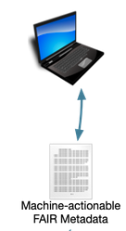

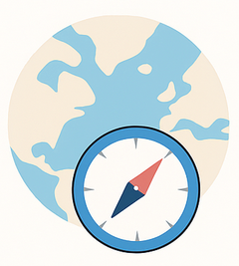

What is a FAIR Data Point?
(FAIR) Data
Not FDP
FAIR
Metadata
Interface
FAIR
Metadata about the FDP

Slide 17
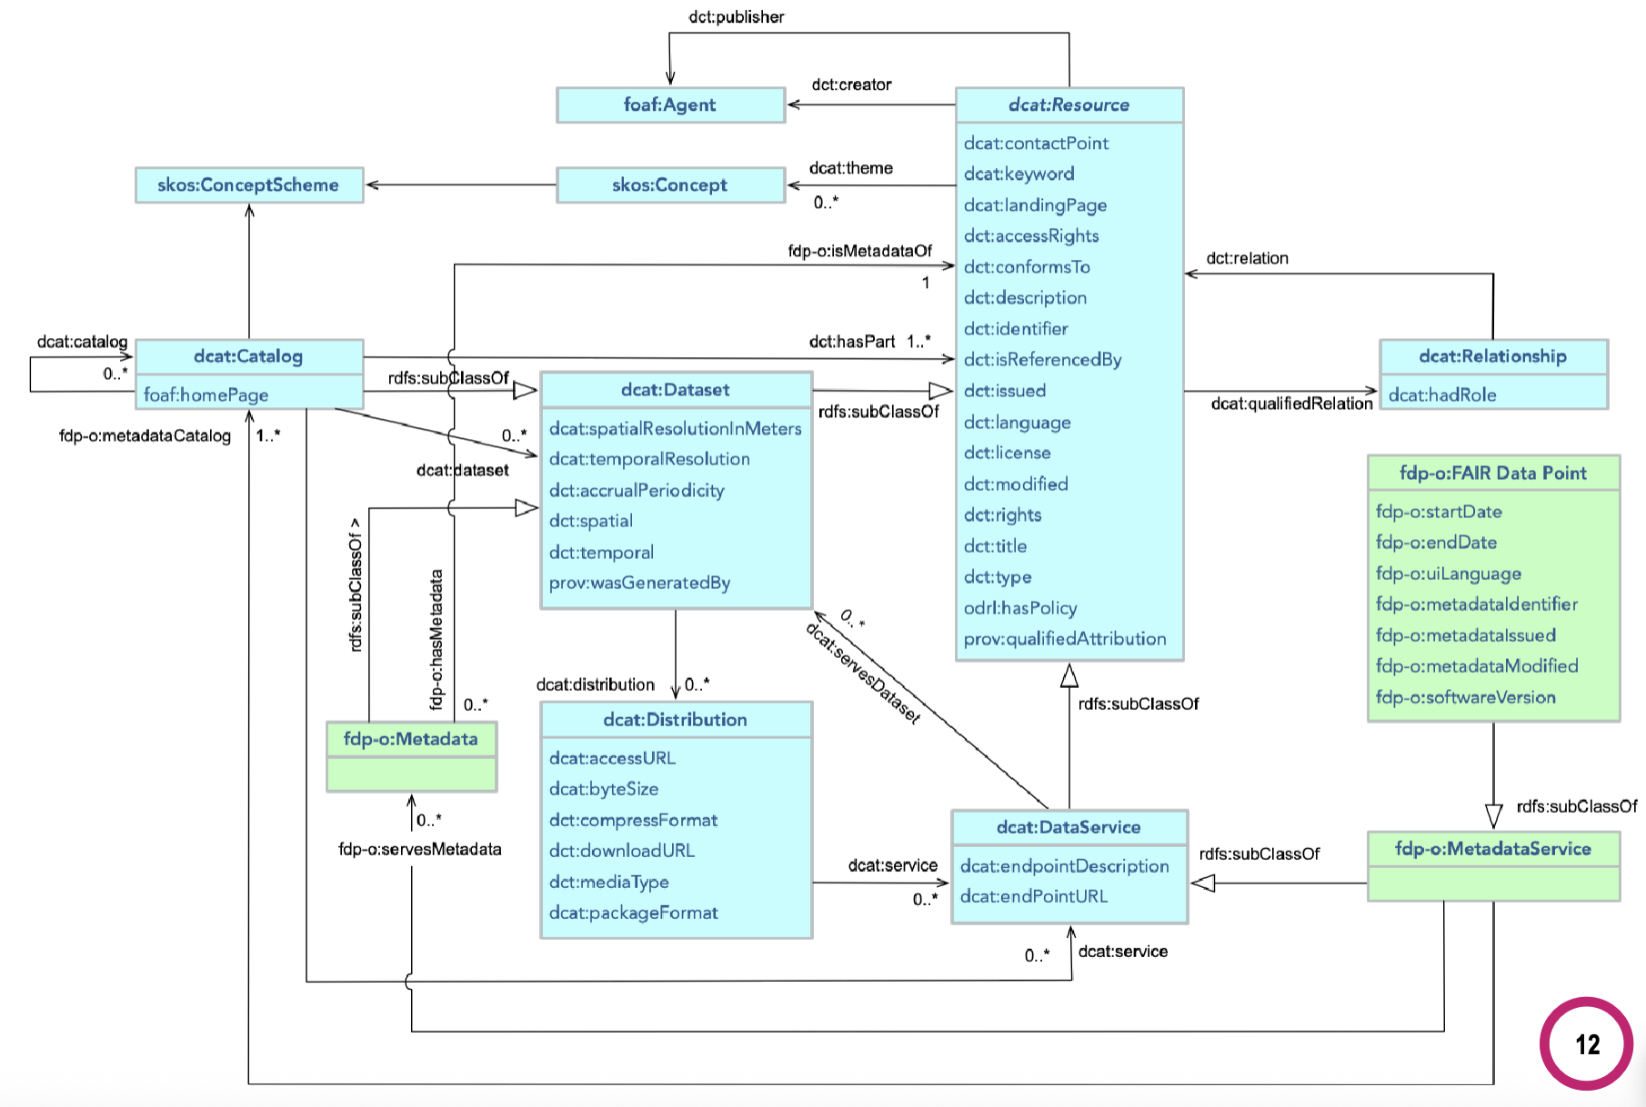
FDP Metadata Model (DCAT Based)

Slide 18
EJP RD Metadata Model (DCAT Based)

Slide 19
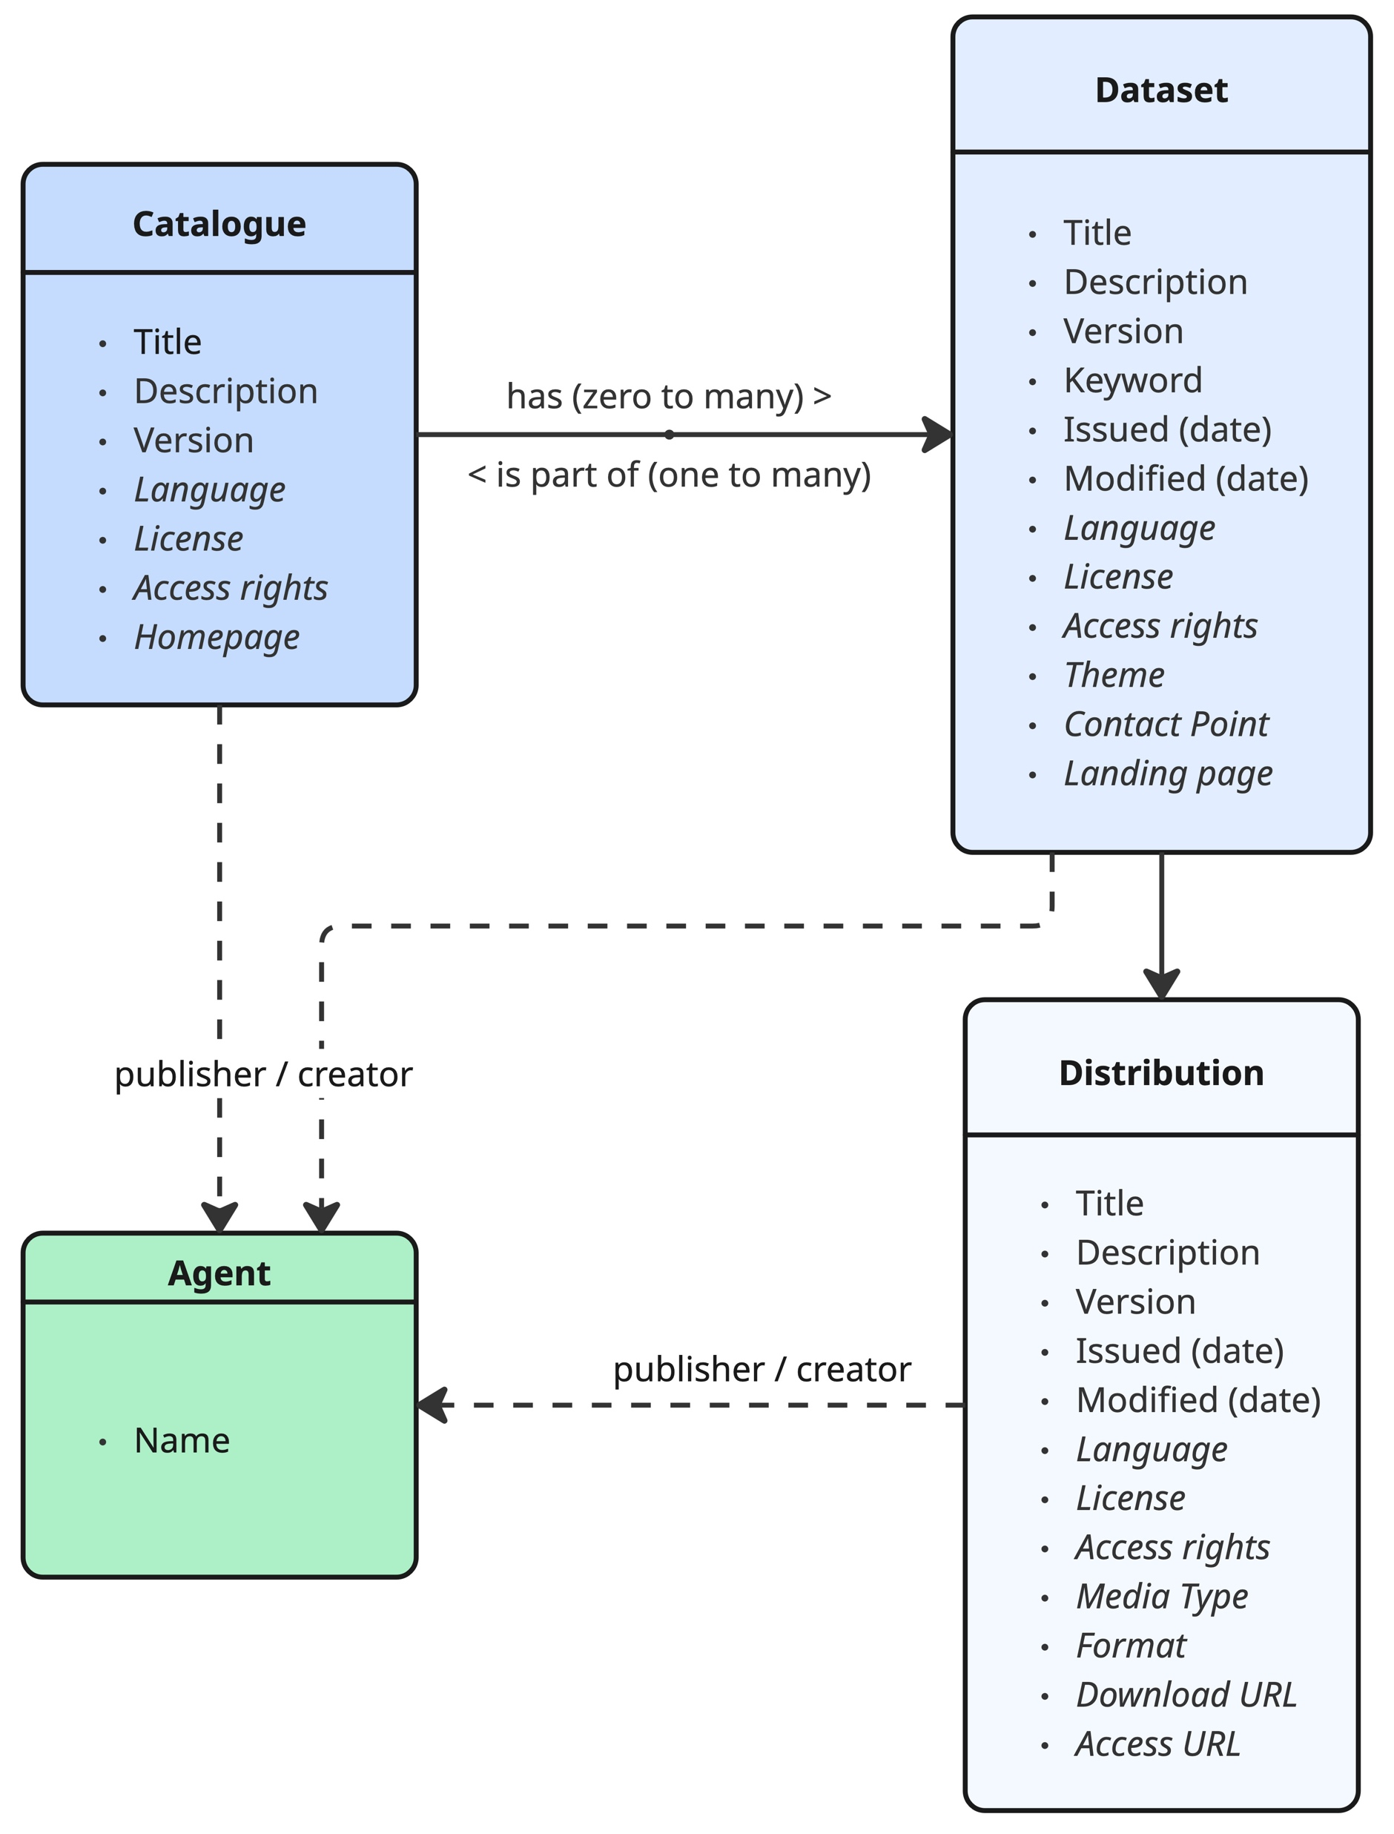

Slide 20
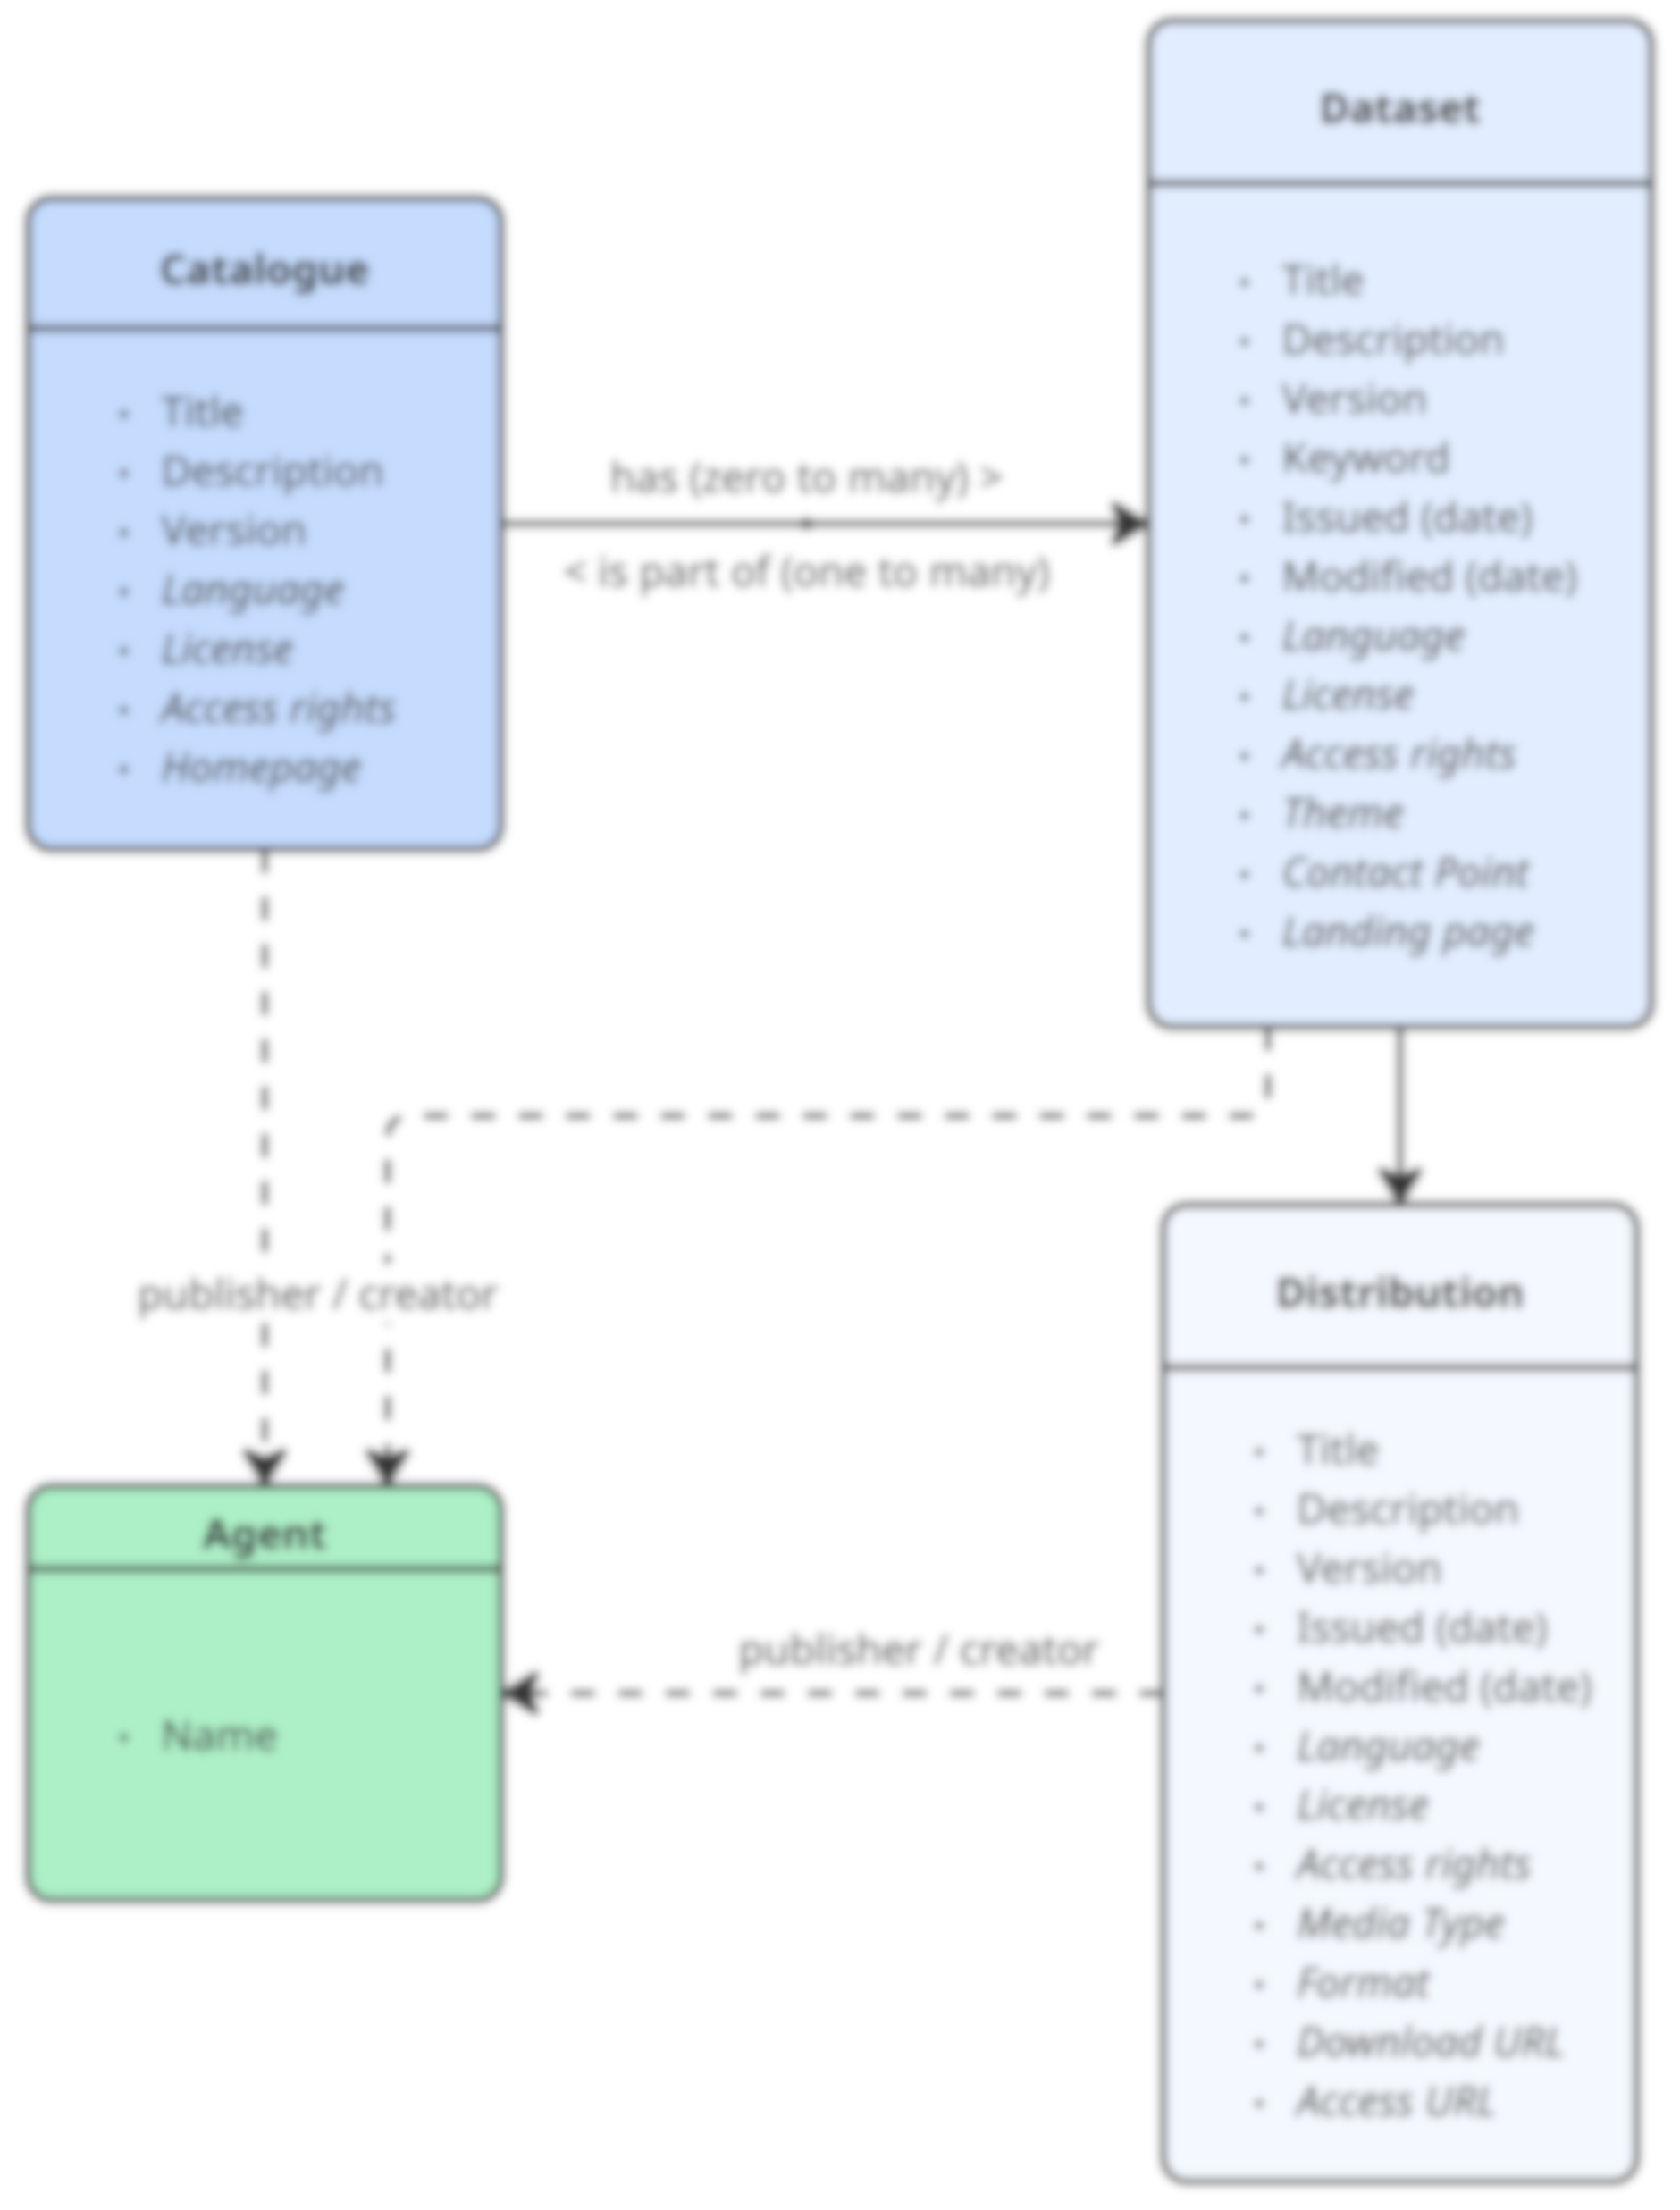

Slide 24
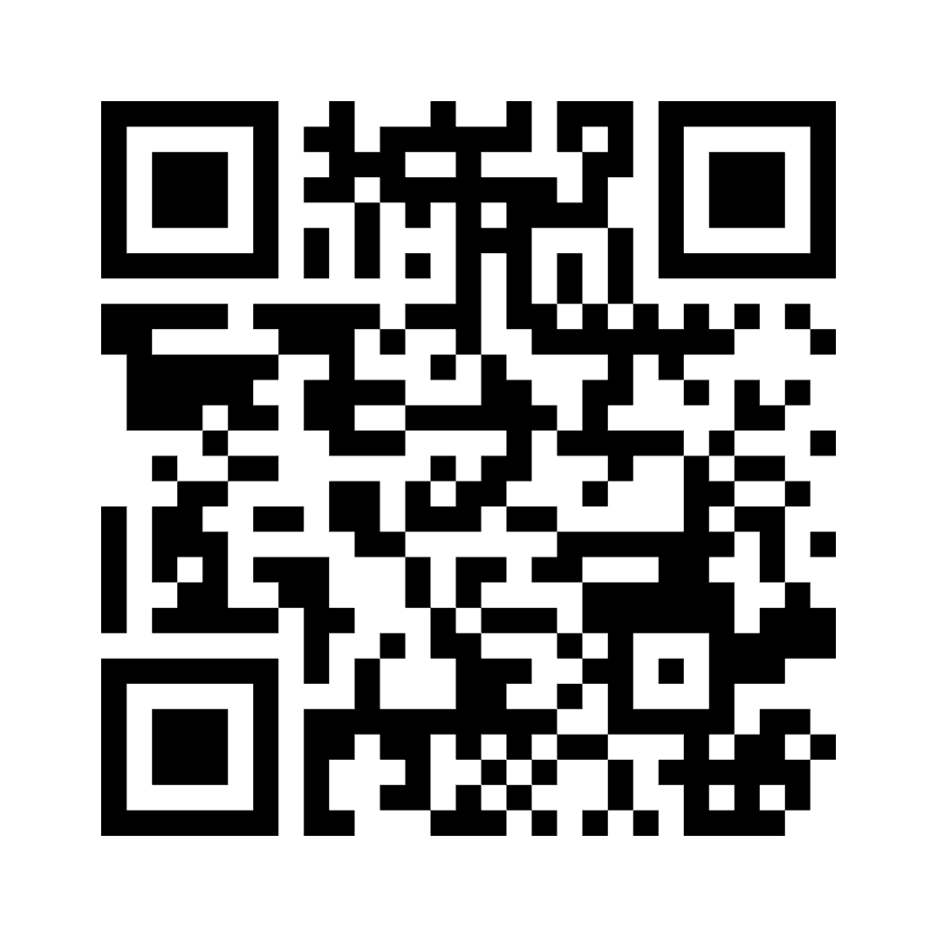

Quiz time!

Slide 25
Recommendations:
Property | Vocabulary
Language | EU Vocabularies Language Authority List
License | Creative Commons
Access rights | EU Vocabularies Access Rights Authority List
Home Page | URL
Theme | Check controlled vocabularies (e.g., OLS)
Media Type | EU Vocabularies File Type Authority List
Notes:
- Create a page in which they can get these links, can be a pdf on surdrive

Slide 26
https://fair-training.ithanet.eu/
Notes:
- Fill in FDP live

Slide 27
Conclusion
FDPs make datasets Findable without exposing sensitive data
  They expose human and machine-readable metadata
FDPs are building blocks for a FAIR, federated ecosystem
Please exercise regularly
You probably yawned (or fought really hard not to) during this presentation

