Slide 1
Design a F.A.I.R. Data Management Plan for a Research Project
FAIRification project management
Agenda:
Introduction: objective of this session (5’)
Groupwise: discuss challenges (10’)
Share results in Mentimeter (5’)
Minilecture on past experience and LUMC DCC & conclusions (10’)

Slide 2
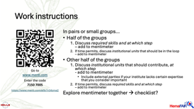
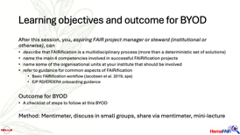
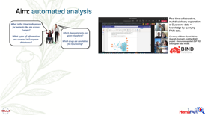

Slide 3
Introduction

Slide 4
Learning objectives and outcome for BYOD
After this session, you, aspiring FAIR project manager or steward (institutional or otherwise), can
describe that FAIRification is a multidisciplinary process (more than a deterministic set of solutions)
name the main 4 competencies involved in successful FAIRification projects
name some of the organisational units at your institute that should be involved
refer to guidance for common aspects of FAIRification
  Basic FAIRification workflow (Jacobsen et al. 2019, spe)
  EJP RD/ERDERA onboarding guidance
Outcome for BYOD
A checklist of steps to follow at this BYOD
Method: Mentimeter, discuss in small groups, share via mentimeter, mini-lecture

Slide 5

Basic FAIR workflow
What challenges do you see in managing a FAIRification project?
What steps may be missing from the basic FAIRification workflow?
Context: you are advising an organisation that will offer FAIRification support for a large institute, a country or region, or a large project.
Go to
www.menti.com
Enter the code
7150 7005
Question 1 only, for now!
https://www.menti.com/alfa1h34zma2

Slide 6
Work instructions
In pairs or small groups…
Half of the groups
  Discuss required skills and at which step
  – add to mentimeter
  If time permits, discuss institutional units that should be in the loop
  – add to mentimeter
Other half of the groups
  Discuss institutional units that should contribute, at which step
  - add to mentimeter
    Include external parties if your institute lacks certain expertise that you consider important
  If time permits, discuss required skills and at which step
  – add to mentimeter
Explore mentimeter together → checklist?
Go to
www.menti.com
Enter the code
7150 7005
https://www.menti.com/alfa1h34zma2

Slide 7
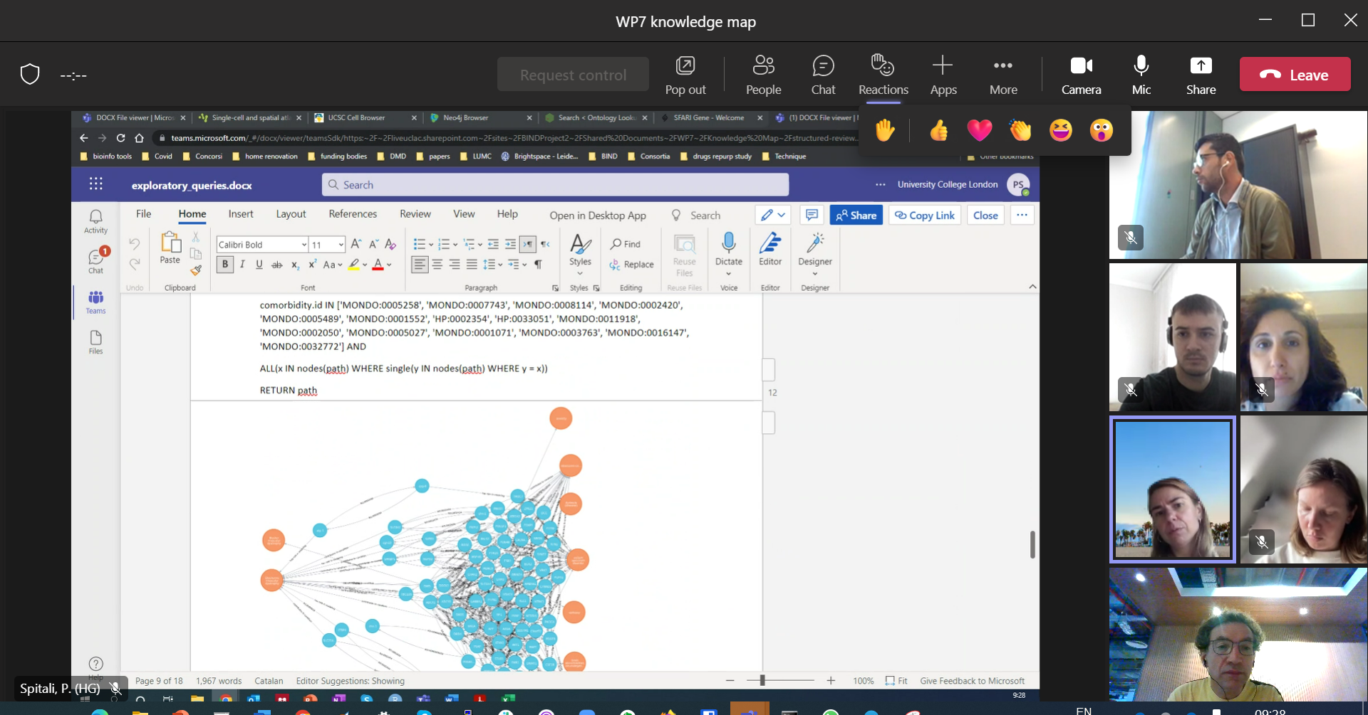

Aim: automated analysis
Real time collaborative, multidisciplinary exploration of Duchenne data + knowledge by querying FAIR data.
Courtesy of Pietro Spitali, Núria Queralt-Rosinach and the BIND project. Resources applied EJP RD ontological data model.
What is the time to diagnosis for patients like me across Europe?
-
What types of information are covered in European databases?
Which diagnostic tests are given elsewhere?
-
Which drugs are candidates for repurposing?

Slide 8
Aim: automated analysis via federated FAIR Data Ecosystems
Real time collaborative, multidisciplinary exploration of Duchenne data + knowledge by querying FAIR data.
Courtesy of Pietro Spitali, Núria Queralt-Rosinach and the BIND project. Resources applied EJP RD ontological data model.
What is the time to diagnosis for patients like me across Europe?
-
What types of information are covered in European databases?
Which diagnostic tests are given elsewhere?
-
Which drugs are candidates for repurposing?
Federated network of resources ready for analyses around the network by automated agents on behalf of bona fide reusers

Slide 9
Aim: automated analysis via federated FAIR Data Ecosystems
Real time collaborative, multidisciplinary exploration of Duchenne data + knowledge by querying FAIR data.
Courtesy of Pietro Spitali, Núria Queralt-Rosinach and the BIND project. Resources applied EJP RD ontological data model.
What is the time to diagnosis for patients like me across Europe?
-
What types of information are covered in European databases?
Which diagnostic tests are given elsewhere?
-
Which drugs are candidates for repurposing?
Federated networks of resources ready for analyses around the network by automated agents on behalf of bona fide reusers
  Interfaces for different stakeholders (non-technical, programmer, machine)
  Data inside interoperable with data inside other resources
  Exposed provide machine readable metadata to navigate the network

Slide 10

FAIRification
FAIR compliant resource
with FAIR data
Web User Interface
Application Programming Interface(s)
Machine understandable declaration of content and functions
Your data in original form
FAIRification
Your data in original form
Ontological Information about resource & access
Ontological model describing data elements

Slide 11
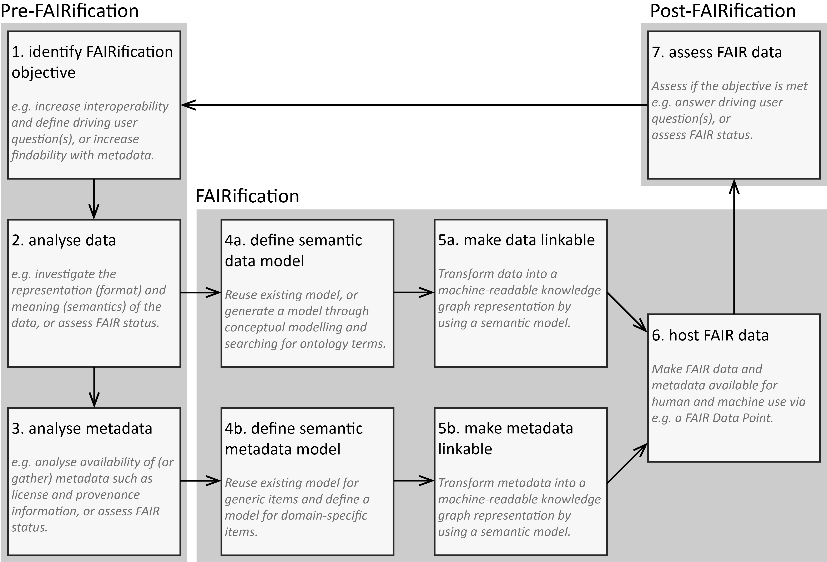
FAIRification
Generic workflow: Jacobsen et al. , 2019 (10.1162/dint_a_00028), specified by
Groenen and Jacobsen et al. 2021 (10.1186/s13023-021-02004-y),
Kersloot et al. 2021 (10.1016/j.jbi.2021.103897),
dos Santos Vieira, Bernabé, Zhang et al. 2022 (10.1186/s13023-022-02558-5),
Atalaia et al. 2024 (10.1186/s13023-024-03059-3),
Lalout et al., 2025 (under review)
Related references
GO FAIR 3-point framework, Schultes et al. 2021,
https://www.go-fair.org/how-to-go-fair/
FAIR cookbook, Welter et al. 2023 (10.1038/s41597-023-02167-2)
EJP RD onboarding guidelines:
https://vp-onboarding-doc.readthedocs.io/
ELIXIR Research Data Management toolkit:
https://rdmkit.elixir-europe.org/

Slide 12
FAIRification
0: Planning, prioritisation, organisational embedding
8: Building Institutional Infrastructure, Capacity building
Generic workflow: Jacobsen et al. , 2019 (10.1162/dint_a_00028), specified by
Groenen and Jacobsen et al. 2021 (10.1186/s13023-021-02004-y),
Kersloot et al. 2021 (10.1016/j.jbi.2021.103897),
dos Santos Vieira, Bernabé, Zhang et al. 2022 (10.1186/s13023-022-02558-5),
Atalaia et al. 2024 (10.1186/s13023-024-03059-3),
Lalout et al., 2025 (under review)
Related references
GO FAIR 3-point framework, Schultes et al. 2021,
https://www.go-fair.org/how-to-go-fair/
FAIR cookbook, Welter et al. 2023 (10.1038/s41597-023-02167-2)
EJP RD onboarding guidelines:
https://vp-onboarding-doc.readthedocs.io/
ELIXIR Research Data Management toolkit:
https://rdmkit.elixir-europe.org/

Slide 13
Minimal constitution of a FAIRification team
Software manager
(FAIR) project manager
FAIRification expert
(embedded in FAIR group, or trained by FAIR experts)
Data manager

Slide 14


Minimal constitution of a FAIRification team – cost for about 10 new data elements
20K €
5K €
Software manager
(FAIR) project manager
FAIRification expert
(embedded in FAIR group, or trained by FAIR experts)
Data manager
20K €
20K €
Rule of thumb:
20K per role (~2-3PM) * complexity of data sets; domain can be in kind
F: relatively low effort, unfamiliarity can cause delays (NB F ‘for humans’ ≠ FAIR)
A, R: time consuming, moderate effort (difficult to predict, min. 3 months)
I: heavy effort, largest benefit, time can be scoped (“80% of effort, 80% of gain”)

Slide 15
Minimal constitution of a FAIRification team
Software manager
(FAIR) project manager
Software developers ‘at hand’
FAIRification expert
(embedded in FAIR group, or trained by FAIR experts)
Data manager
FAIR experts ‘at hand’
(e.g. ontology data modellers, data/software engineers, ELSI experts)
Domain experts ‘at hand’
(e.g. PIs, clinicians, researchers)

Slide 16
FAIRification team organisation
Data producing/collecting group publishing data for reuse
Data stewardship service provider
Software manager
FAIRification project manager
Software developers ‘at hand’
FAIRification expert
(embedded in FAIR group, or trained by FAIR experts)
Data manager
FAIR experts ‘at hand’
(e.g. ontology modellers, data & software engineers, ELSI experts)
Domain experts ‘at hand’
(e.g. PIs, clinicians, researchers)
Knowledge transfer

Slide 17
LUMC FAIR organisation
Building the LUMC Data Competence Centre
(work in progress)

Slide 18
LUMC Data Competency Centre
(founders)
LUMC Data Competence
Centre (DCC)
Database support group
(Advanced Data Management group)
FAIR research group (Biosemantics group)
Research Policy group (Directorate Research)
IT department
(IT and Digital Innovation department)

Slide 19
LUMC Data Competency Centre - extended
LUMC Data Competence Centre (DCC)
Database support (Advanced Data Management group)
FAIR research (Biosemantics group)
Research Policy (Directorate Research)
IT
(IT and Digital Innovation department)
Genomics support
(SASC)
FAIR research software (Proteomics group)
Pathology support group
Public Health DCC

Slide 20

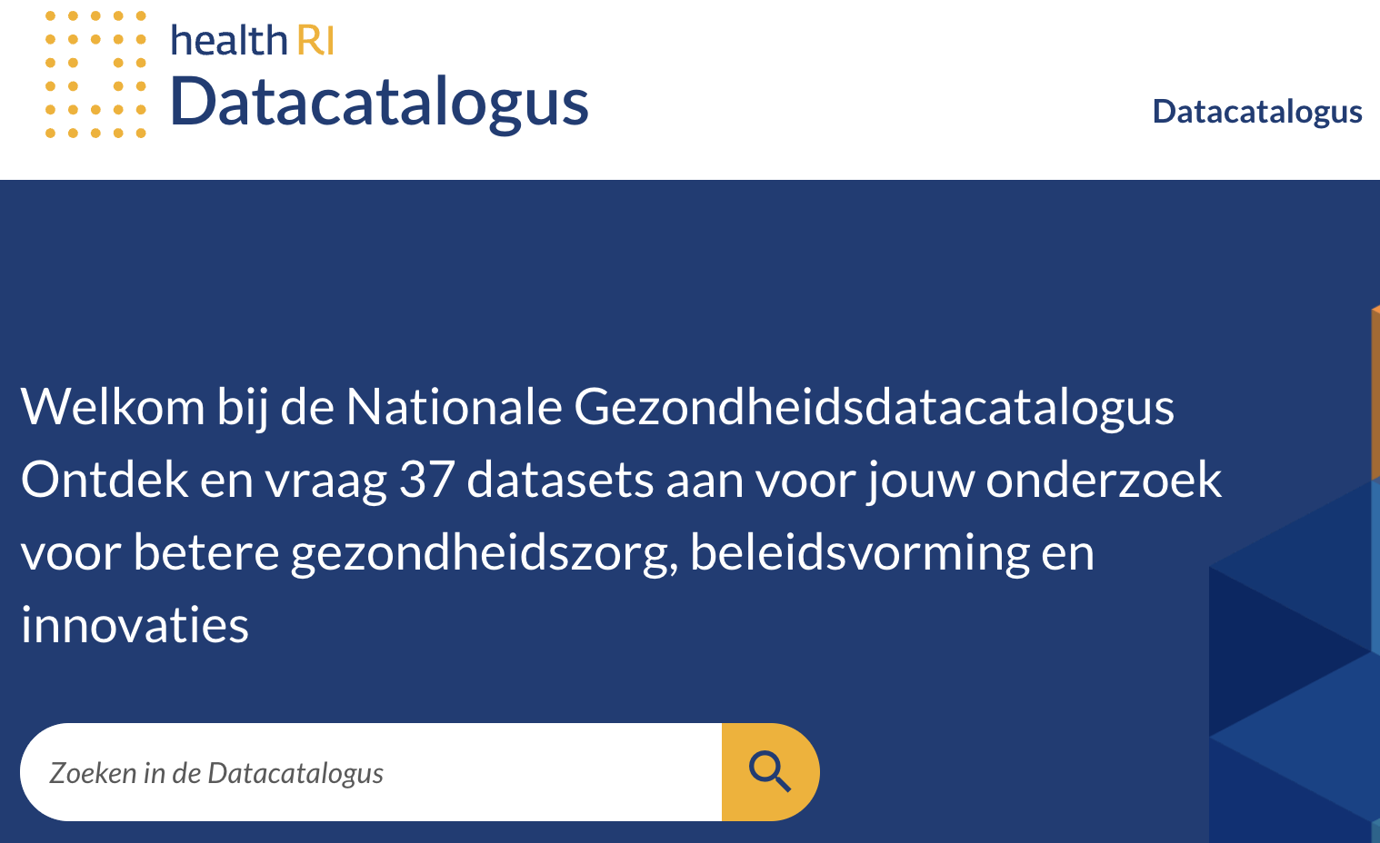
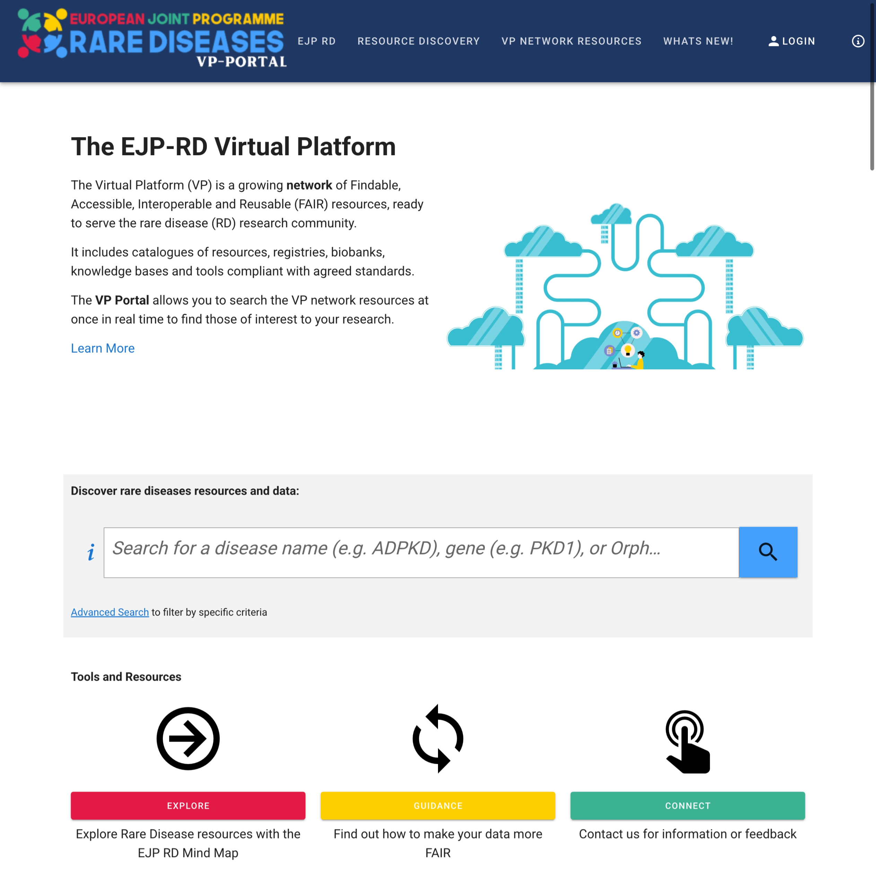
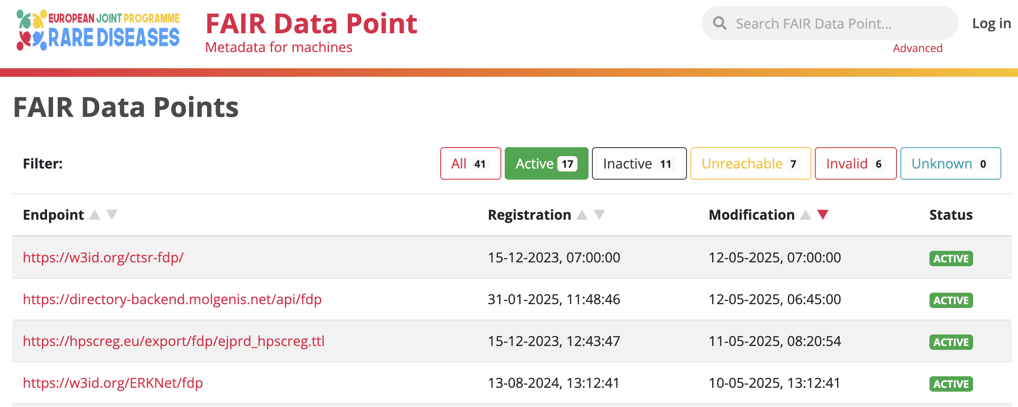
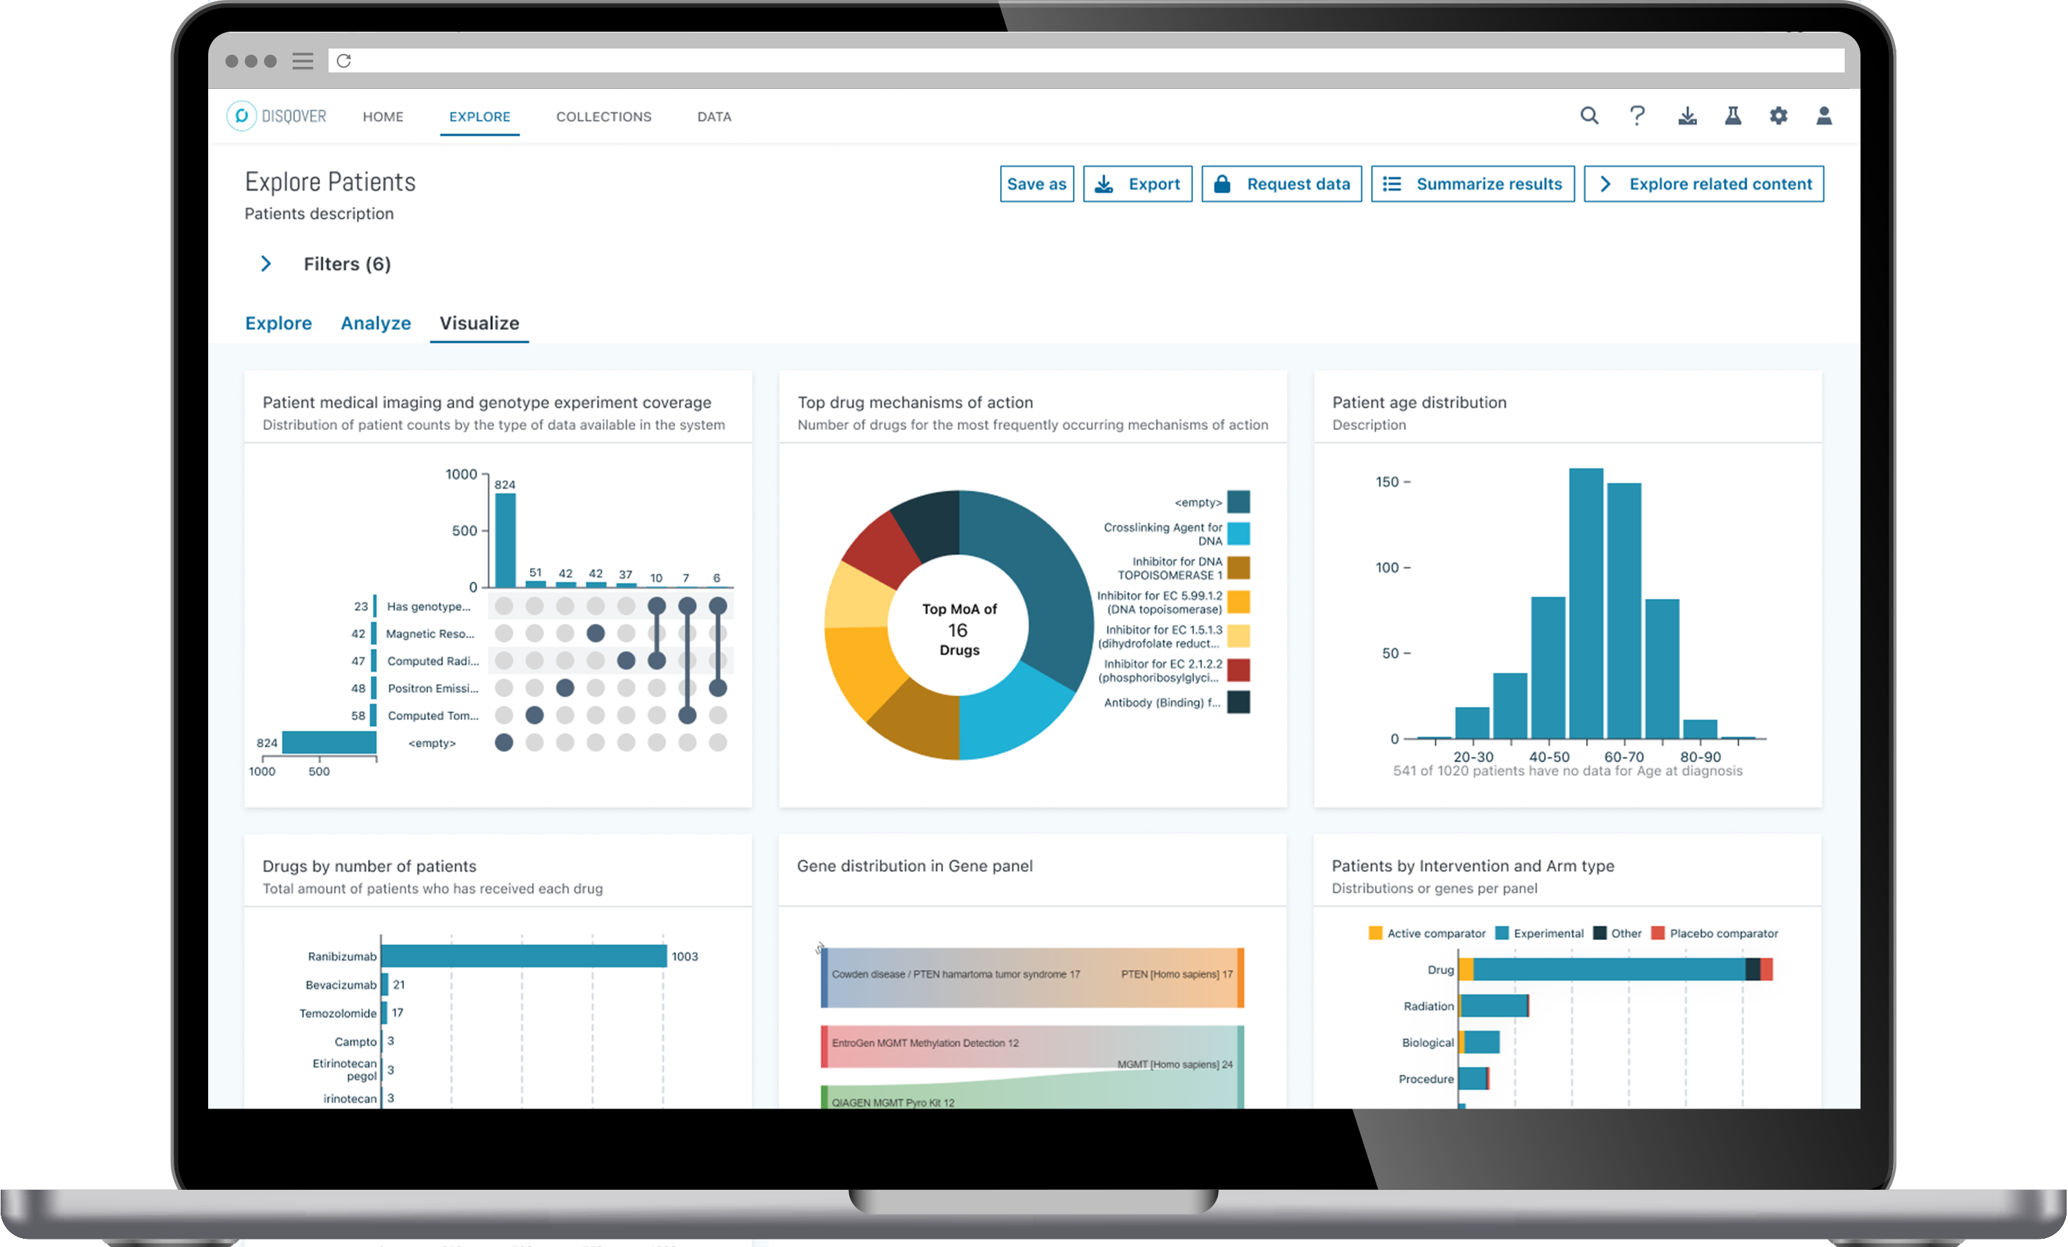

Focus of DCC: FAIR metadata management
Dataset in Clinical Data Platform
IT&DI
FAIRification
Publish machine actionable metadata conform agreed standards for machines
Health RI National data portal
LCCO
Dataset in cBioPortal
Rare Disease Data Hub & Virtual Platform
Dataset in Castor
Dataset in OPAL
ADM
FAIR data point
Metadata Navigator for machines
Disqover
Navigator for humans
ENDO & BOND registries
DCC-central
Clinical Genetics Genome & Clinical Data sets for EJP RD use case
Testing commercial software
HG&CG
Focus of DCC as service hub:
FAIR metadata management
BIND Knowledge base
LUMC-curated FAIR LOVD instances
Knowledge graph applications
Biosemantics group
PHEG
GP Dataset in ELAN
Databases for ontologised data & knowledge graphs
LUMC departments manage many databases

Slide 21
Focus of DCC: FAIR metadata management
Dataset in Clinical Data Platform
IT&DI
FAIRification
Publish machine actionable metadata conform agreed standards for machines
Health RI National data portal
LCCO
Dataset in cBioPortal
Rare Disease Data Hub & Virtual Platform
Dataset in Castor
Dataset in OPAL
ADM
FAIR data point
Metadata Navigator for machines
Disqover
Navigator for humans
ENDO & BOND registries
DCC-central
Clinical Genetics Genome & Clinical Data sets for EJP RD use case
Testing commercial software
HG&CG
BIND Knowledge base
LUMC-curated FAIR LOVD instances
Knowledge graph applications
Biosemantics group
PHEG
GP Dataset in ELAN
Databases for ontologised data & knowledge graphs
LUMC departments manage many databases

Slide 22
CONCLUSIONS
FAIRification is a multidisciplinary process
  Minimal competencies: FAIRification steward, Domain Data Steward, Software steward, Project Manager.
  Each steward maintains links with experts in their field.
FAIRifcation at an institute
  Requires groups that minimally cover FAIR implementation, Data management, IT, Policy.
  At LUMC: Biosemantics group, Advanced Data Mangement, IT&DI department, Directorate Research.
Jacobsen et al. 2019 provides a generic FAIRIfication workflow as a backbone for FAIRification
  Each project specifies this workflow
  The EJP RD provides practical onboarding guidance.
Outcome for BYOD
Identified skills and the generic steps of FAIRification
Can be used as a reference during the next sessions of the BYOD and future FAIRification.

