Slide 1
FAIR Principles Training School
Larnaca, Cyprus
12–14 May 2025

Slide 2
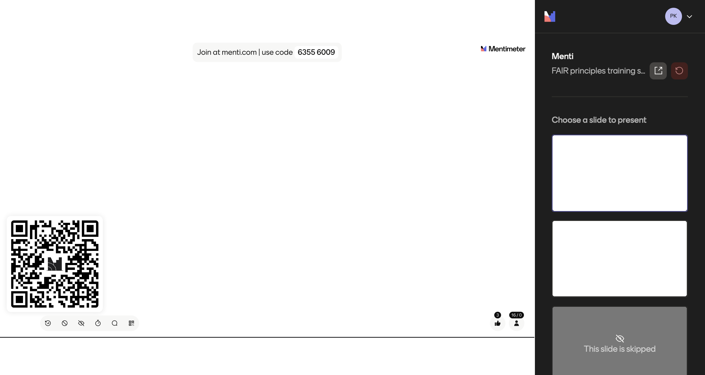

Slide 3

Some logistics…

Slide 4


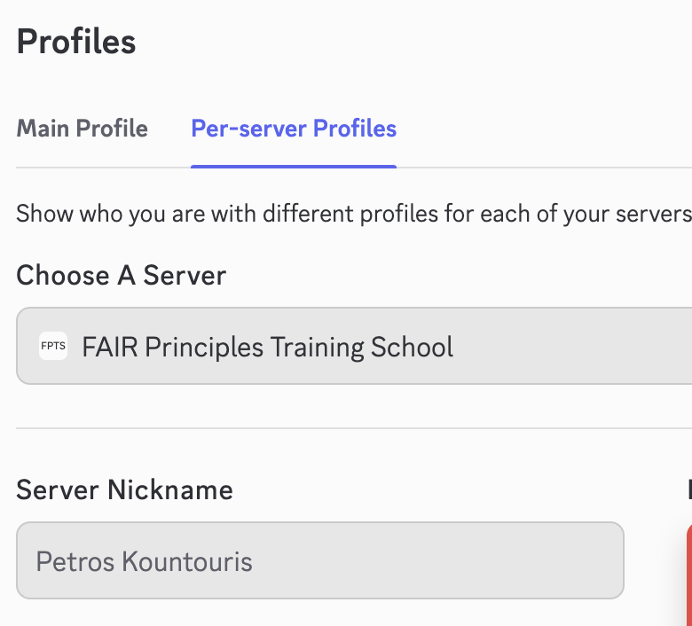
Discord server for collaboration
A Discord server for collaboration during/after the training school was created
Please join via: https://discord.gg/B3kaqfPe
Change your per-server nickname to your first/full name, so that we can identify the person we are discussing with.

Slide 5
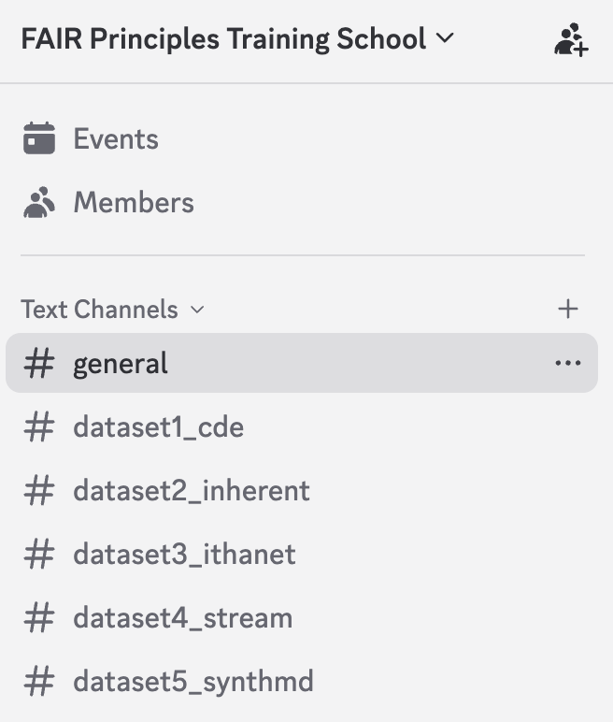
Discord server for collaboration
All training school material will be posted on the Discord server:
  Communication about the school and its schedule
  Datasets
  Links to tools presented during the lectures
  Q&A
  Social activities

Slide 6
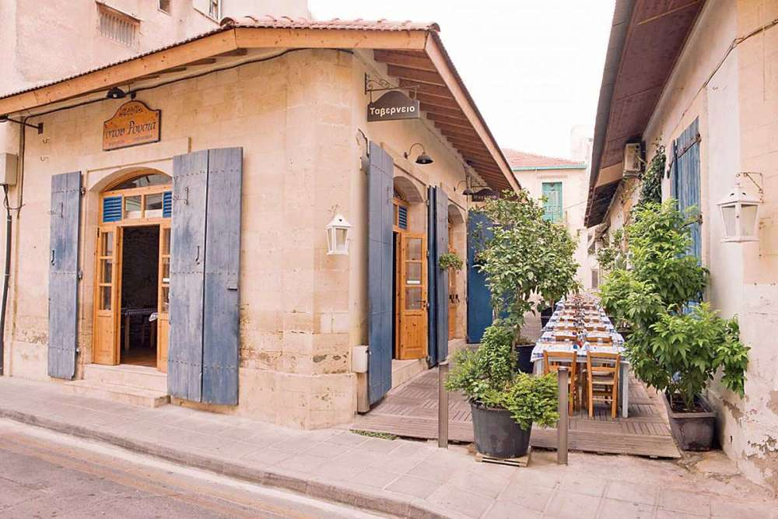
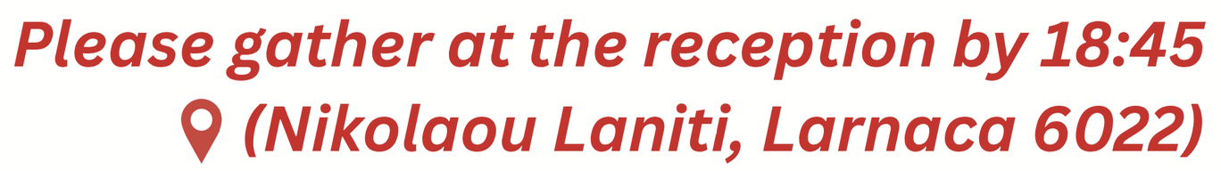
Speaking of social activities… the dinner
Group dinner on 13th May at 7:00 PM at "Stou Rousha" restaurant

Slide 7
Spread the word
Share on Social Media
Use hashtags: #FAIRtraining #HELIOS #HemaFAIR
Tag HELIOS and HemaFAIR in your post
LinkedIn: HELIOS ACTION, HemaFAIR
Twitter: @HELIOSACTION, @hemafair
Facebook
Instagram
Tag the COST Association

Slide 8
Introduction to HELIOS and HemaFAIR

Slide 9

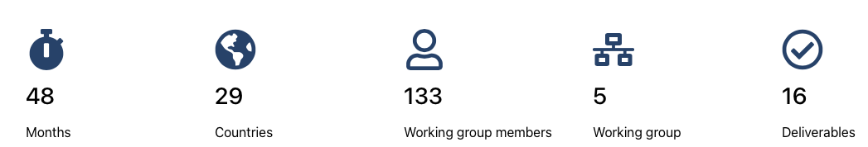
HELIOS COST Action CA22119 – Haemoglobinopathies in European Liaison of Medicine and Science
34
225

Slide 10
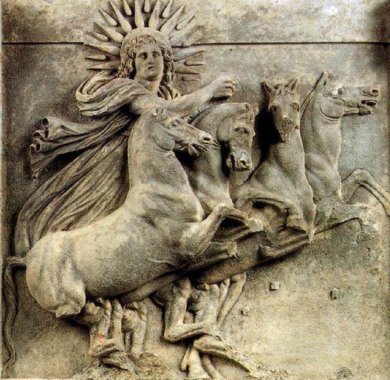
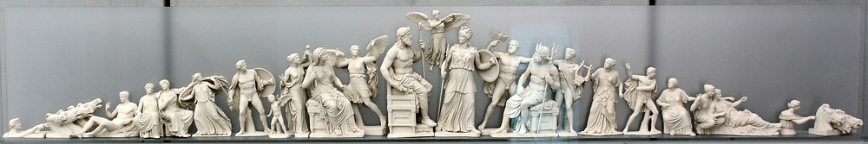
Haemoglobinopathies in European Liaison of Medicine and Science (HELIOS)
HELIOS (hee·lee·os)
Notes:
The east pediment portrayed the miraculous birth of Athena from the head of her father Zeus. The scene takes place on Mt Olympus in the presence of the other gods who watch standing, sitting or half-reclining. The pediments' corners contained the chariots of Helios (Sun), which emerges from the sea, and Selene (Moon), which sinks in the ocean waves, indicating thus that the goddess' birth takes place at dawn. The centre of the scene was occupied by the statues of Zeus and Athena. Due to the misadventures suffered by the Parthenon over the following centuries, many of the temple's sculptures have been destroyed; some survive in mutilated form, while others are represented only by small fragments.

Slide 11
Duration: 4 years (20 September 2023 – 19 September 2027)
Geographical coverage: worldwide
COST member countries
Near Neighbour Countries (NNCs)
International Partners Countries (IPCs)
Funding: Networking and training activities
Eligibility for funding depends on the country status
Meetings, workshops, training schools, short term scientific missions, publications, dissemination activities, etc.
Funded by: COST Association

Slide 12
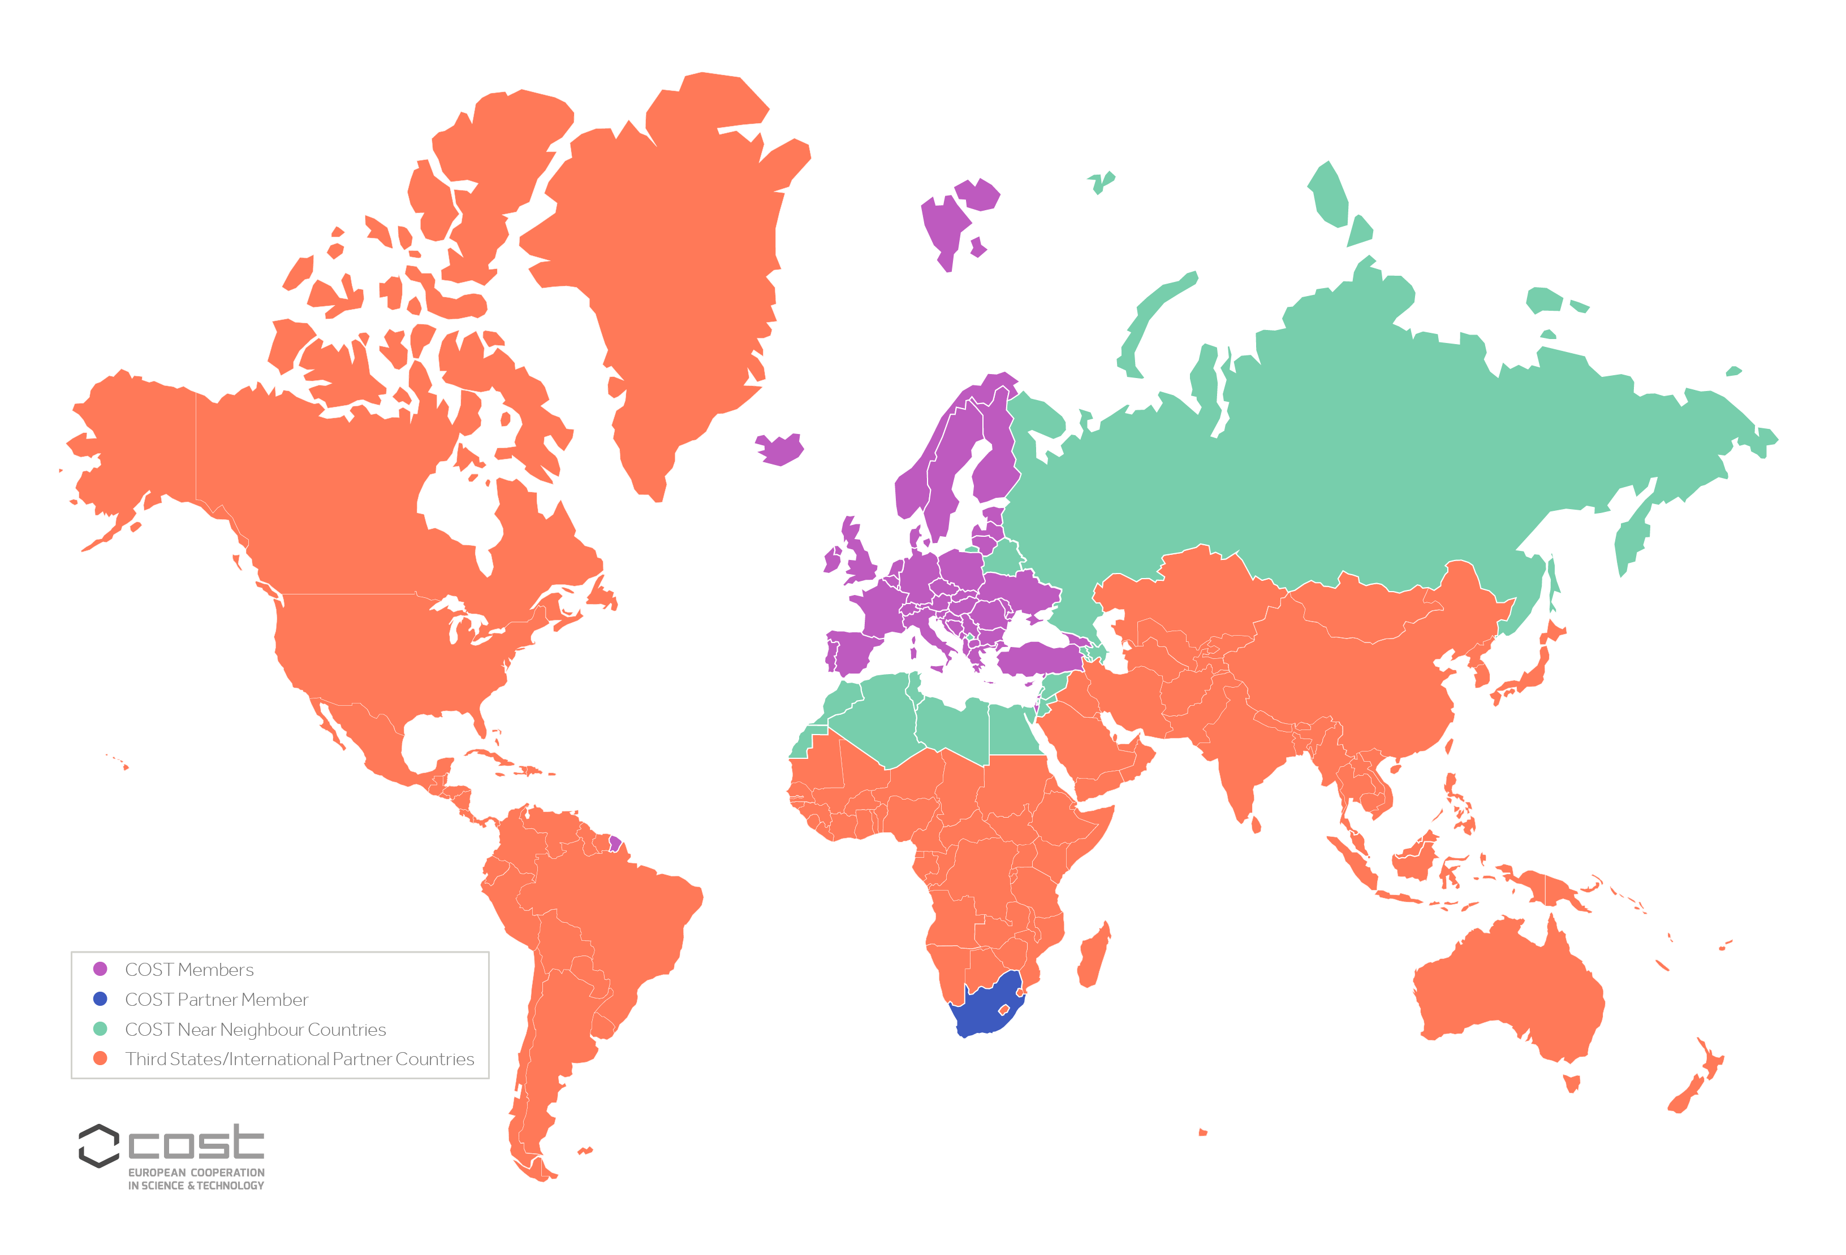

Slide 13

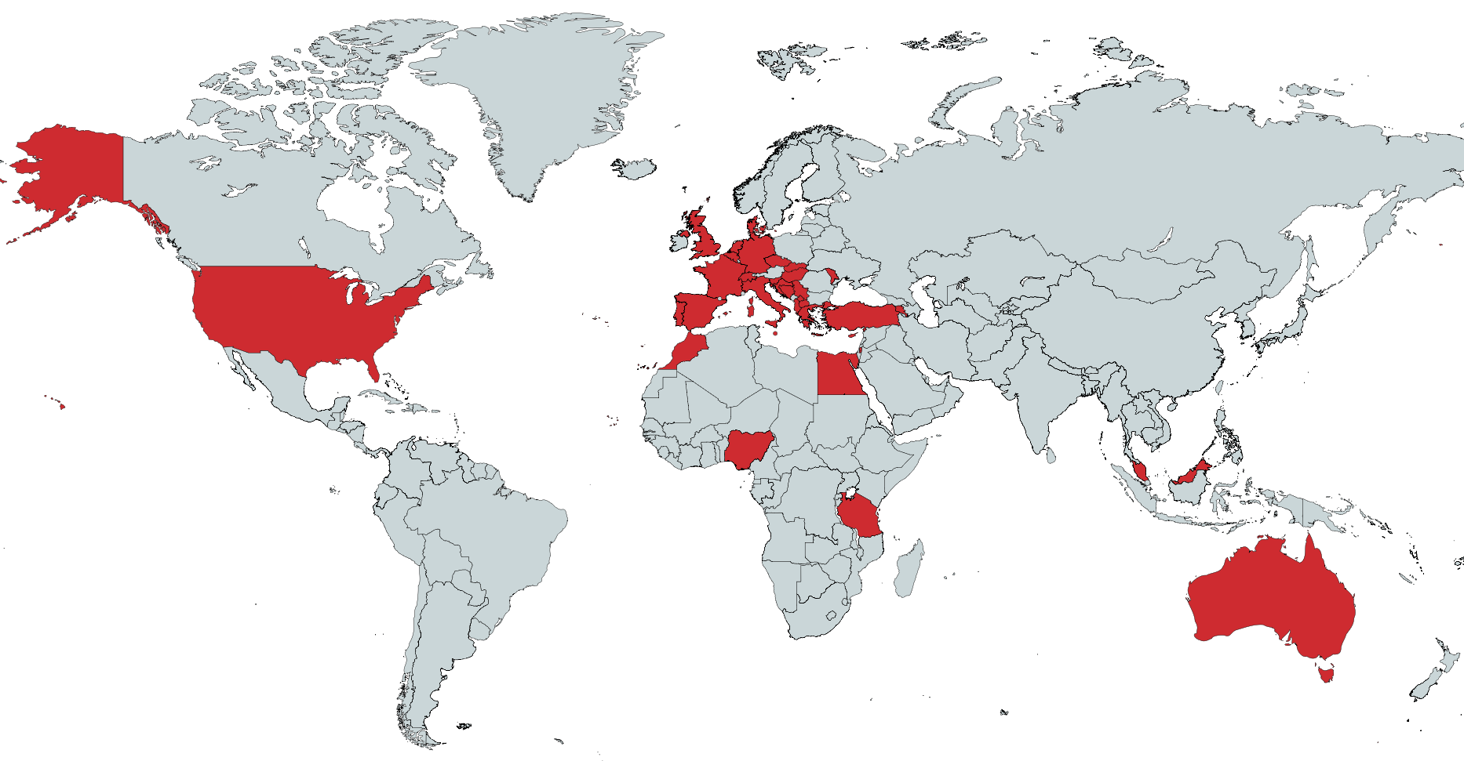






HELIOS COST Action CA22119
Membership
More than 225 members from 34 countries
WG1
128
WG2
113
WG3
114
WG4
127
WG5
90

Slide 14

















Europe (mainly)
International

Slide 15
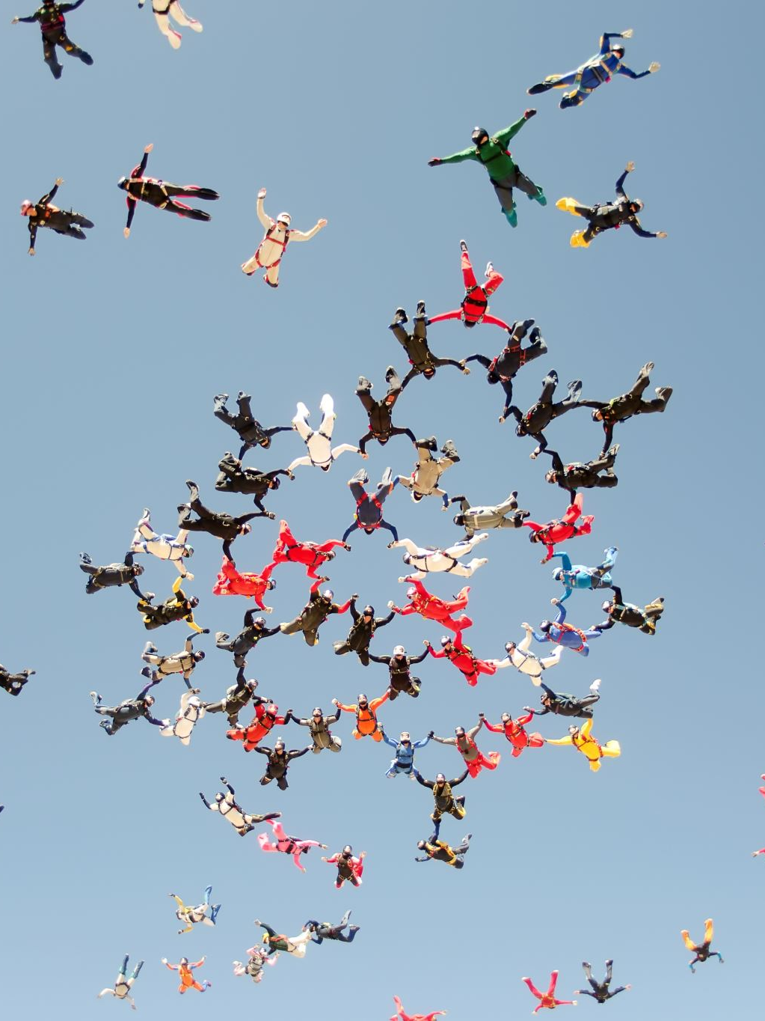
Action challenge
To facilitate the integration of national and international research activities, providing an ideal environment to pursue long-term multi-disciplinary research.
Standardisation and harmonisation of procedures and protocols within Europe and other participating countries
Generation of standardised FAIR datasets to advance research in the field
Investigation and review of the current and potential utilisation of new and emerging therapies and treatments
Stronger interaction between all stakeholders involved in haemoglobinopathies.

Slide 16
HELIOS objectives
Research Coordination objectives
To identify needs and harmonise procedures and protocols related to different aspects of haemoglobinopathies in Europe and beyond.
To promote multi-centre, data-driven research in haemoglobinopathies.
To monitor the current implementation and review the potential use of new and emerging therapies and treatments.
To disseminate knowledge to the scientific community, patient advocacy groups, policy makers, and the public.
Capacity Building objectives
To promote participation of young researchers/innovators, women and researchers from inclusiveness target countries in the network and in leadership roles of the Action.
To promote the use of new technologies in diagnosis and research
To develop a European training programme for haemoglobinopathies
To strengthen interaction and dialogue between cross-sectoral groups

Slide 17
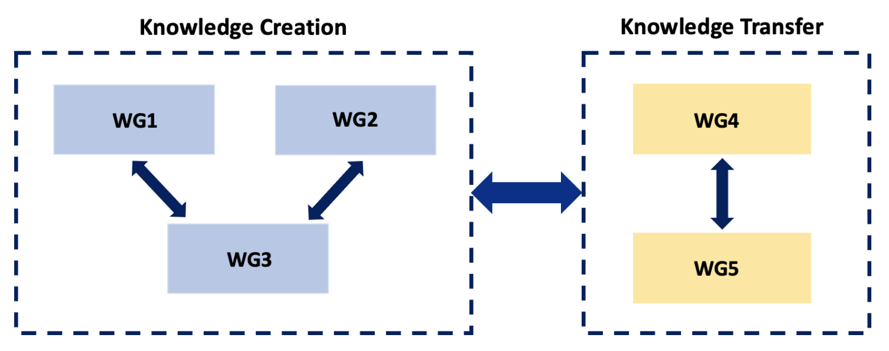
HELIOS Working Groups
WG1: Molecular research and diagnosis
WG2: Clinical research and patient management
WG3: Data management, sharing, and analysis
WG4: Education, training, and capacity building
WG5: Dissemination and outreach

Slide 18





HELIOS COST Action CA22119
Funding opportunities
Short-Term Scientific Missions Grants
Dissemination Conference
Grants
Virtual Mobility Grants
Inclusiveness Target Countries Grants
Young Researchers & Innovators Grants
Up to 4000 EUR
Up to 1500 EUR
Up to 2500/500 EUR
Up to 2500/500 EUR
Up to 1250/500 EUR
7 STSMs Granted
11,800 EUR
5 VM Granted
7,000 EUR
4 ITC Granted
5,000 EUR
4 YRI Granted
6,600 EUR
1 DC Granted
1,250 EUR

Slide 19

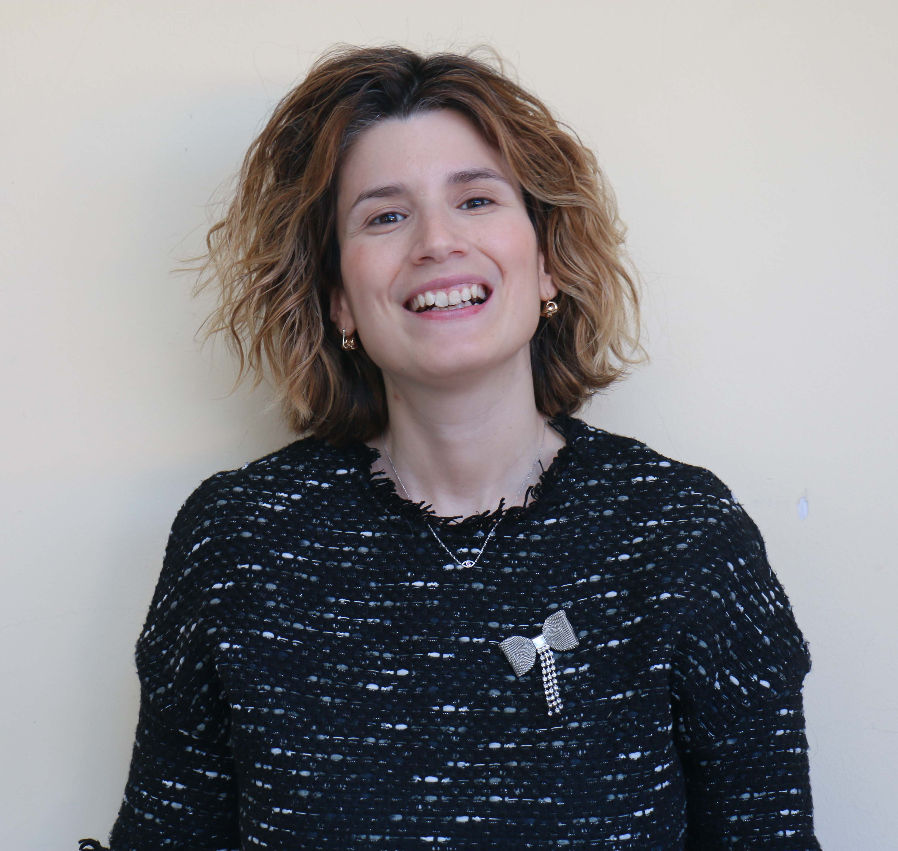
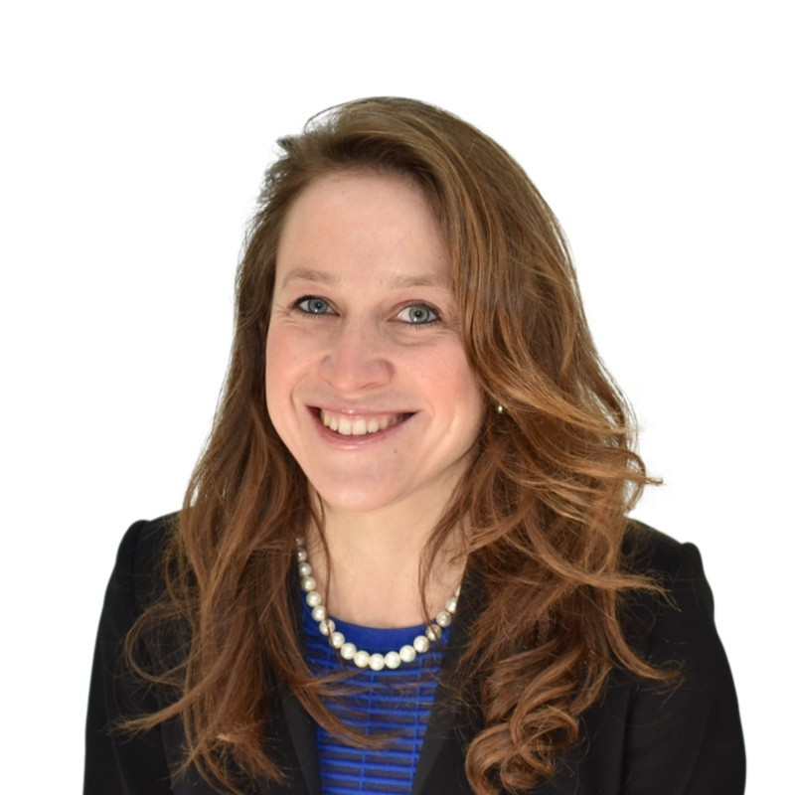
HELIOS COST Action CA22119
Training opportunities
Monthly Discussion Club
Young Researchers and Innovators of the HELIOS network have the opportunity once a month to present their work, ideas, and challenges to the network.
Organized by Dr Eleni Gavriilaki
Invited speaker series
Talks by a diverse range of experts to our monthly speaker series to talk about their recent publication on novel insights into the diagnosis, care, guidelines and economics of haemoglobinopathies.
Organised by Ms. Stephanie Muth

Slide 20
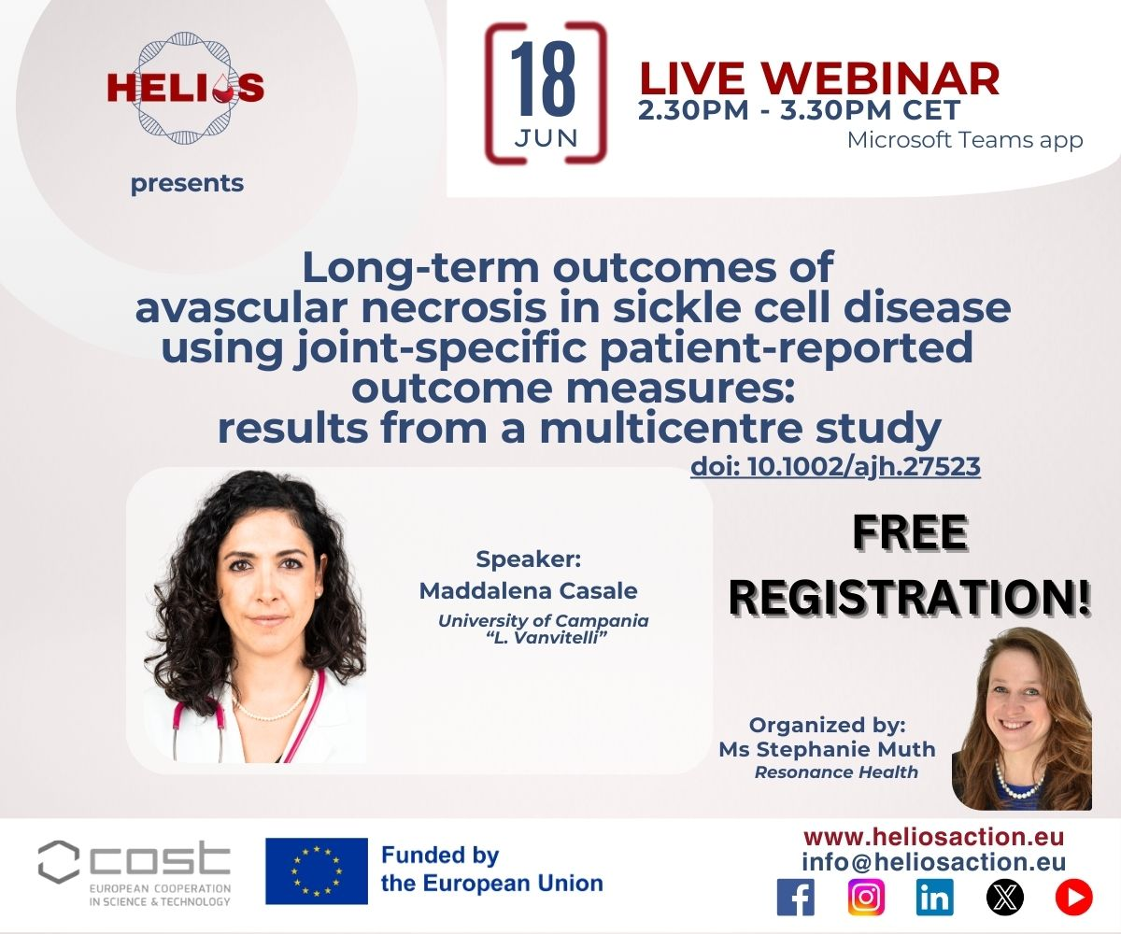
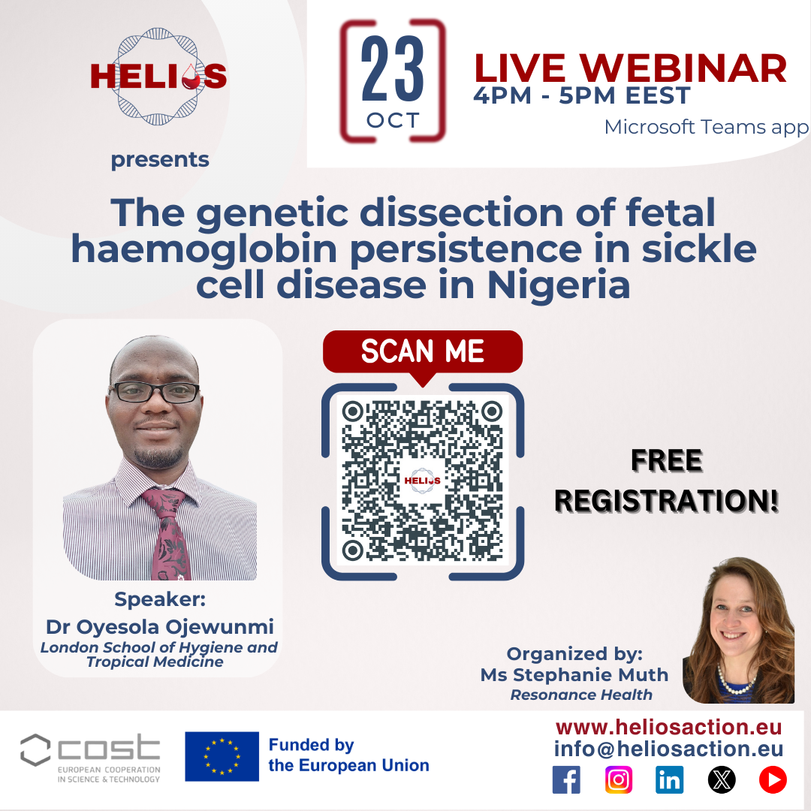
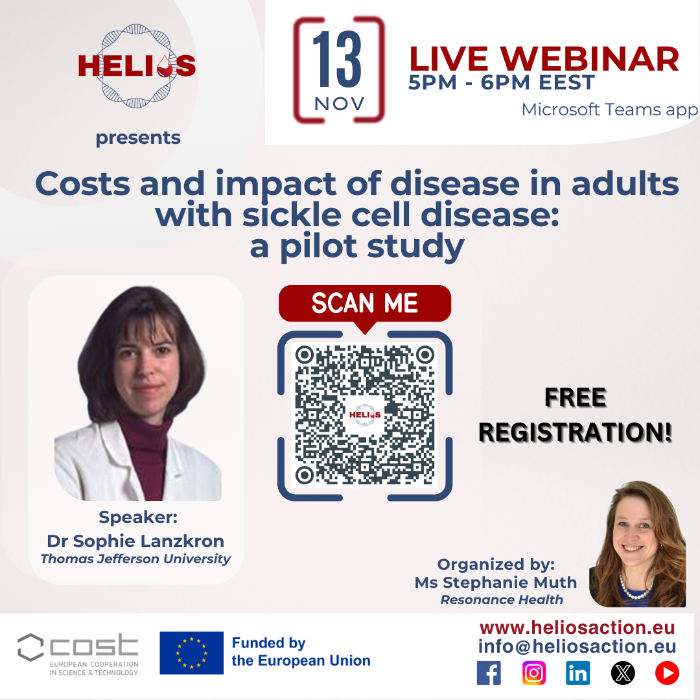
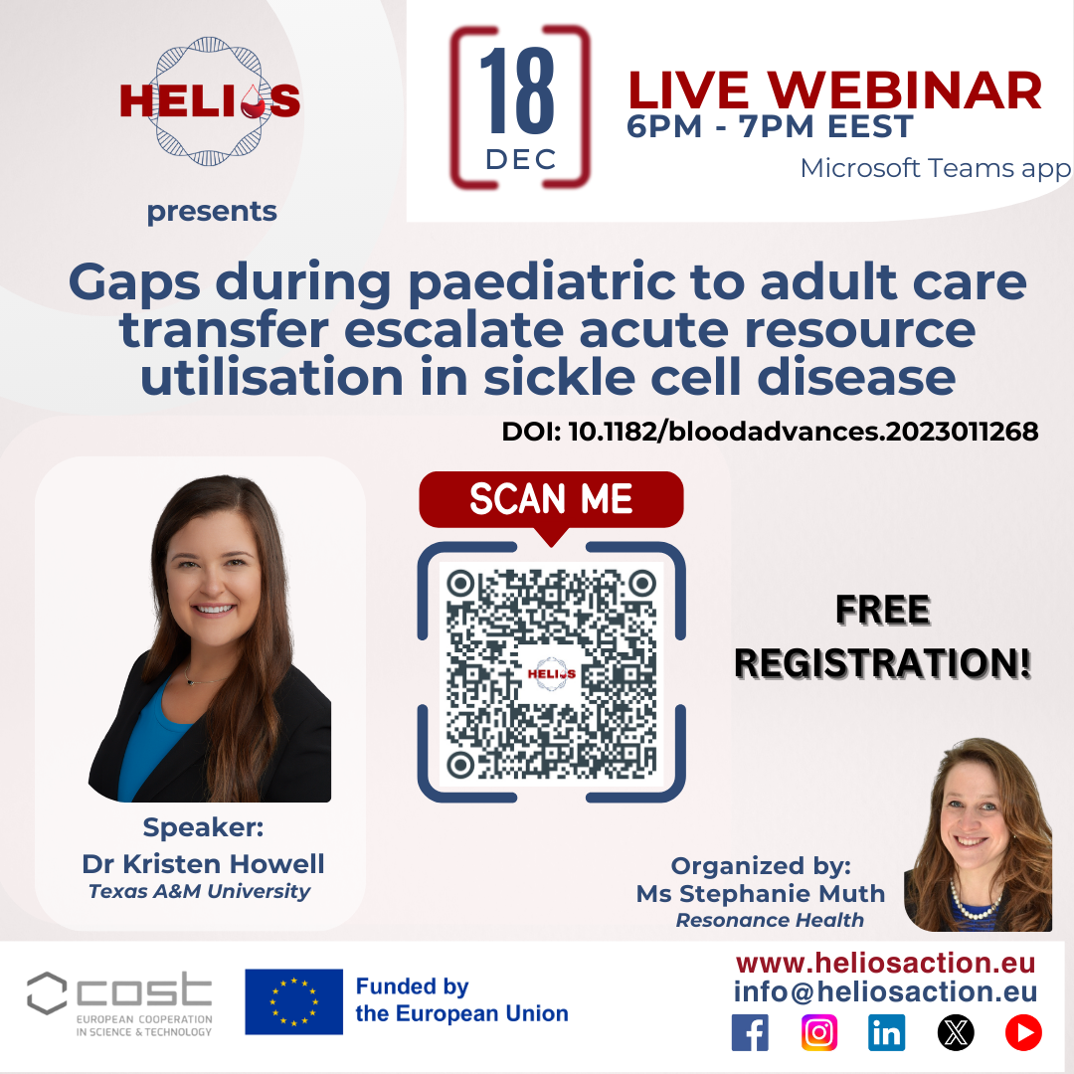
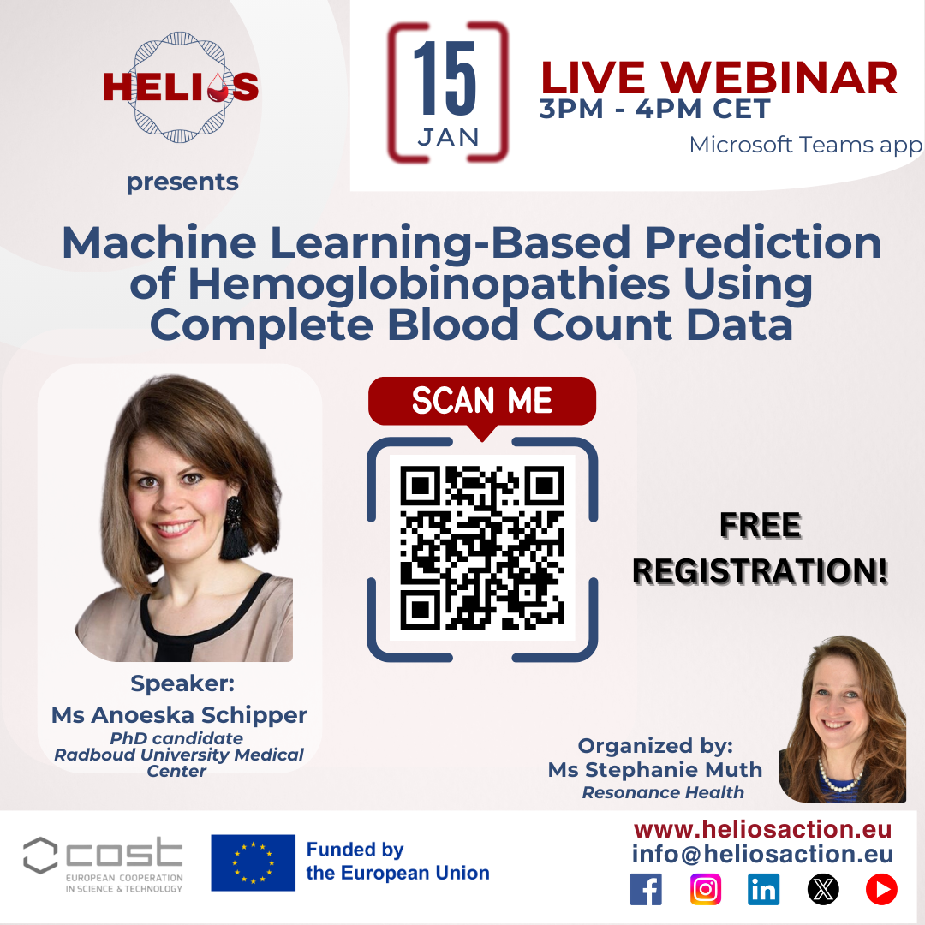
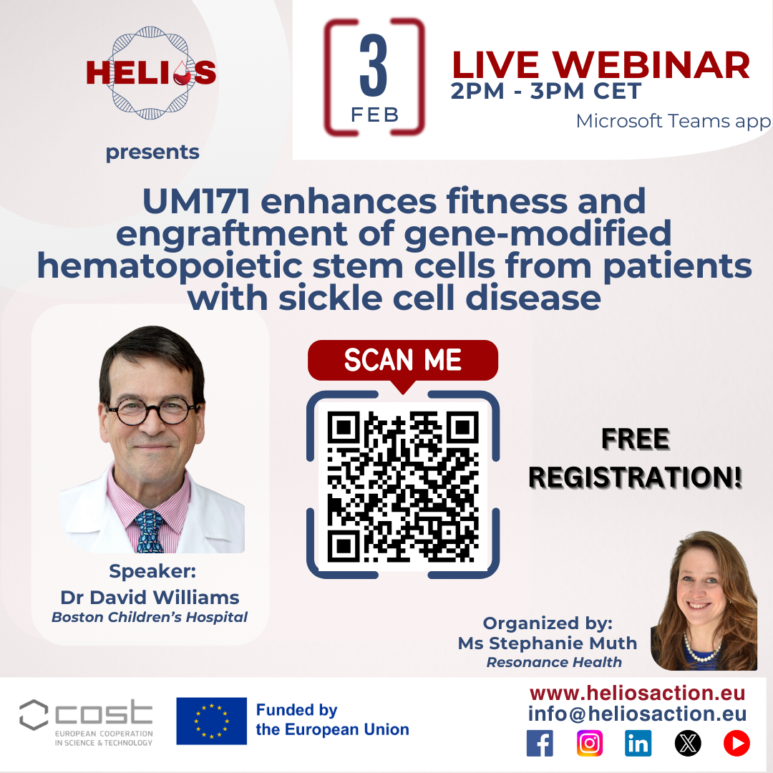
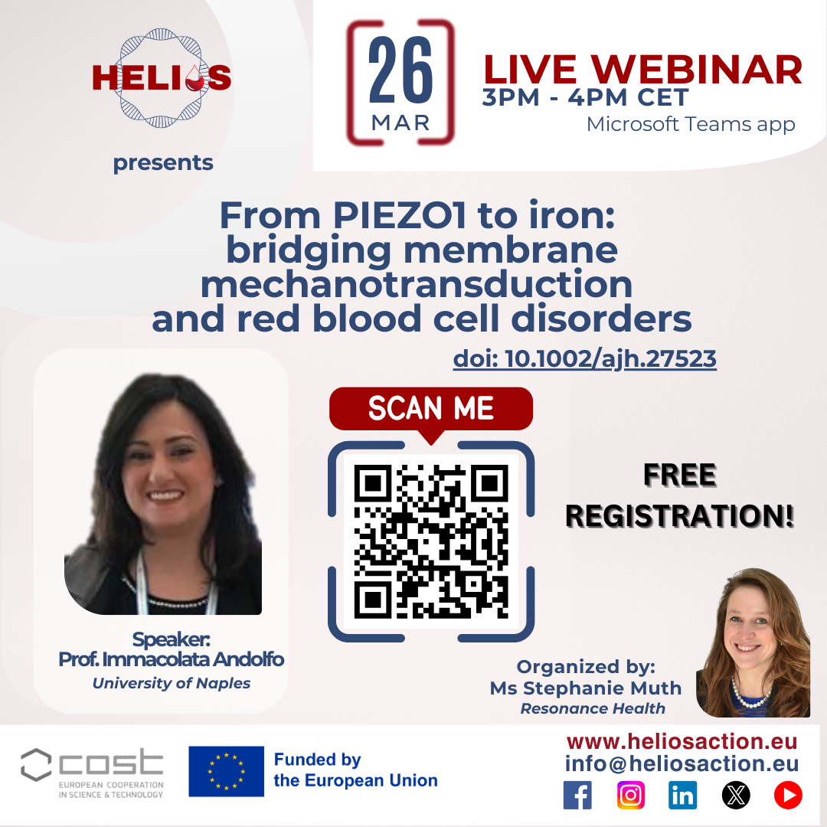
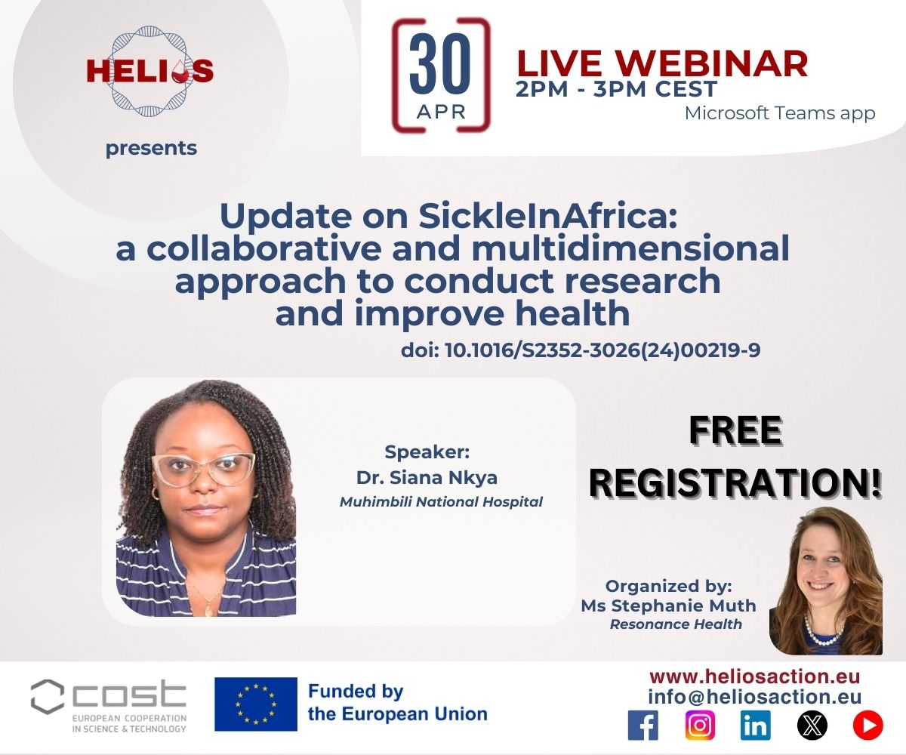
Invited Speaker Series

Slide 21
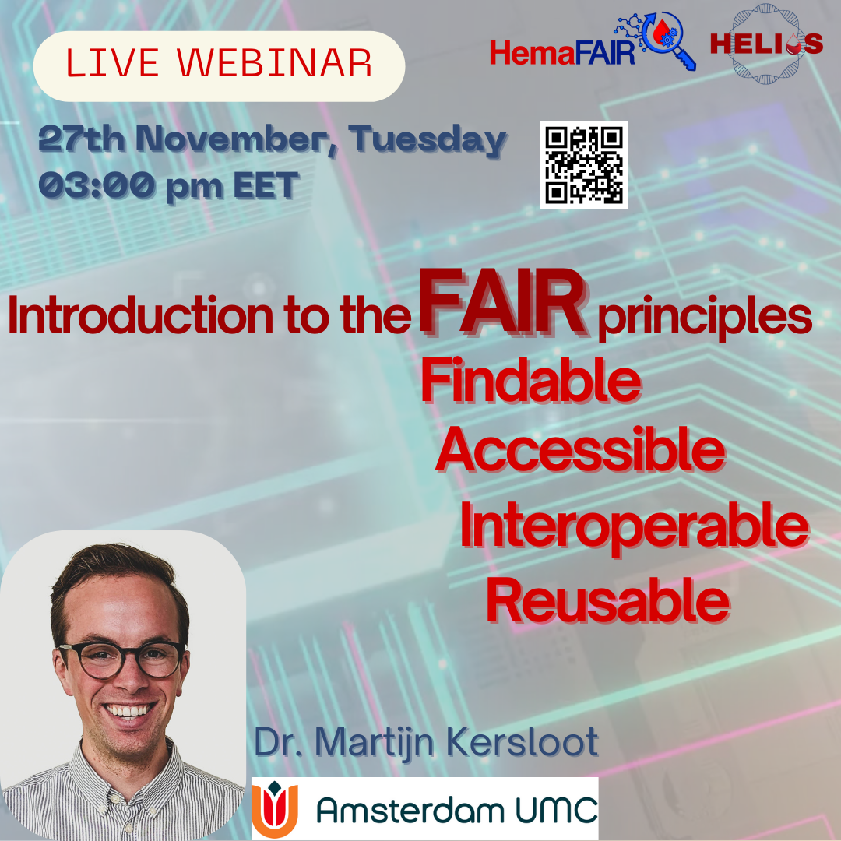
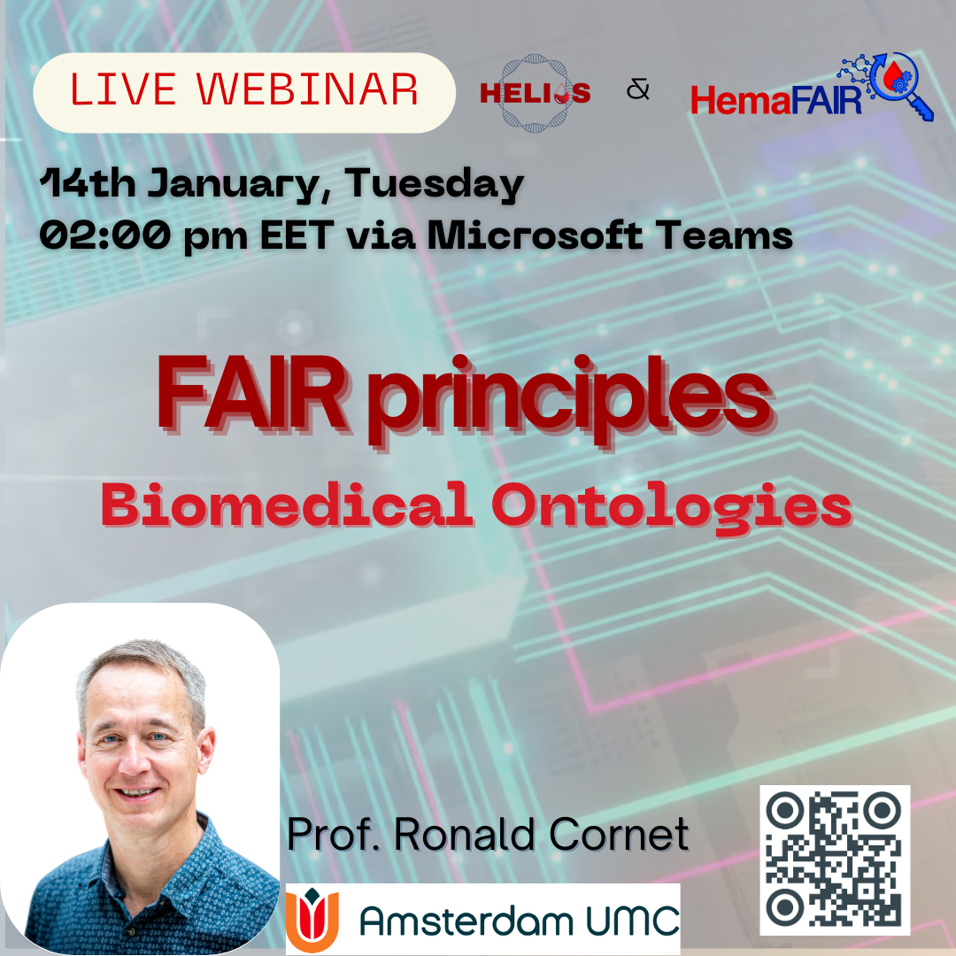
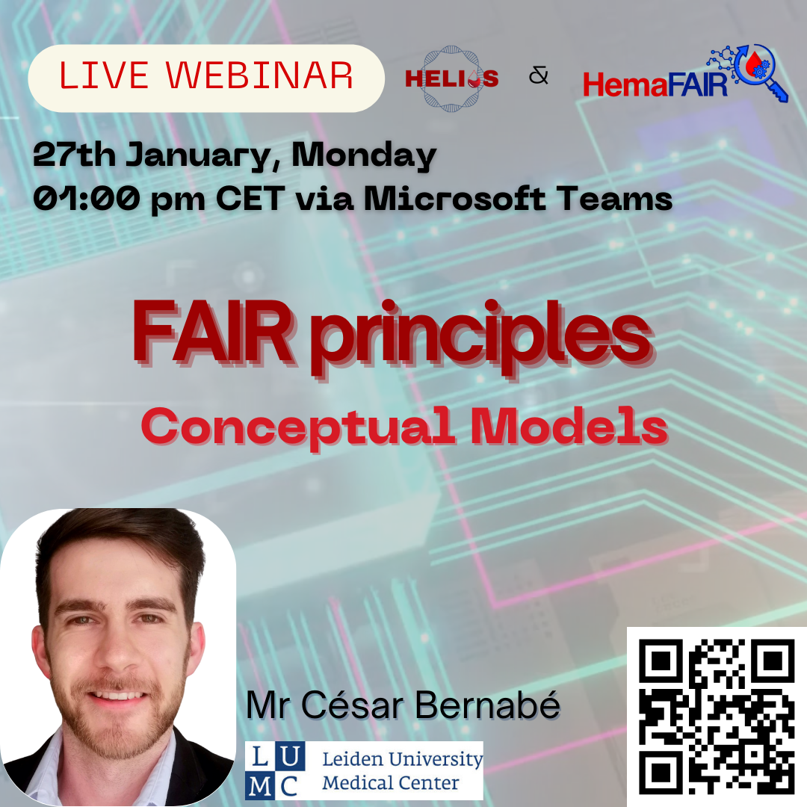
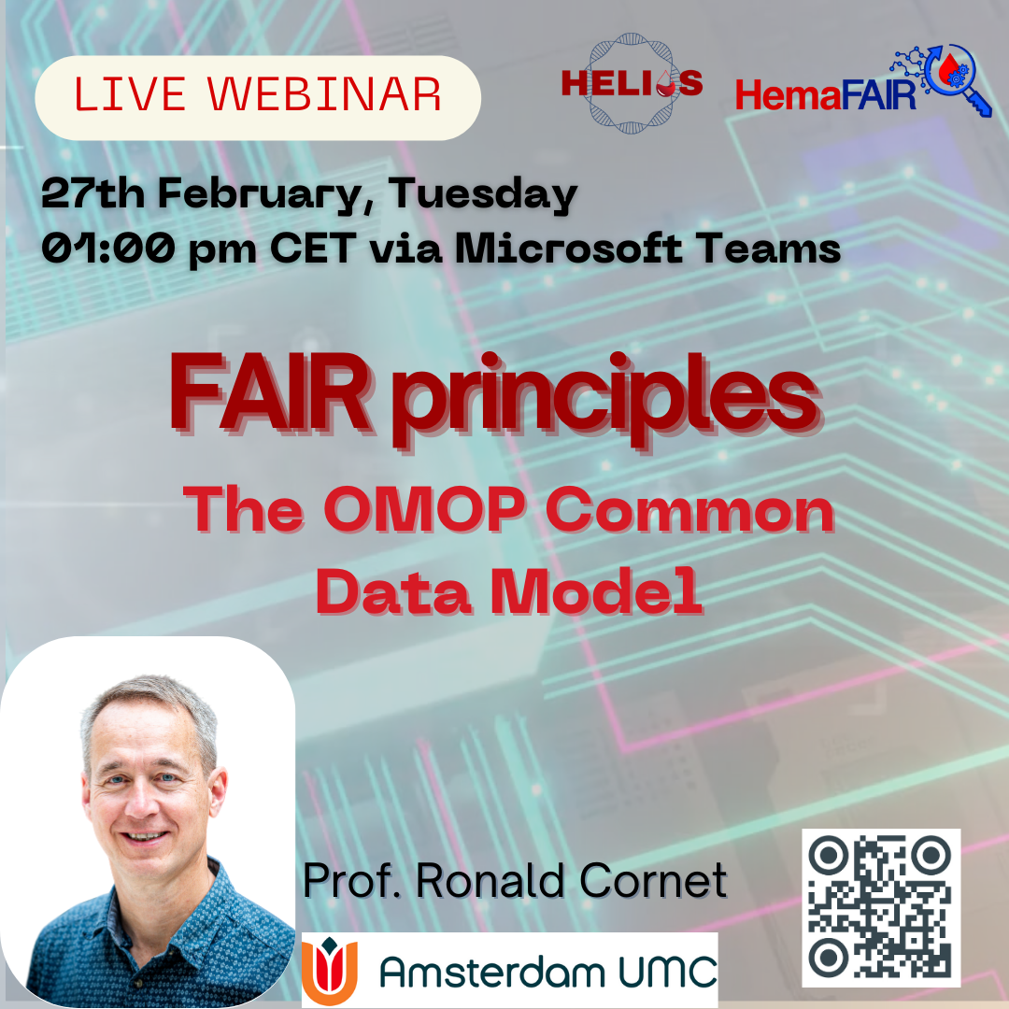
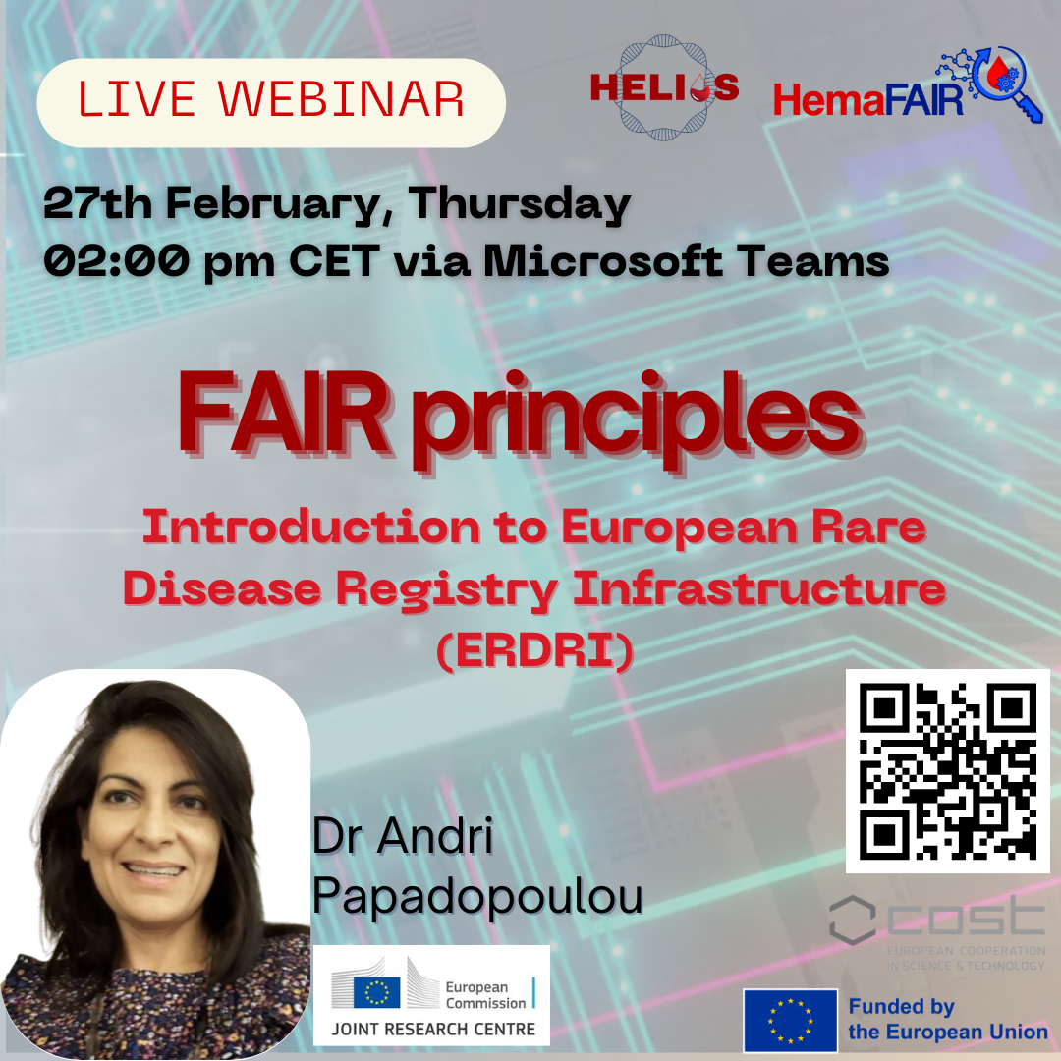
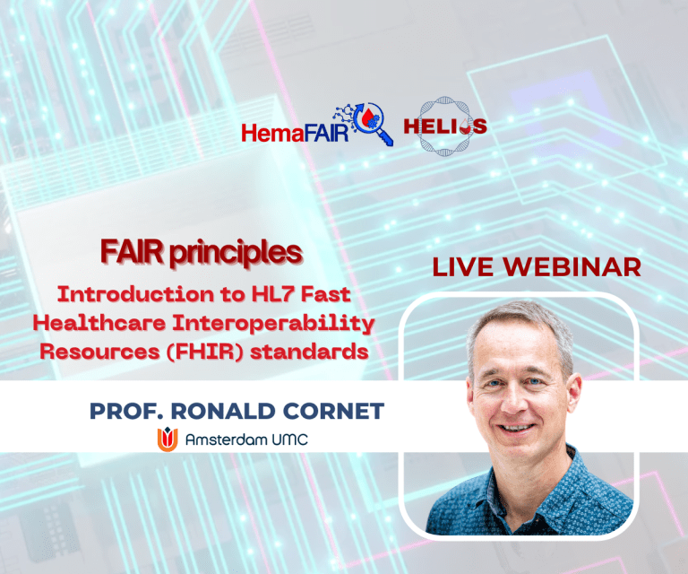
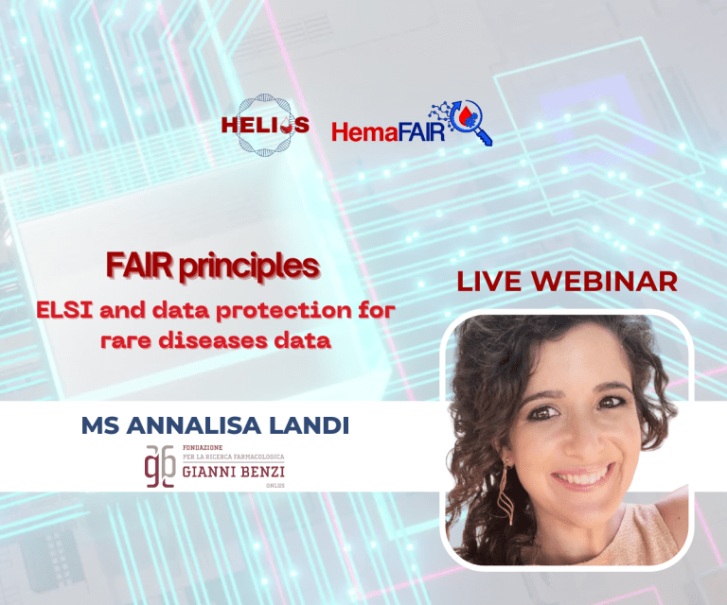
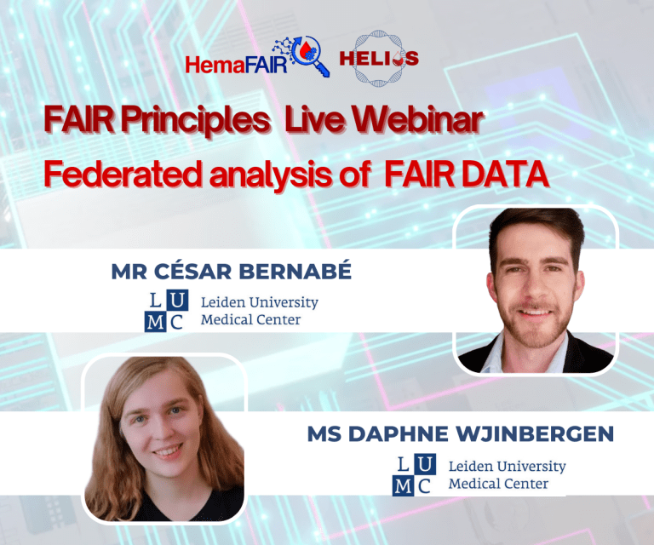
FAIR Principles Webinars
In collaboration with HemaFAIR

Slide 22
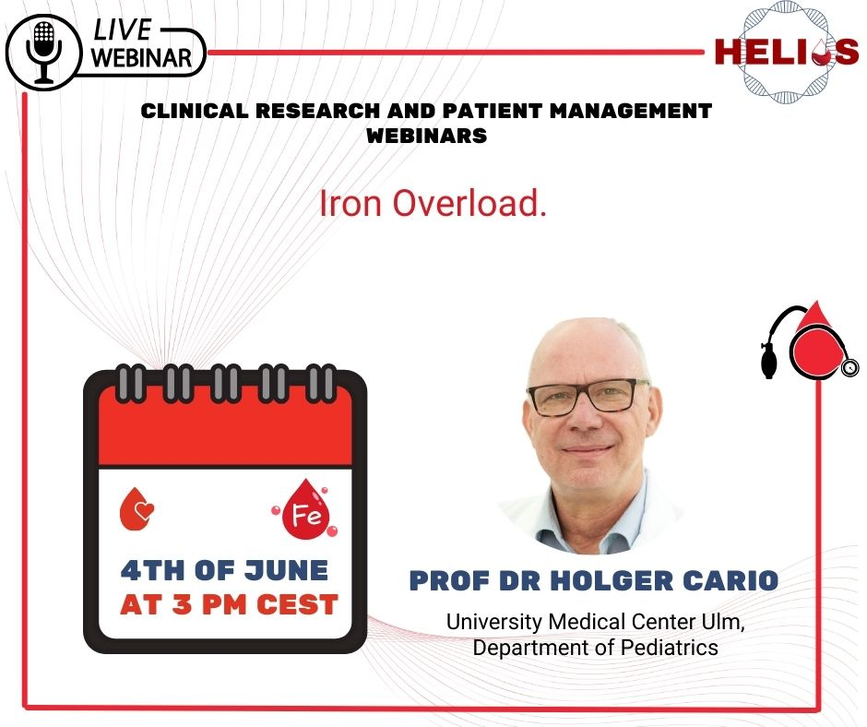
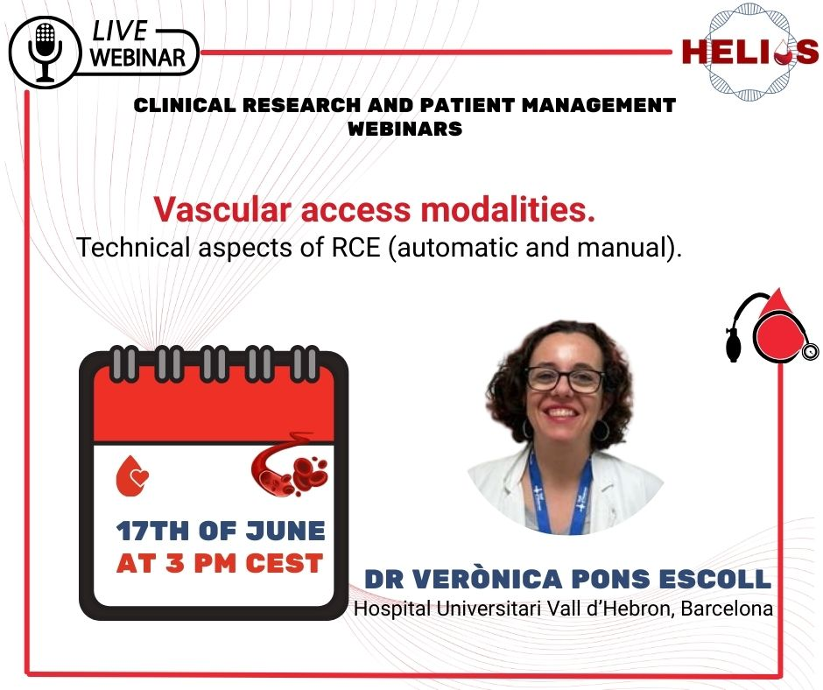
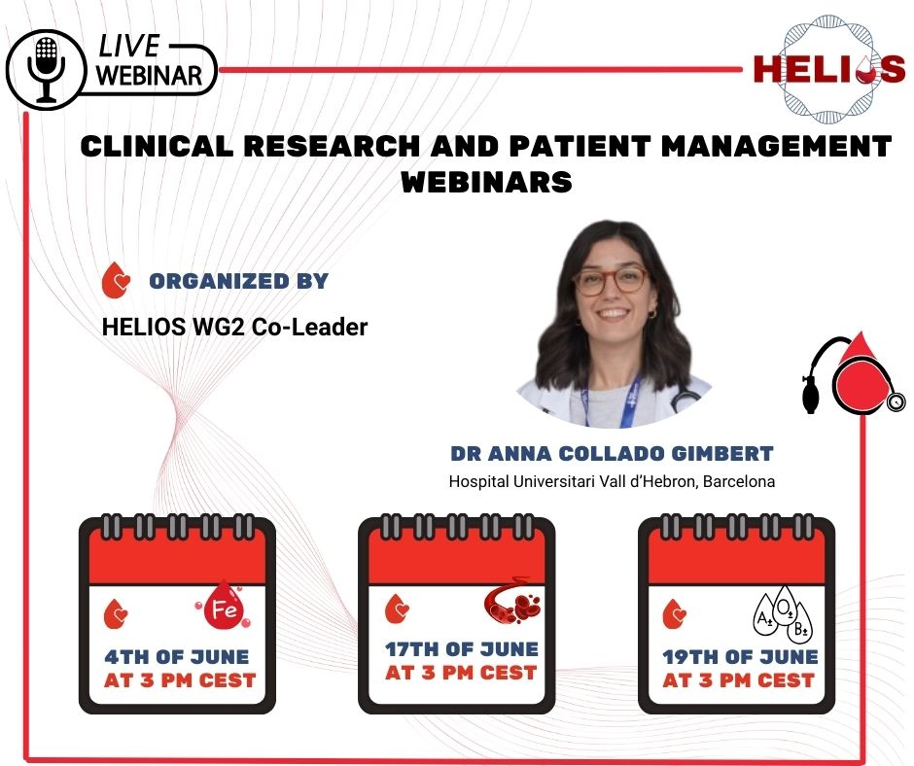
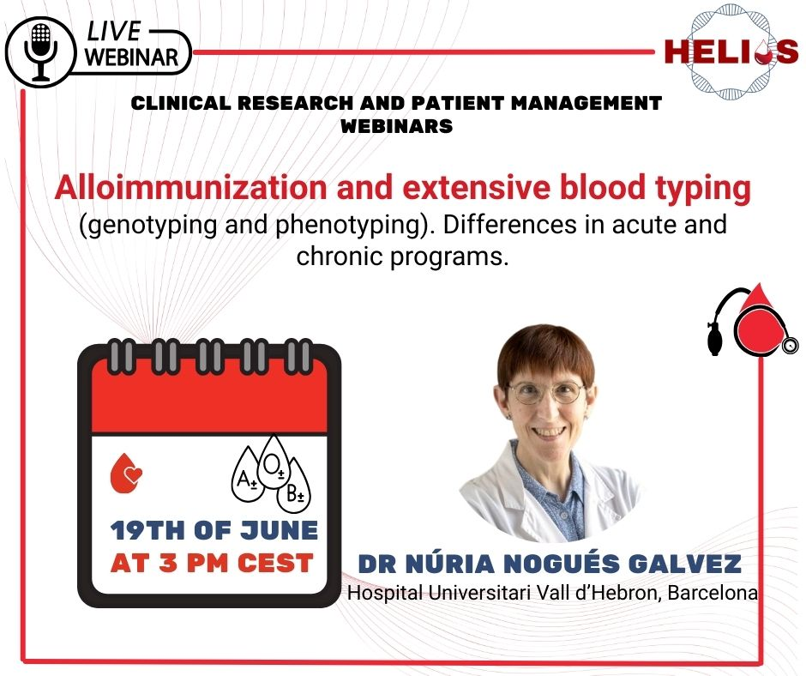

Slide 23
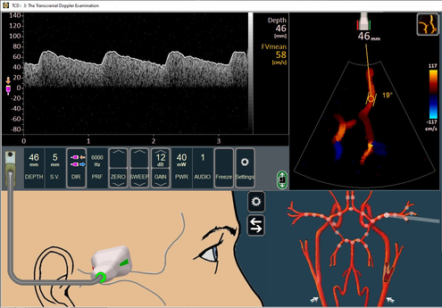
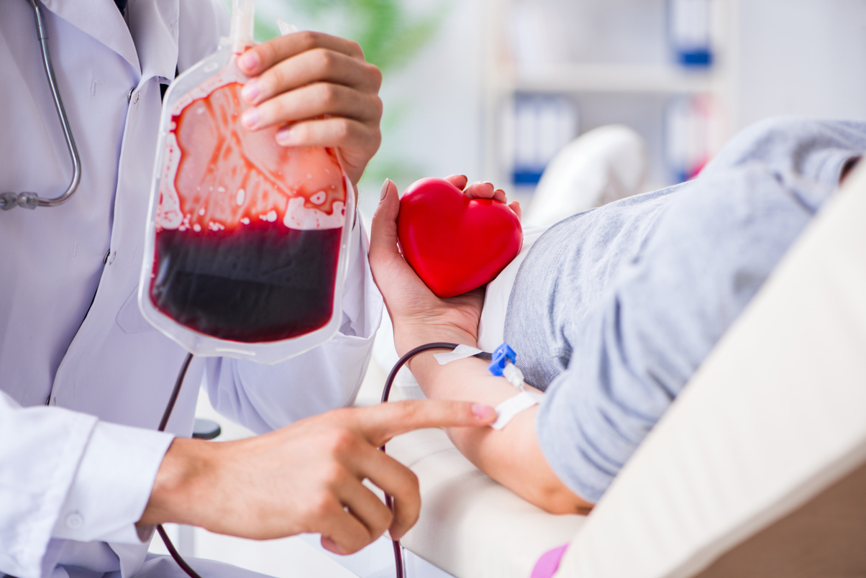
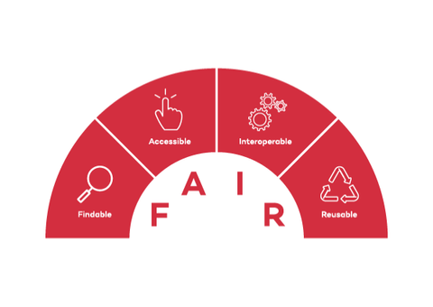



HELIOS COST Action CA22119
Training opportunities
Alloimmunization
Transcranial Doppler
FAIR Principles
Patient education
Science communication
Equality and Ethics
....Many more!!!

Slide 24


Slide 25





HemaFAIR Overview
Duration: 36 months (1 July 2024 – 30 June 2027)
Number of partners: 5
Number of WPs: 14
Funded by Horizon Europe - Twinning project
Budget: 1,499,976.25 €

Slide 26
Primary objective
The primary objective of HemaFAIR is to raise the scientific profile of CING in order to improve the position of researchers in Cyprus in the fields of biomedical informatics and rare haematological diseases (RHDs), with a focus on the use of FAIR data and standards in research and education*.
* development of a training programme

Slide 27
HemaFAIR use case
Aim: demonstrate the FAIRification process on two existing platforms for hemoglobinopathies: the national Cyprus Haemoglobinopathy Patient Registry and the international INHERENT platform.

Slide 28
INHERENT
International project focused on studying the role of genetic modifiers in haemoglobinopathies
>120 centres from 45 countries
Recently completed pilot study to test the operational feasibility of the project
INHERENT platform – developed on REDCap; to be FAIRified as part of HemaFAIR
~1000 enrolled patients from 15 centres in 8 countries – ~800 patients with GWAS data
Open participation for any group interested in contributing

Slide 29
Take home messages
Training activities planned under HELIOS and HemaFAIR have the capacity to advance data-driven research in haemoglobinopathies
Additional joint training activities expected
Collaboration can benefit other linked projects and tools, e.g. INHERENT, patient registries, ITHANET, standardised variant curation, ERDERA, Global Globin Project

Slide 30

Introduction to the course

Slide 31
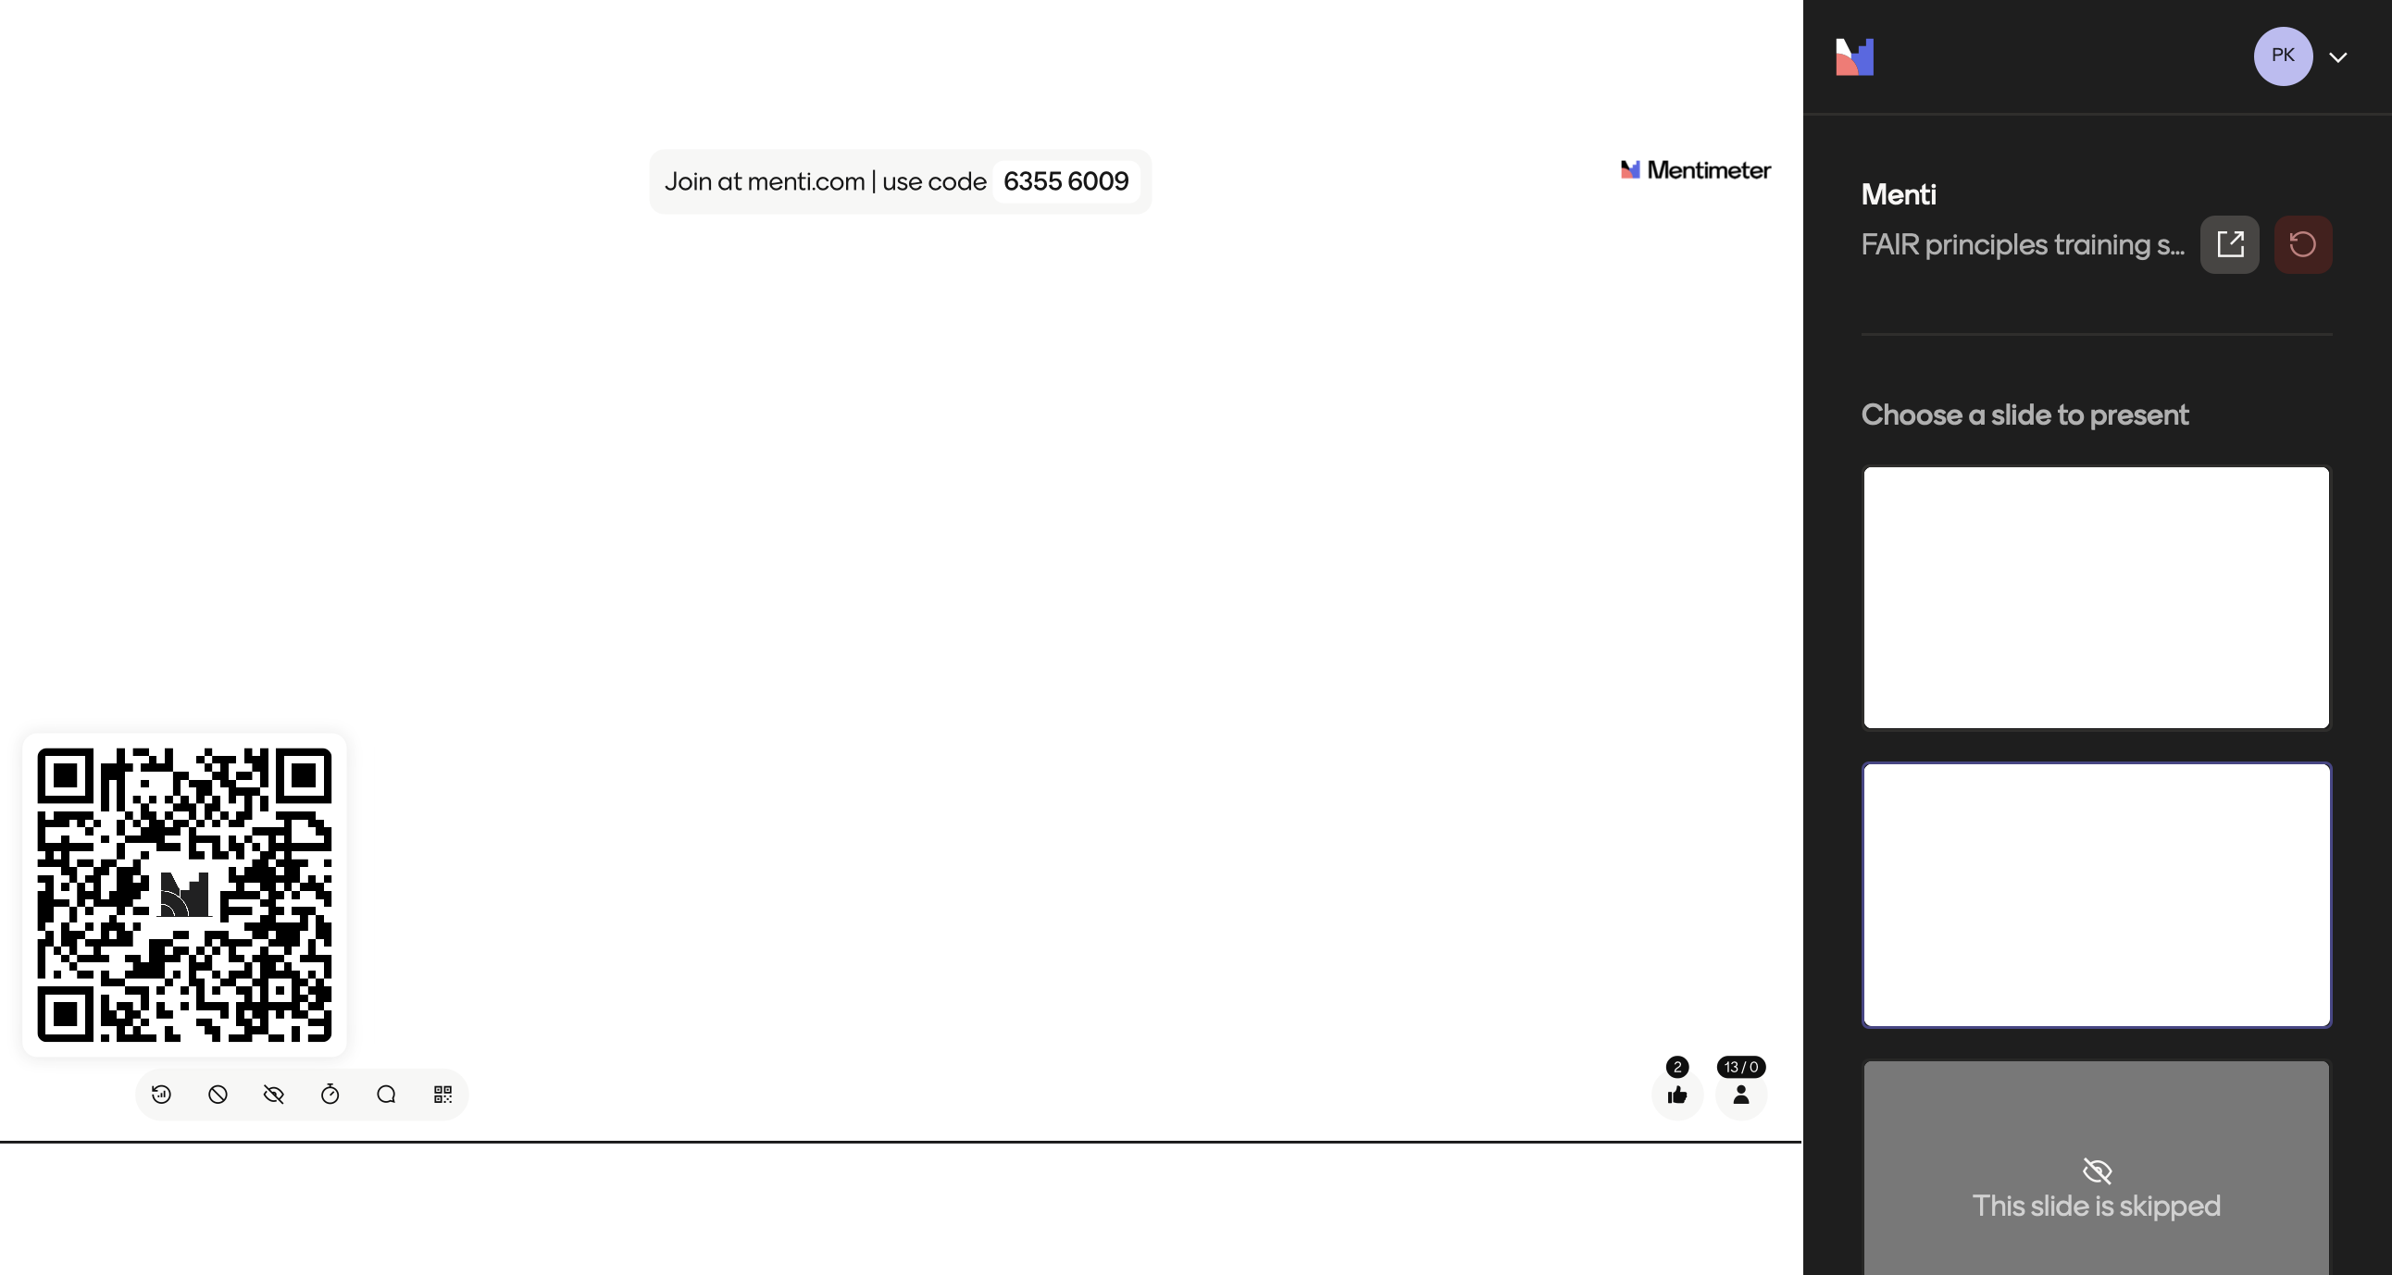

Slide 32
The learning objectives of the training school
Understand the meaning and importance of the FAIR principles for research data management
Recognize the relationship and the differences between FAIR data and Open Science practices
Apply methods to make data Findable by using persistent identifiers and rich metadata
Understand best practices for making data Accessible, including data licensing and access protocols
Recognize methods and standards for enhancing data Interoperability across systems
Develop skills to make data Reusable through proper documentation, use conditions, and provenance information
Design a FAIR data management plan for a research project
Understand how to select and use FAIR-compliant data repositories
Identify tools and resources for assessing the FAIRness of datasets
Understand what machine-actionability and its importance in FAIR data practices entails
Explain ethical considerations and responsible data sharing in the context of FAIR
Understand best practices for making data Accessible, including data licensing and access protocols
Understand what metadata standards and ontologies are and how they make (meta)data more Interoperable.
Integrate FAIR data practices into the full research data lifecycle
Understand the role of FAIR data in enhancing the reproducibility of research projects and re-use of data
Explain methods for the analysis of FAIRified datasets

Slide 33
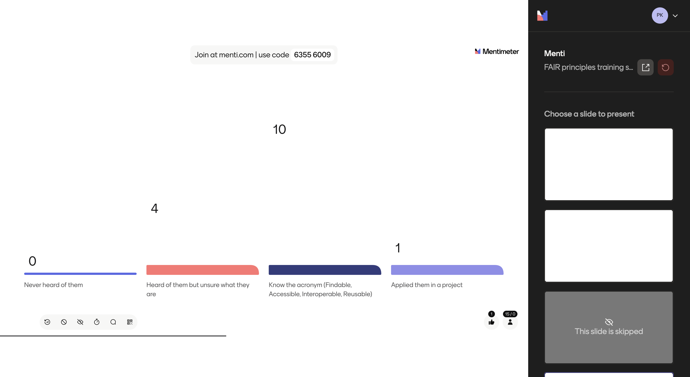

Slide 34
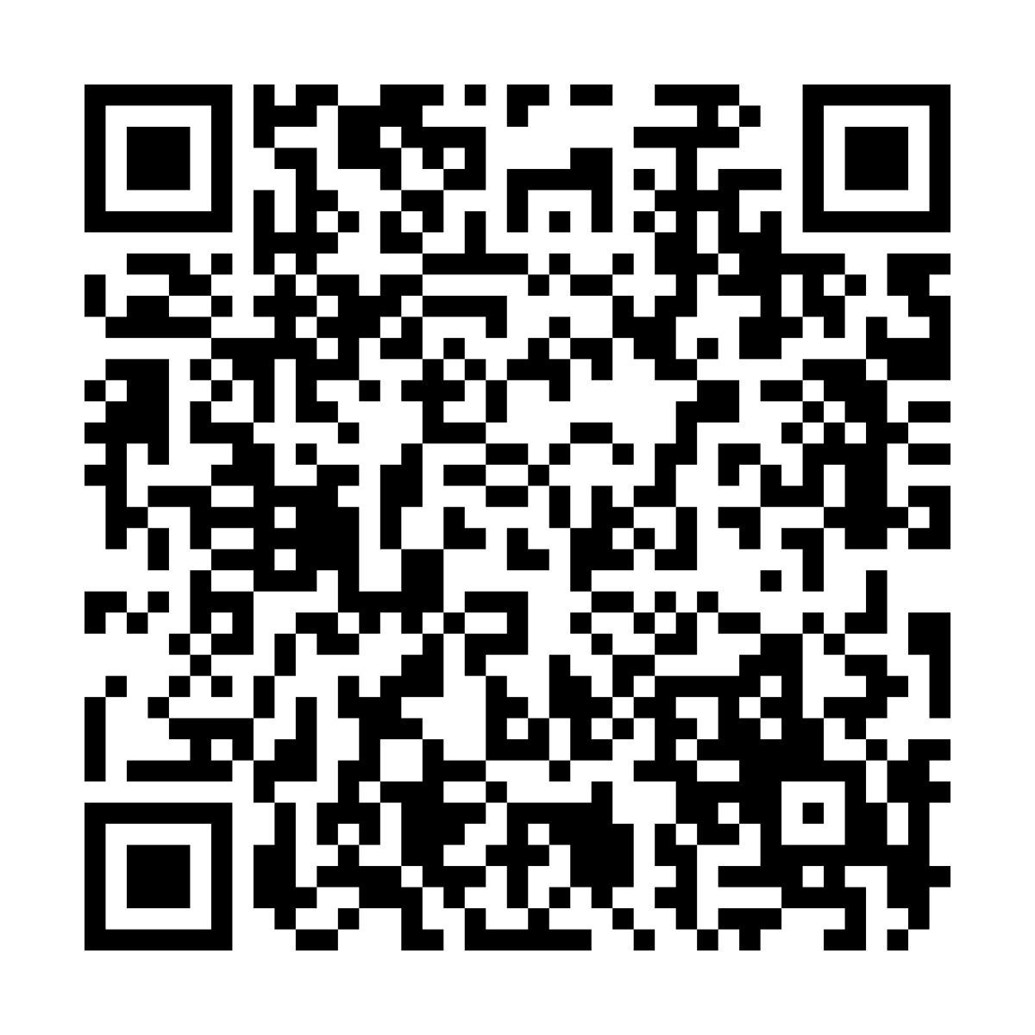
Assessing Understanding and Implementation of FAIR Data Principles in Research Practices
Survey: ~15 minutes
Your responses will provide valuable insights into:
Familiarity with FAIR principles
Current data management practices
Challenges in implementing FAIR standards
Areas where additional support or resources may be needed
The survey will be relaunched after the end of the training school to evaluate the progress
https://redcap.link/z0gck5k8

Slide 35
Brief overview of selected datasets

Slide 36
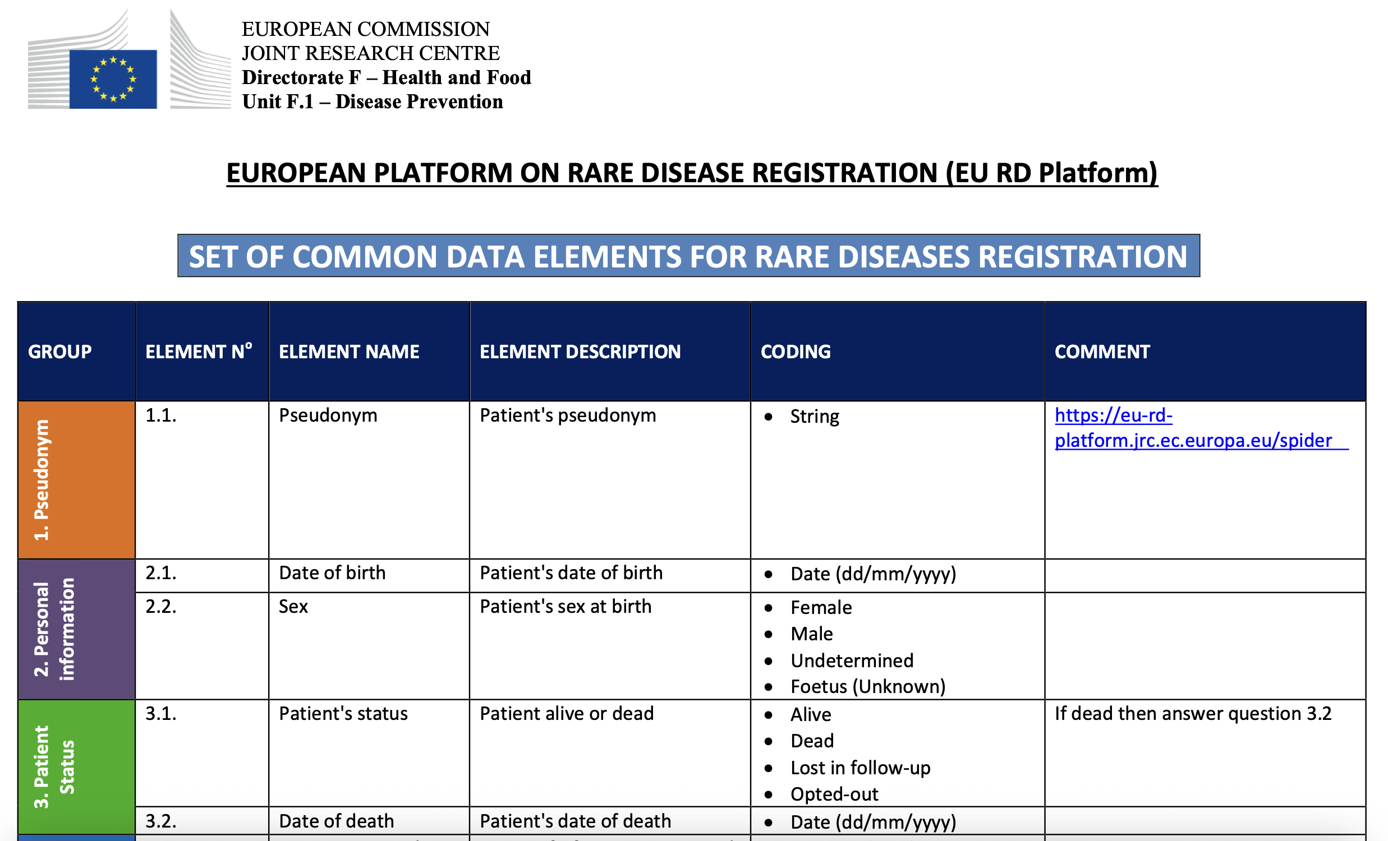
Dataset 1 – Common Data Elements (CDEs)
A minimum set of parameters to be collected for rare disease patient registries
Recommended by the Joint Research Centre – European Commission
16 data elements

Slide 37
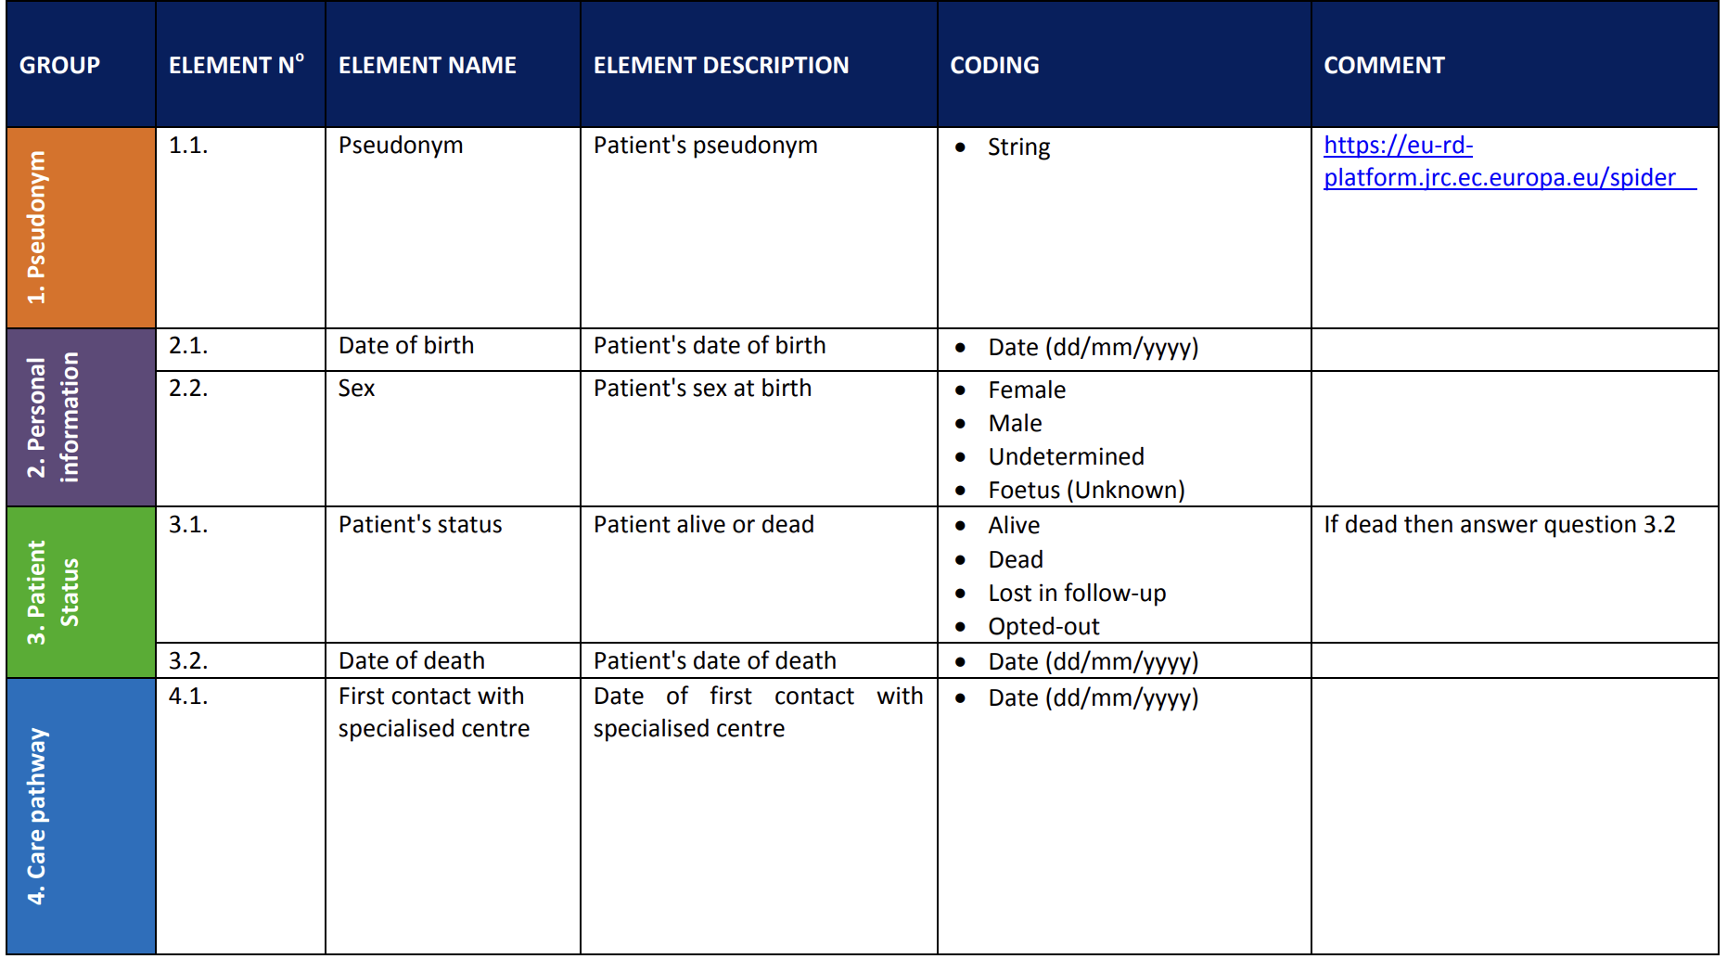
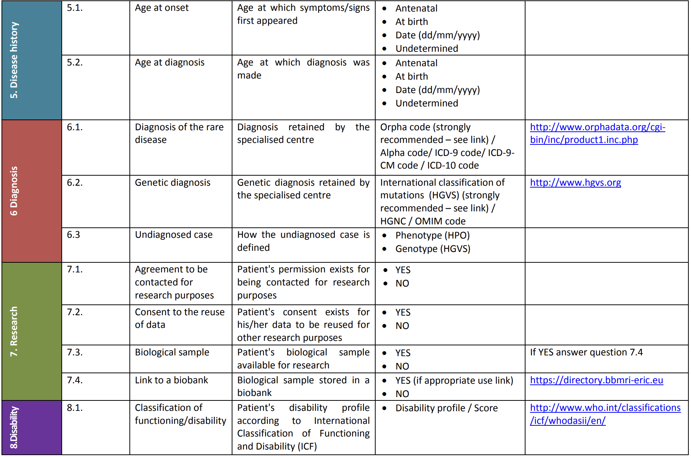
Dataset 1 – Common Data Elements (CDEs)

Slide 38

Dataset 2 – INHERENT and patient registries for hemoglobinopathies
European / international studies on hemoglobinopathies (and other rare anemias)
Several national registries are based on these datasets
Includes the CDEs
Focused clinical questions

Slide 39
Dataset 2 – INHERENT and patient registries for hemoglobinopathies
Parameter categories: demographics, diagnosis, lab tests, clinical manifestations, medical history, treatments
Clinical Question 1 (55 elements): What is the prevalence of specific thalassemia genotypes (overall, per centre/region, country, ethnic group) and its association with the transfusion status?
Clinical Question 2 (176 elements): What is the incidence of new iron overload-related complications?

Slide 40
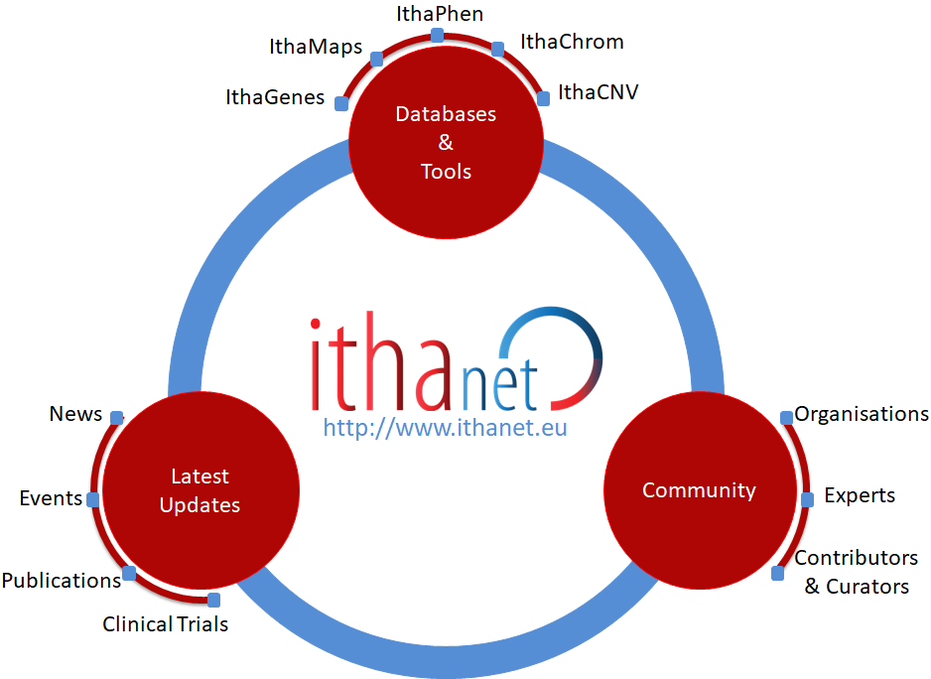
Dataset 3 – The ITHANET community portal
Open knowledgebase for haemoglobinopathies, developed and maintained since 2007
Three major databases/datasets:
IthaMaps
IthaGenes
IthaPhen

Slide 41
IthaMaps – Epidemiological dataset
36 parameters
Existing healthcare policies in each country (e.g. prevention programme, national registry, dedicated treatment centres)
Status and burden of major haemoglobinopathies in each country (e.g. prevalence and incidence)
Region-specific variant frequencies (rather than only country-wide)

Slide 42
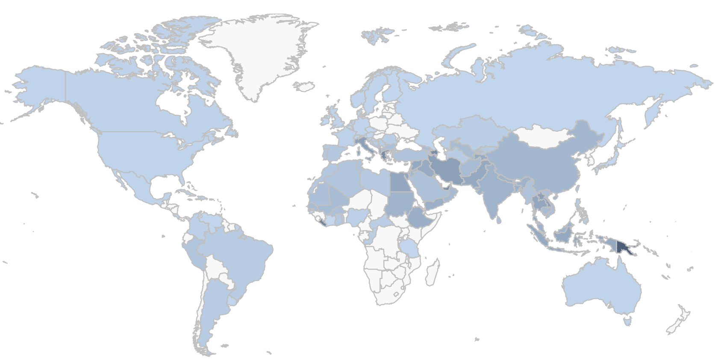
Prevalence of β-thalassaemia carriers
Info on major haemoglobinopathies
Prevalence of β-thalassaemia carriers
Prevalence of SCD carriers
Prevalence of α-thalassaemia carriers
Prevalence of HbE carriers
Prevalence of HbC carriers
Expected incidence of α-thalassaemia
Ιncidence of β-thalassaemia
Ιncidence of SCD
Ιncidence of α-thalassaemia
  Known β-thalassaemia patients
  Known SCD patients
  Known α-thalassaemia patients

Slide 43
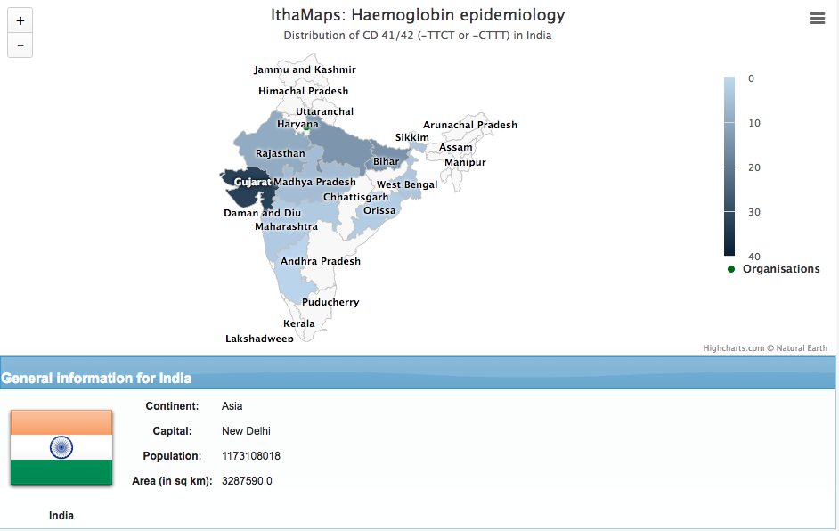
General Information
Haemoglobinopathy-specific healthcare policy information
Prevalence and incidence of major haemoglobinopathies
Mutation frequencies
Organisations
Microattributions

Slide 44
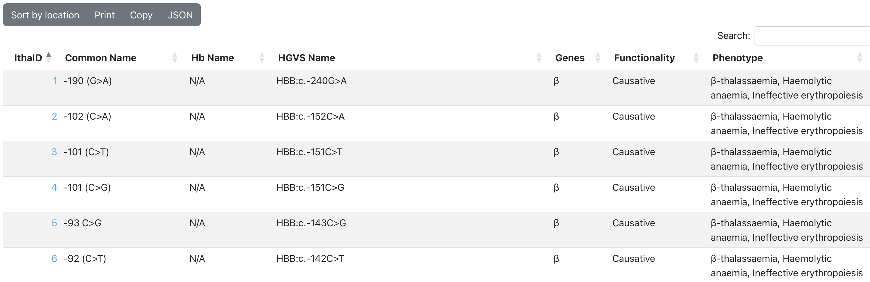
IthaGenes – Genetics dataset
Genes: 544
Variants: 3510

Slide 45
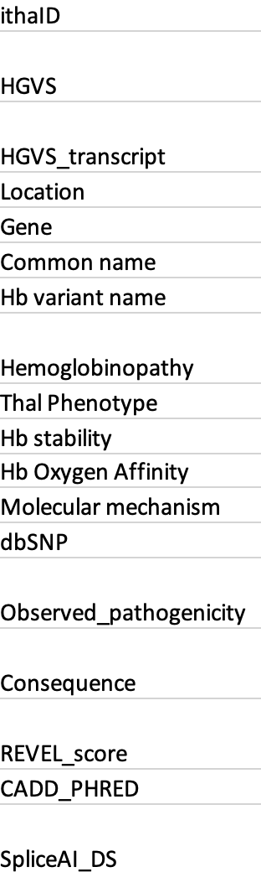
IthaGenes – Genetics dataset
18 data elements
Identifier(s)
Variant location
Variant names
Functional information
Phenotype
Pathogenicity – associated disease
In silico predictions

Slide 46
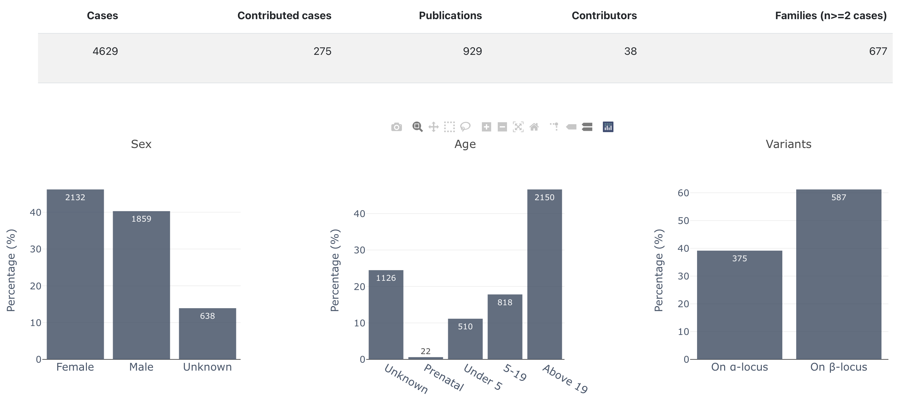
IthaPhen – genotype/phenotype dataset
Cases: 4629
Publications: 929
Families: 677
Genotype – phenotype database for haemoglobinopathies
Xenophontos M, Minaidou A, et al. IthaPhen: an interactive database of genotype-phenotype data for haemoglobinopathies. HemaSphere, 2023
Notes:
IthaPhen is a database that demonstrates the correlations between genotype and phenotype analyses, including anonymised patient data reported in scientific literature.
IthaPhen includes information on gender, age, origin, family, haematological parameters, Hb pattern analysis and stability, transfusion information, RBC morphology/microscopy, clinical classification and clinical complications of a reported subject and also providing descriptive statistics and visualization for easy interpretation.

Slide 47
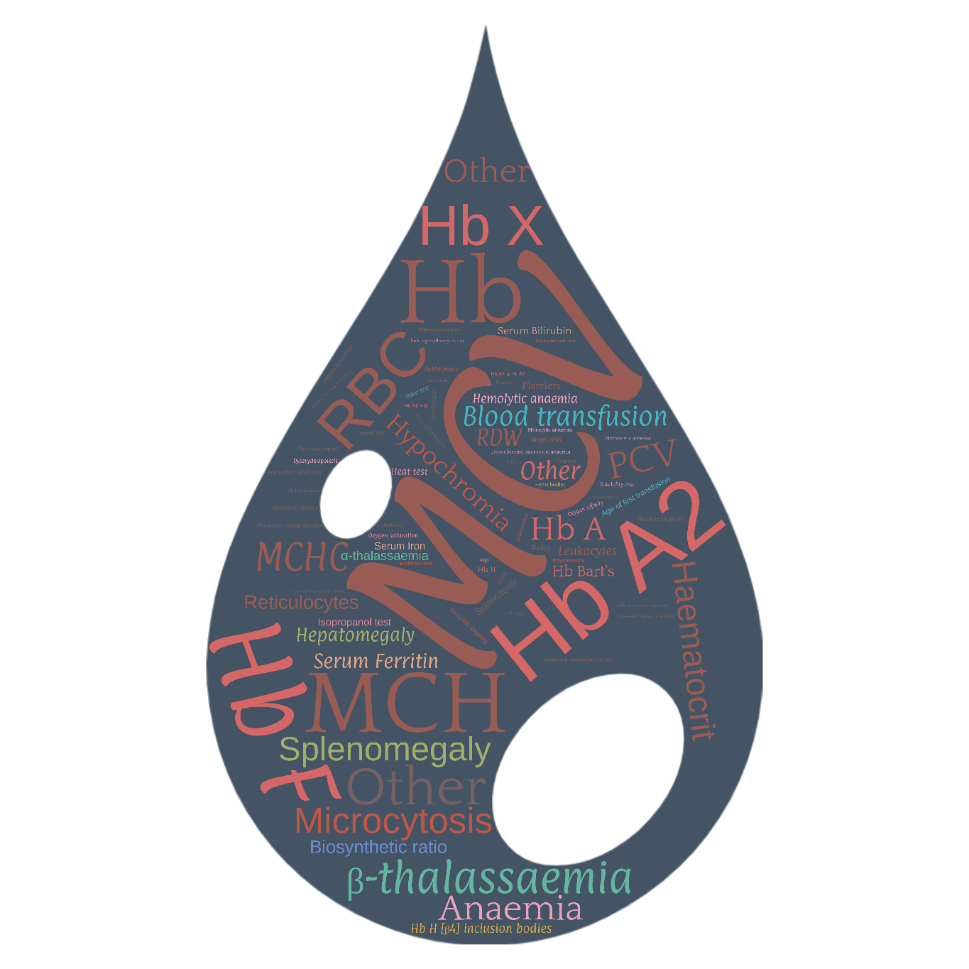
Phenotypic parameters
83 parameters organised in 13 categories
Xenophontos M, Minaidou A, et al. IthaPhen: an interactive database of genotype-phenotype data for haemoglobinopathies. HemaSphere, 2023

Slide 48


Dataset 4 – Patient registry on Acute Myeloid Leukemia
STREAM – European patient registry of relapse/refractory Acute Myeloid Leukemia
Part of the IMPACT-AML project. Funded by Horizon Europe.
Includes the CDEs
66 parameters: demographics, diagnosis, treatment, survival

Slide 49

Dataset 5 – Synthetic Datasets for Software Development in Rare Disease Research
SynthMD
a Python tool for generating synthetic patient data to support software development and evaluations in rare disease research
three synthetic datasets for three popular rare diseases i.e. Sickle Cell Disease (SCD), Cystic Fibrosis (CF), and Duchenne Muscular Dystrophy (DMD)
https://github.com/BIH-MI/synthetic-rd-data

Slide 50


Slide 51

Questions?

