Slide 1


Introduction to the FAIR Principles and the Research Data Life Cycle
HemaFAIR | Training School
Martijn Kersloot, PhD
Assistant Professor | Reusable Health Data | Dept. of Medical Informatics | Amsterdam UMC

Slide 2



Research Data
Life Cycle
FAIR
Principles
Relation to the Training School
1
2
3

Slide 3
Research Data
Life Cycle
FAIR
Principles
Relation to the Training School
1
2
3

Slide 4
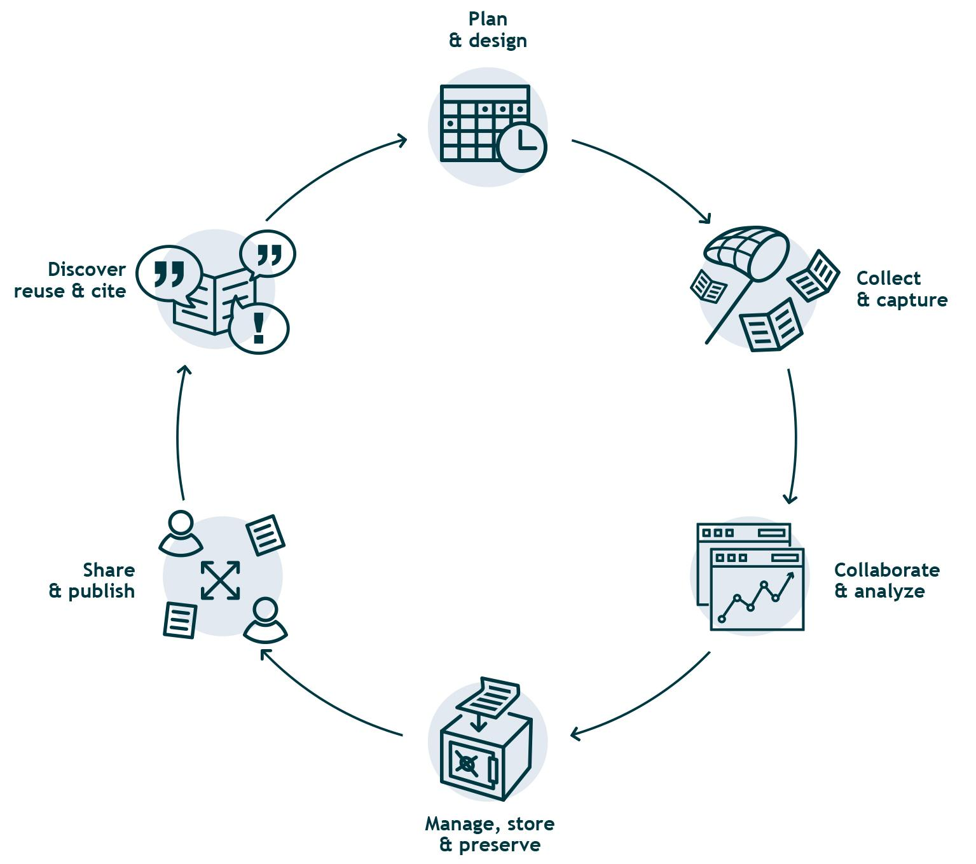
Research Data Life Cycle
How do you handle the data you collect in your research?
Phases of a research project with associated data management tasks.
Based on: Corti L, Van den Eynden V, Bishop L, Woollard M. 2. In: The Research Data Lifecycle. Sage; 2019.
Jisc. Research data management toolkit; 2021.
Pinnock G. The Research Data Management (RDM) lifecycle at the University of Cape Town (UCT); 2019.

Slide 5
Research Data Life Cycle
How do you handle the data you collect in your research?
Phases of a research project with associated data management tasks.
This session gives an introduction of the Life Cycle We will cover all phases throughout the
different lectures in the Training School
Based on: Corti L, Van den Eynden V, Bishop L, Woollard M. 2. In: The Research Data Lifecycle. Sage; 2019.
Jisc. Research data management toolkit; 2021.
Pinnock G. The Research Data Management (RDM) lifecycle at the University of Cape Town (UCT); 2019.

Slide 6
Research Data Life Cycle
How do you handle the data you collect in your research?
Phases of a research project with associated data management tasks.
Based on: Corti L, Van den Eynden V, Bishop L, Woollard M. 2. In: The Research Data Lifecycle. Sage; 2019.
Jisc. Research data management toolkit; 2021.
Pinnock G. The Research Data Management (RDM) lifecycle at the University of Cape Town (UCT); 2019.

Slide 7
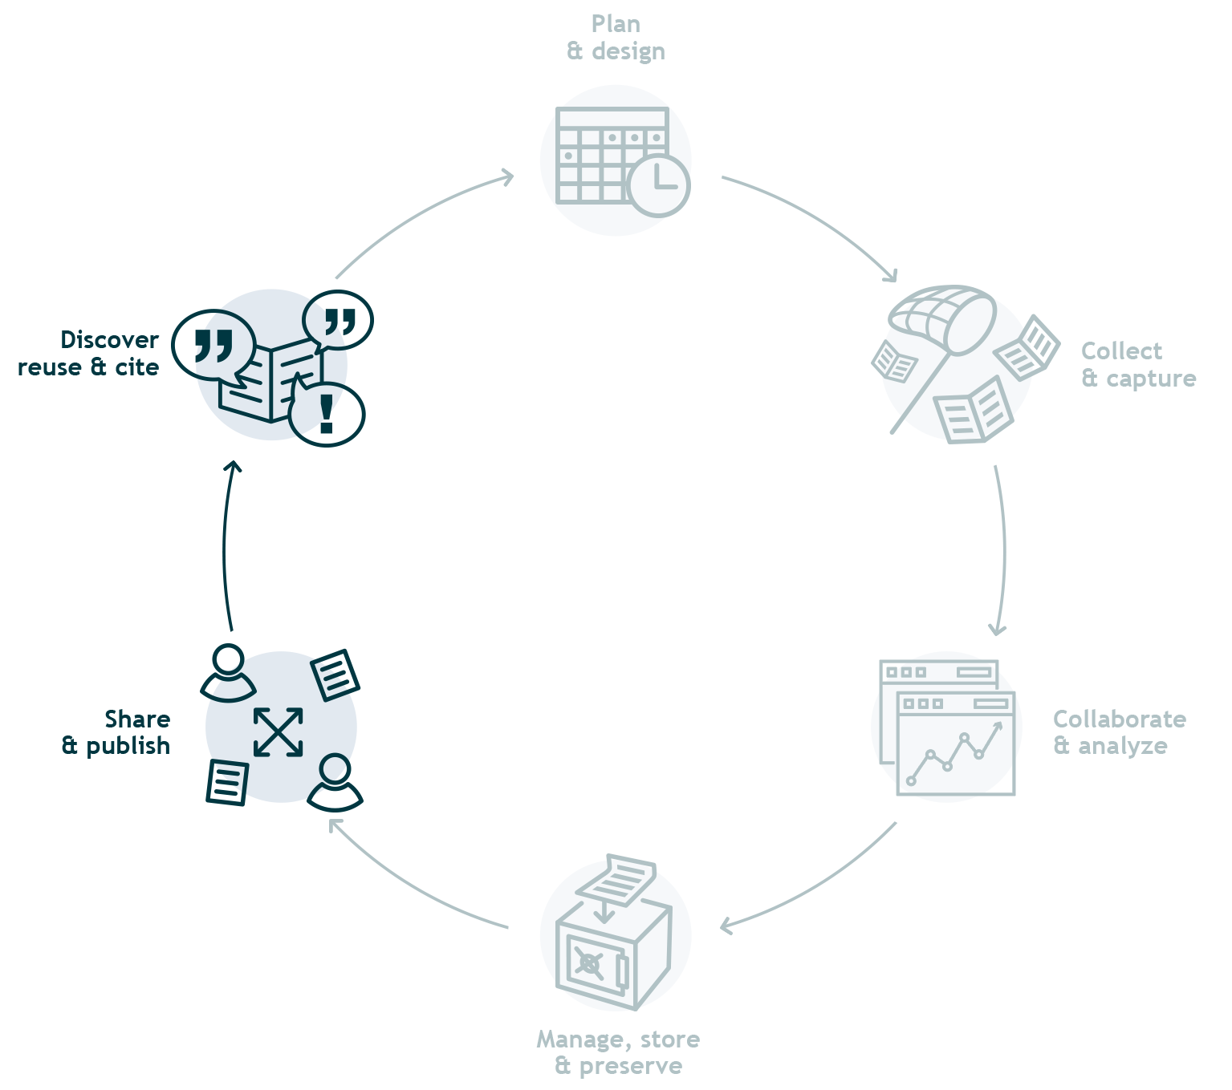
Research Data Life Cycle
How do you handle the data you collect in your research?
Phases of a research project with associated data management tasks.
Drivers of evidence-based medicine and progress in science
Source: van Valkenhoef G, et al. Deficiencies in the transfer and availability of clinical trials evidence: a review of existing systems and standards. BMC Medical Informatics and Decision Making. 2012 Sep;12(1).
Tenopir C, et al. Changes in Data Sharing and Data Reuse Practices and Perceptions among Scientists Worldwide. PLOS ONE. 2015 Aug;10(8):e0134826.

Slide 8
Research Data
Life Cycle
FAIR
Principles
Relation to the Training School
1
2
3

Slide 9

80 %
of data collected in scientific research
cannot be reused
Based on: Mons, Barend, et al. "Cloudy, increasingly FAIR; revisiting the FAIR Data guiding principles for the European Open Science Cloud." Information services & use 37.1 (2017): 49-56.

Slide 10
80 %
of data collected in scientific research
cannot be reused
Data management focuses on using data for a single project
Data are unstructured, or not well documented
Based on: Mons, Barend, et al. "Cloudy, increasingly FAIR; revisiting the FAIR Data guiding principles for the European Open Science Cloud." Information services & use 37.1 (2017): 49-56.

Slide 11
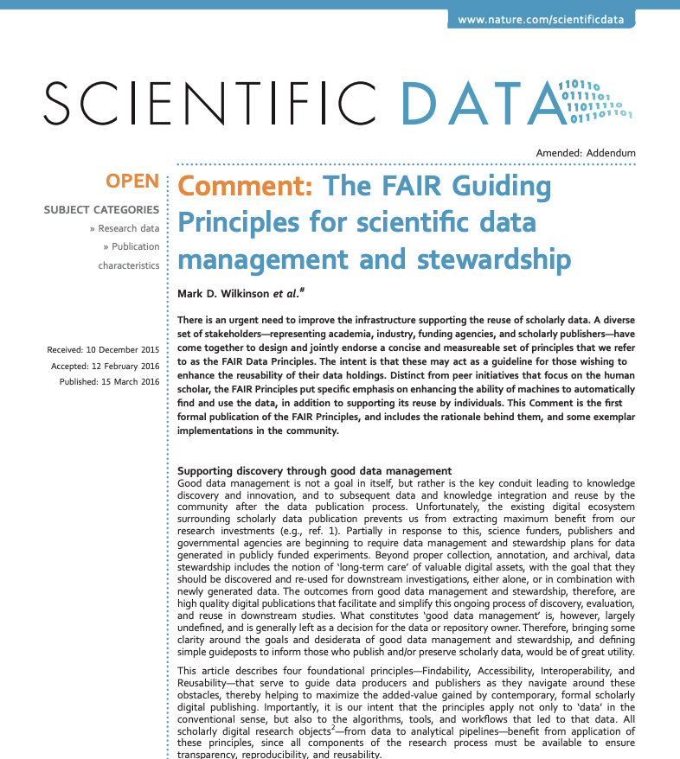
The FAIR Principles
15 guiding principles
Scientific data management and stewardship
Published in 2016
Covering data, metadata, and infrastructure
Source: Wilkinson, Mark D., et al. "The FAIR Guiding Principles for scientific data management and stewardship." Scientific data 3.1 (2016): 1-9.

Slide 12
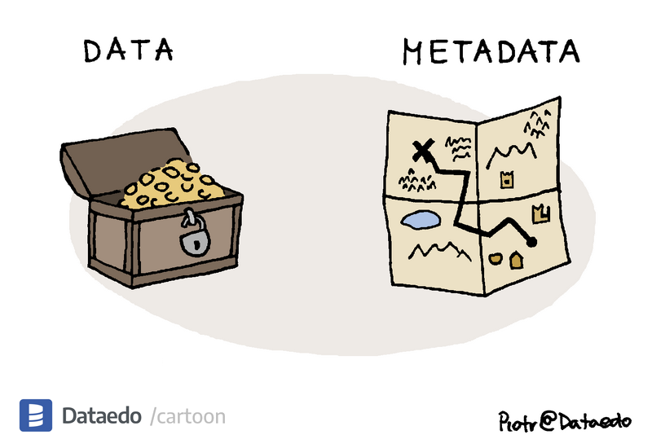
Metadata
Data describing your data / biobank / registry / …
Make sure that others understand:
What your research project is about
What (type of) data your collect
If/how they could access that data
Image: Dataedo | Data is treasure, but how do you know where it is burried?
https://dataedo.com/cartoon/data-vs-metadata-2

Slide 13
The FAIR Principles
Describe what you should do with your (meta)data
Do not describe how you should do that
Source: Wilkinson, Mark D., et al. "The FAIR Guiding Principles for scientific data management and stewardship." Scientific data 3.1 (2016): 1-9.

Slide 14

FAIR: an acronym for humans & machines
Findable
Accessible
Described, identified and registered or indexed in a clear and unambiguous manner
Accessible through a clearly defined access procedure
& metadata should always remain accessible
Interoperable
Reusable
Conceptualised, expressed and structured using
common, published standards
Characteristics and provenance are described in detail, with clear conditions for use
Source: Wilkinson, Mark D., et al. "The FAIR Guiding Principles for scientific data management and stewardship." Scientific data 3.1 (2016): 1-9.

Slide 15

The need for machine-readable, FAIR (meta)data
The body of knowledge and amount of available data is growing exponentially
Maximize the knowledge gained from the efforts and sacrifices of participants
We are unable to operate at the scope, scale, and speed required for this

Slide 16
The need for machine-readable, FAIR (meta)data
The body of knowledge and amount of available data is growing exponentially
Maximize the knowledge gained from the efforts and sacrifices of participants
We are unable to operate at the scope, scale, and speed required for this
We need machines to find, access, interoperate, and reuse data → machine-readable (meta)data

Slide 17
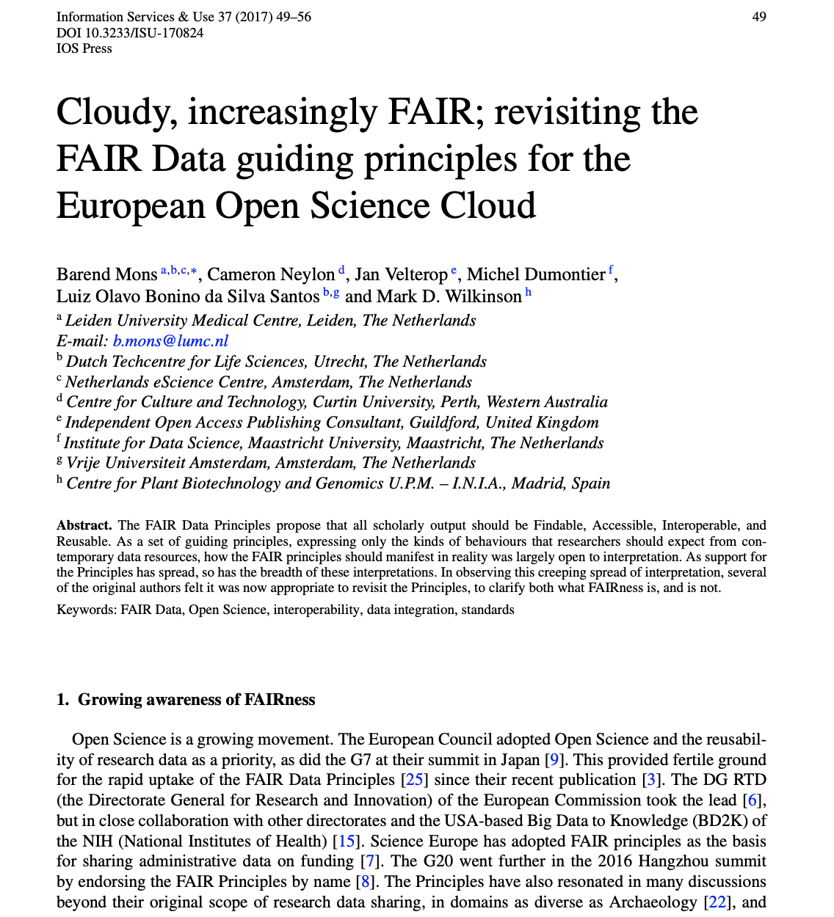
Misconceptions about the principles
FAIR is not a standard
FAIR is not equal to Open
FAIR is not just about humans being able to find, access, reformat and finally reuse data
Source: Mons, Barend, et al. "Cloudy, increasingly FAIR; revisiting the FAIR Data guiding principles for the European Open Science Cloud." Information services & use 37.1 (2017): 49-56.

Slide 18
Misconceptions about the principles
FAIR is not a standard
FAIR is not equal to Open
FAIR is not just about humans being able to find, access, reformat and finally reuse data
FAIR at its core:
machine-readable (meta)data
Source: Mons, Barend, et al. "Cloudy, increasingly FAIR; revisiting the FAIR Data guiding principles for the European Open Science Cloud." Information services & use 37.1 (2017): 49-56.

Slide 19
The benefits of machine-readable, FAIR (meta)data
Allow for unambiguous interpretation and analysis
Allow for performing distributed analyses
Allow for automated processing in a more efficient and scalable manner

Slide 20

The benefits of machine-readable, FAIR (meta)data
Allow for unambiguous interpretation and analysis
Allow for performing distributed analyses
Boost the performance of data re-users for the benefit of people living with a rare disease
Allow for automated processing in a more efficient and scalable manner

Slide 21
FAIR: an acronym for humans & machines
Findable
Accessible
Described, identified and registered or indexed in a clear and unambiguous manner
Accessible through a clearly defined access procedure
& metadata should always remain accessible
Interoperable
Reusable
Conceptualised, expressed and structured using
common, published standards
Characteristics and provenance are described in detail, with clear conditions for use
Source: Wilkinson, Mark D., et al. "The FAIR Guiding Principles for scientific data management and stewardship." Scientific data 3.1 (2016): 1-9.

Slide 22



Findable
Datasets should be described, identified and registered or indexed in a clear and unambiguous manner.
Data and metadata must be assigned globally unique and persistent identifiers (F1)
Metadata should be extensive (F2), allowing for a dataset to be located using attributes in its metadata (F2) or its identifier (F3)
Data and metadata must be included in a searchable resource (F4)
Based on: Jacobsen, Annika, et al. “FAIR Principles: Interpretations and Implementation Considerations”. Data Intelligence 2020; 2 (1-2): 10–29.

Slide 23



Accessible
Datasets should be accessible through a clearly defined access procedure, ideally using automated means. Metadata should always remain accessible.
Data and metadata
can be retrieved using a standardized protocol (A1) that is open, free, universally implementable (A1.1)
The protocol allows for authentication and authorization procedures where necessary (A1.2)
Regardless of whether the data is still available, metadata should always be accessible (A2)
Based on: Jacobsen, Annika, et al. “FAIR Principles: Interpretations and Implementation Considerations”. Data Intelligence 2020; 2 (1-2): 10–29.

Slide 24



Interoperable
Data and metadata are conceptualised, expressed and structured using
common, published standards.
Knowledge in data and metadata is represented using a formal, accessible, shared, and broadly applicable language (I1)
Data and metadata should use vocabularies that follow FAIR principles (I2)
Data and metadata should include qualified references to other data and metadata (I3)
Based on: Jacobsen, Annika, et al. “FAIR Principles: Interpretations and Implementation Considerations”. Data Intelligence 2020; 2 (1-2): 10–29.

Slide 25


Reusable
Characteristics of data and their provenance are described in detail according
to domain-relevant standards, with clear and accessible conditions for use.
Data and metadata should be richly described with attributes to assess appropriateness for reuse (R1)
Data and metadata should include a clear and accessible data usage license (R1.1) and detailed provenance (R1.2)
Data and metadata should meet domain-relevant community standards (R1.3)
Based on: Jacobsen, Annika, et al. “FAIR Principles: Interpretations and Implementation Considerations”. Data Intelligence 2020; 2 (1-2): 10–29.

Slide 26
Research Data
Life Cycle
FAIR
Principles
Relation to the Training School
1
2
3

Slide 27
The Research Data Life Cycle and FAIR principles
Throughout the Training School

Slide 28

Today
Design a FAIR Data Management Plan
for a Research Project
Tuesday
Best Practices for Making Data Accessible
Improving Interoperability with Metadata and Ontologies
Wednesday
Ethical Considerations & Responsible Data Sharing

Slide 30
Wednesday
Methods for Analyzing FAIRified Datasets

Slide 31
Today
FAIR data practices: Creating a FAIR Data Point
Tuesday
Improving Interoperability with Metadata and Ontologies

Slide 32
Today
Making Research Data Findable in Rare Diseases
FAIR data practices: Creating a FAIR Data Point
Tuesday
Best Practices for Making Data Accessible
Improving Interoperability with Metadata and Ontologies
Wednesday
Ethical Considerations & Responsible Data Sharing

Slide 33
Wednesday
Role of FAIR Data in Research Reproducibility and Re-use

Slide 34

Summary
Making data FAIR increases the value of the data and reduces waste and inefficiencies
Machine-readable, FAIR (meta)data allow for performing distributed analyses
Don’t FAIRify ‘after the fact’: integrate the FAIR principles in the way you do research

Slide 35
Summary
Making data FAIR increases the value of the data and reduces waste and inefficiencies
Machine-readable, FAIR (meta)data allow for performing distributed analyses
Don’t FAIRify ‘after the fact’: integrate the FAIR principles in the way you do research
The sessions in this Training School focus on
how you can do so

